Slide 1
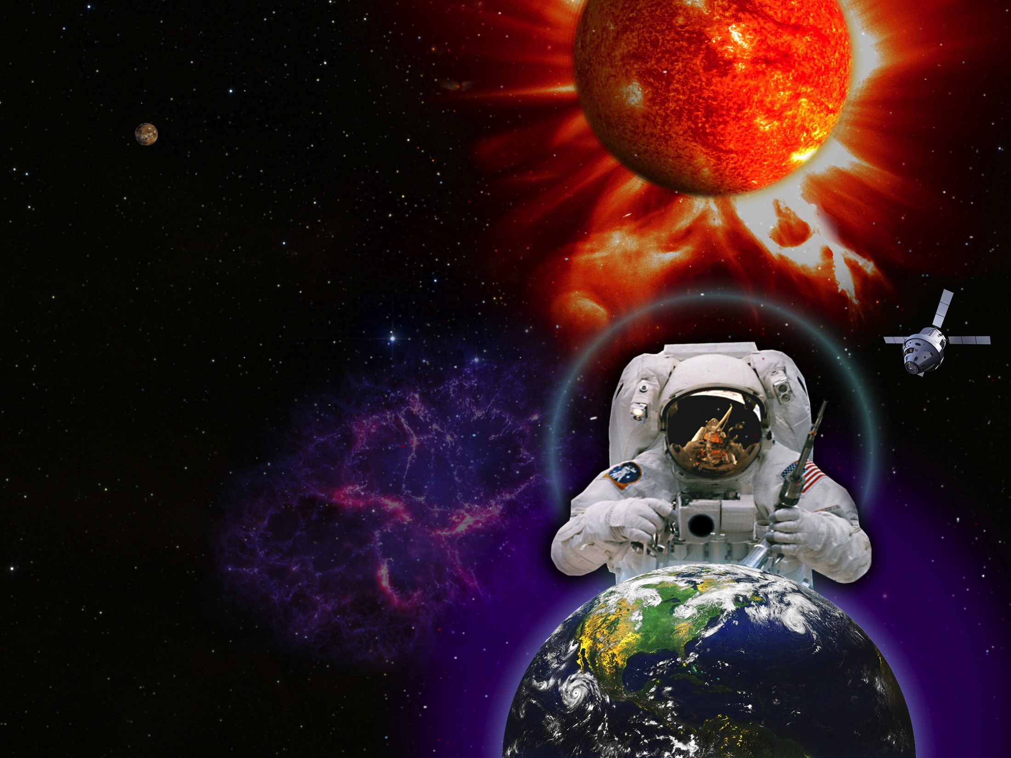
SpaceWeather Services to Build Global Resilience
UN Workshop, February 3, 2015
International efforts to characterize, understand and predict space weather events
Lika Guhathakurta
Heliophysics Division
NASA/Science Mission Directorate

Slide 2
ILWS
HISTORY
NASA's success in establishing the LWS line in 2000 was the initial impetus
Exploratory meeting in May 2001, in Tenerife
IACG blessing in January 2002 (Moscow)
Kickoff meeting in September 2002 (Washington, DC)
Official commencement, 01/2003
Ten year anniversary at UN, 02/2013
http://ilwsonline.org/
STRUCTURE
Working group
The general assembly is made up of
representatives nominated by national
agencies.
Meets annually.
Establishes and amends charter
Provides the forum for coordination
among national agencies
Steering Committee
  NASA, ESA, JAXA, RFSA, CSA, CNSA
  Chair (2 year term)
  Meets ~twice a year
  Estabishes Scientific task groups
Task groups
  Carry out discipline-specific tasks
  Advise the steering committee and
  working group

Slide 3
ILWS Mantra
Mission: Stimulate, strengthen, and coordinate space research to understand the governing processes of the connected Sun-Earth system as an integrated entity
Membership: Space organizations committed to contribute to ILWS over the next decade and beyond. Contributions to include any of the following
Space Flight Missions
Mission payloads or subsystems
Mission launch or tracking services
Additional data sources supporting flight missions (sounding rockets, balloon, or ground-based)
Data dissemination, storage, distribution, and value adding systems
Supporting theory and modeling
Objectives: To stimulate and facilitate
  Study of the Sun-Earth connected system as a system and its effect which influence life and society.
  Synergistic coordination of international research in solar-terrestrial physics, including all relevant data sources as well as theory and modeling.
  Collaboration among potential partners in solar-terrestrial space missions.
  Effective and user driven access to all data, results, and value-added products.

Slide 4
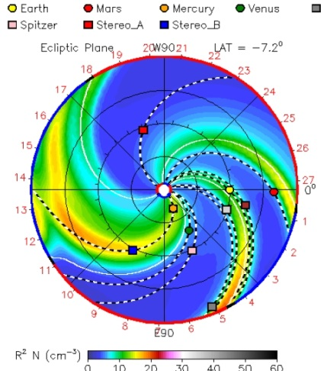
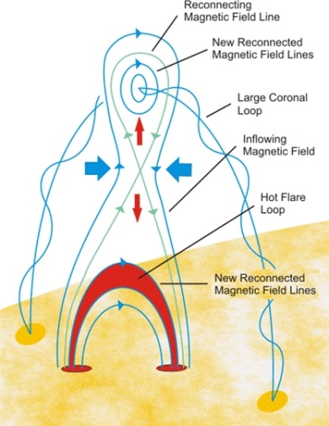
What is Heliophysics
Heliophysics is an environmental science:
a unique hybrid between meteorology and
astrophysics
It has an applied branch And a pure branch
space weather fundamental physical process
Propagation models of solar disturbances
out to 2 AU
Magnetic reconnection
In the US National Space Weather Program 1995
Living With a Star 2000, ILWS 2003
International Heliosphysical Year 2007
Applications directed science coordinated by NSF community
Applications directed science coordinated by NASA & international community
Add comparative heliospheric studies

Slide 5
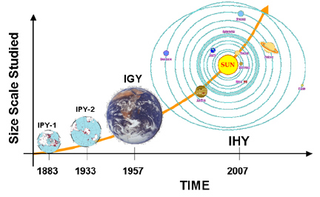
Evolution of System Studies
SKYLAB
Heliophysical: A broadening of the concept "geophysical," extending the connections from the Earth to the Sun & interplanetary space.

Slide 6
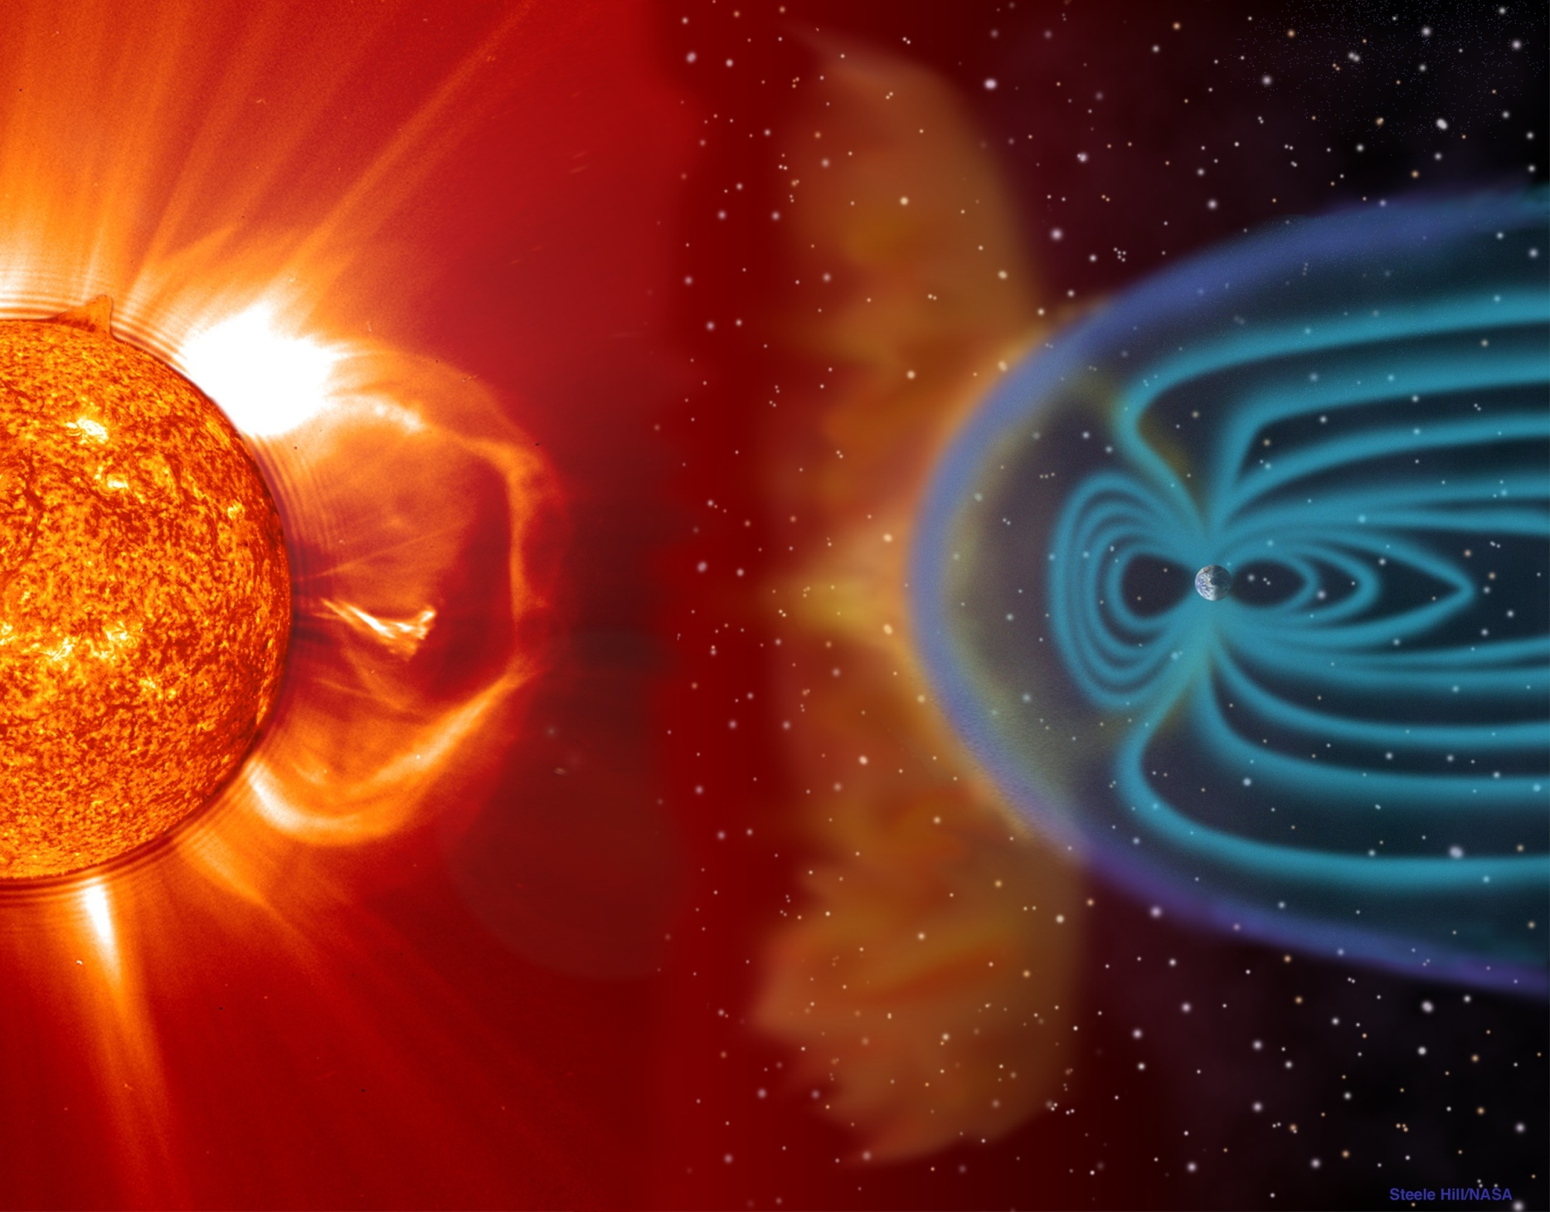
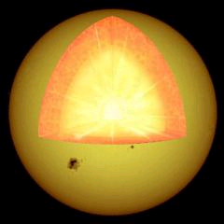
galactic cosmic rays
EARTH
SUN
convection zone
HELIOPHYSICS
radiative zone
core
particles and
magnetic fields
photons
bow shock
surface
solar wind
surface
sunspot
atmosphere
atmosphere
plage
heliosphere
ionosphere
coronal mass ejection
plasmasphere
magnetosphere
not to scale

Slide 7
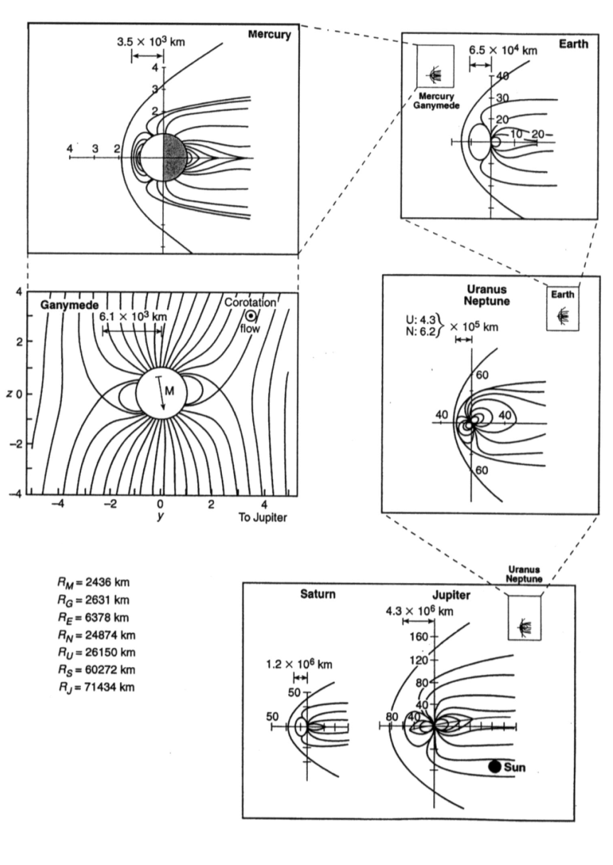
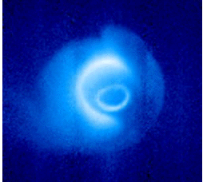
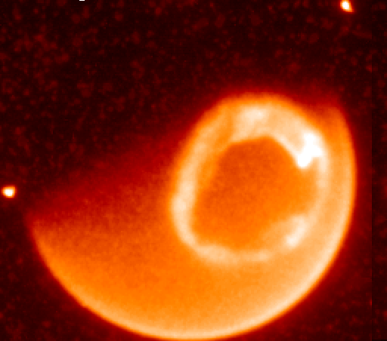
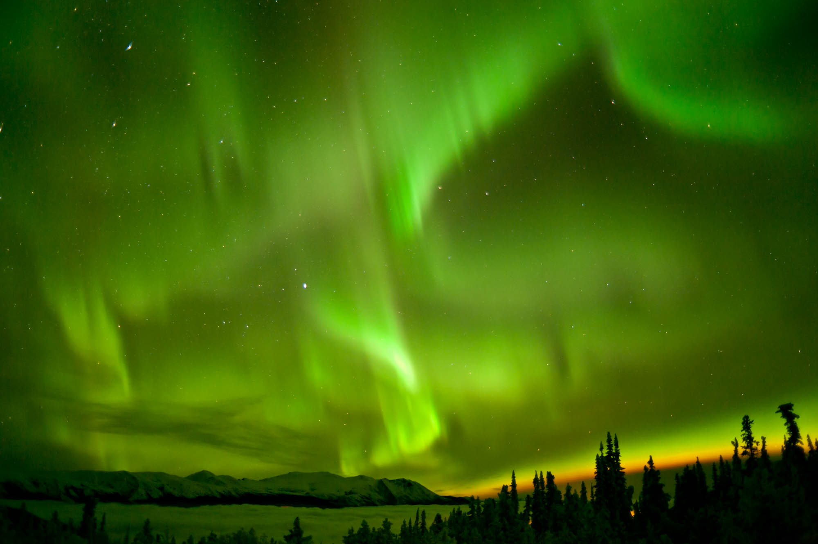
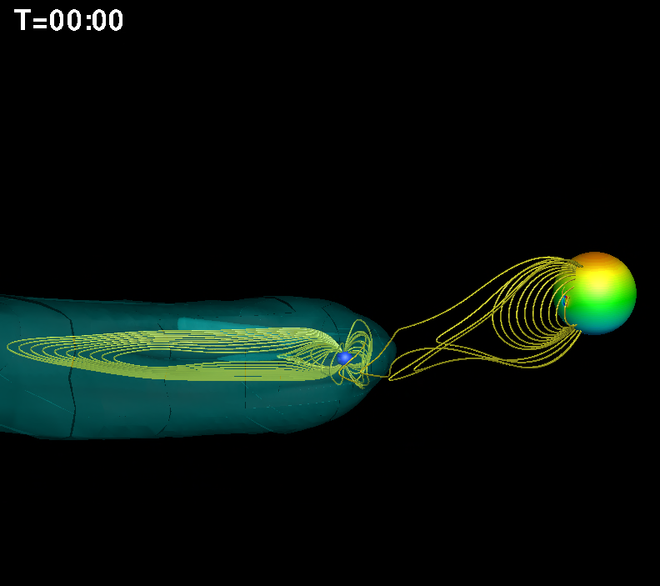
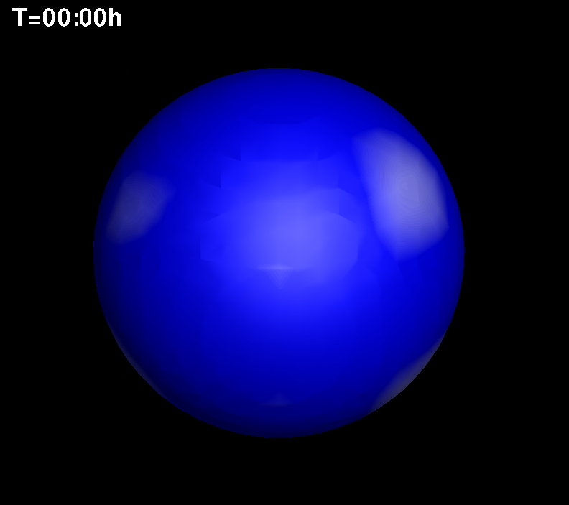
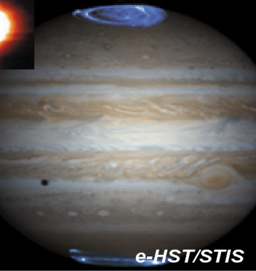

Sun-Earth System Science:
Growth from a “consuming” science to a “producing” science for the benefit of humankind
Space Weather is no longer the domain of Earth only!
Space Weather is now also Interplanetary!!
Space Weather just became Exoplanetary!!!
IMAGE/EUV
IMAGE/FUV
Extreme Space Weather on Close-in Exoplanets
Plasmasphere
Aurora
Io Torus
Cassini/UVIS

Slide 8
SkyLab Heliophysics
GAME CHANGERS
The Corona is hot and controlled by magnetic fields
➔ X-Ray and EUV Variability at Earth (NOAA R-Scale)
High-Speed Solar Wind originates from coronal holes
➔ Solar Particles Impact Earth (NOAA S-Scale)
Mass from the corona is ejected into interplanetary space
➔ Solar catastrophic events can impact Earth’s magnetosphere (NOAA G-Scale)

Slide 9
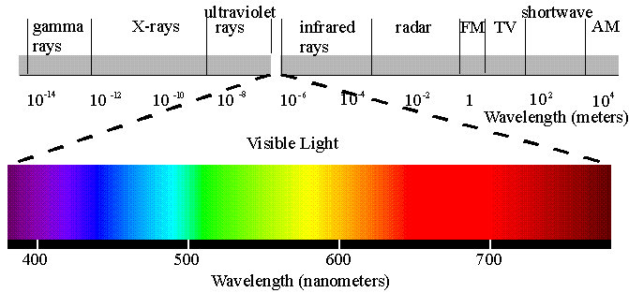
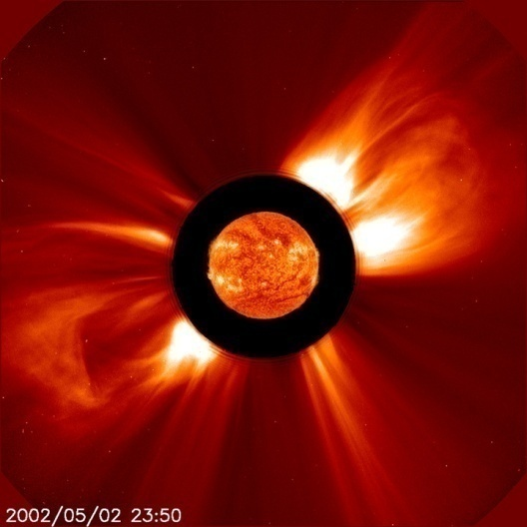
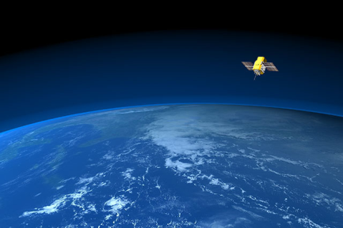
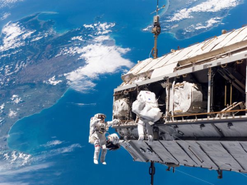

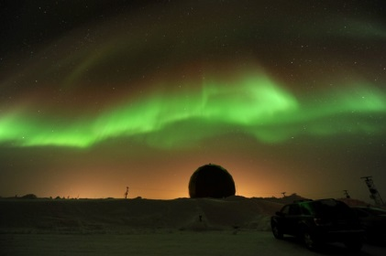
Terrestrial Space Weather
Electro-magnetic Radiation
Ultra Violet and X-ray Radiation
8 minutes
Matter
R-Scale
Satellite drag;
radio blackouts
Blame it on B
(magnetic field)
Charged Particle Radiations
S-Scale
NOAA Space Weather Scales
10-30 minutes
Matter
Magnetic Fields
Radiation:
astronaut health. aviation
& satellite function
Magnetized Blobs of Solar Material
18-96 hours
G-Scale
Aurora;
geomagnetic storms &
radio disturbances

Slide 10
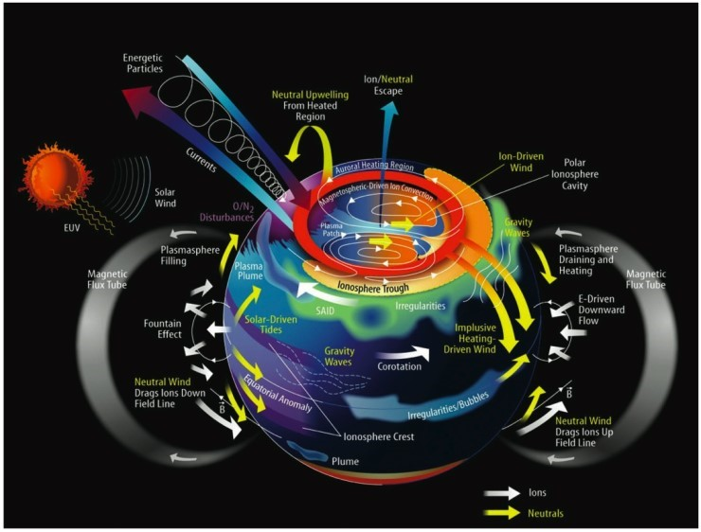
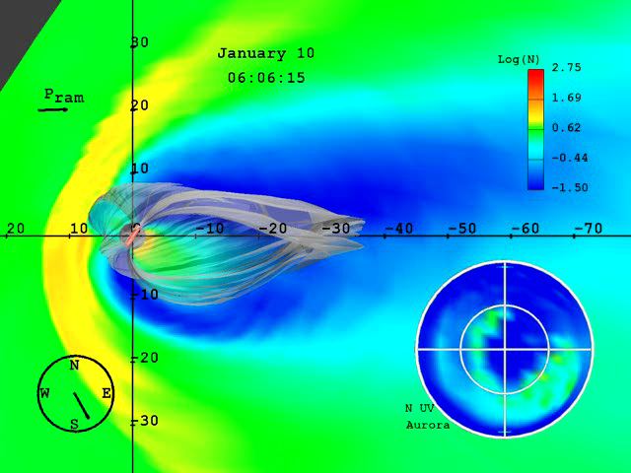
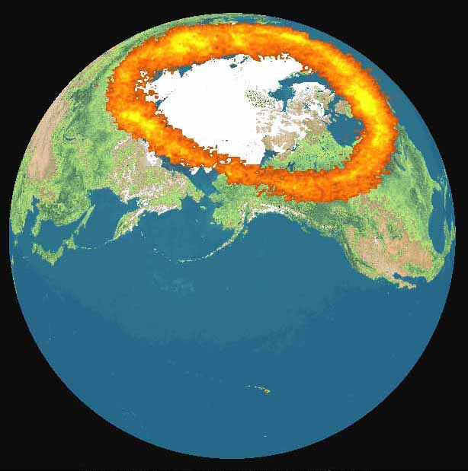
Space Weather’s Terrestrial Influence
(an example)
Space weather interacts with Earth’s B-Field and can dramatically affect the Earth

Slide 11
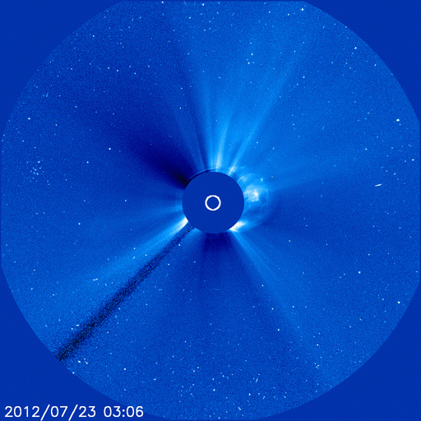
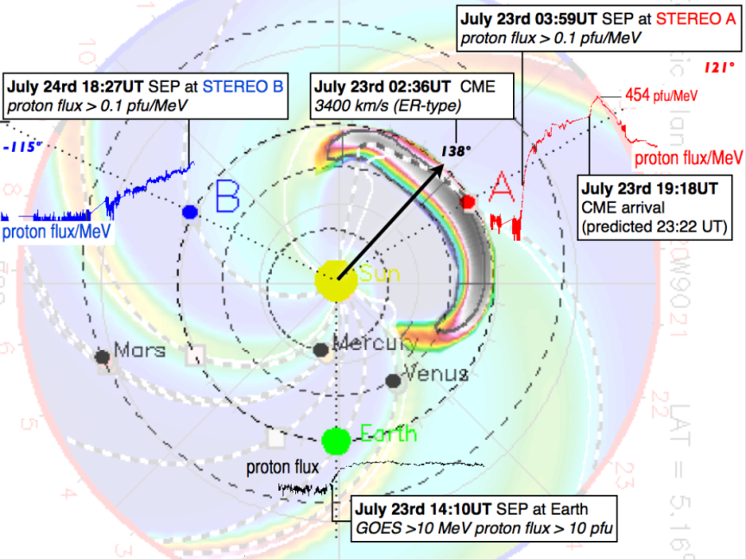
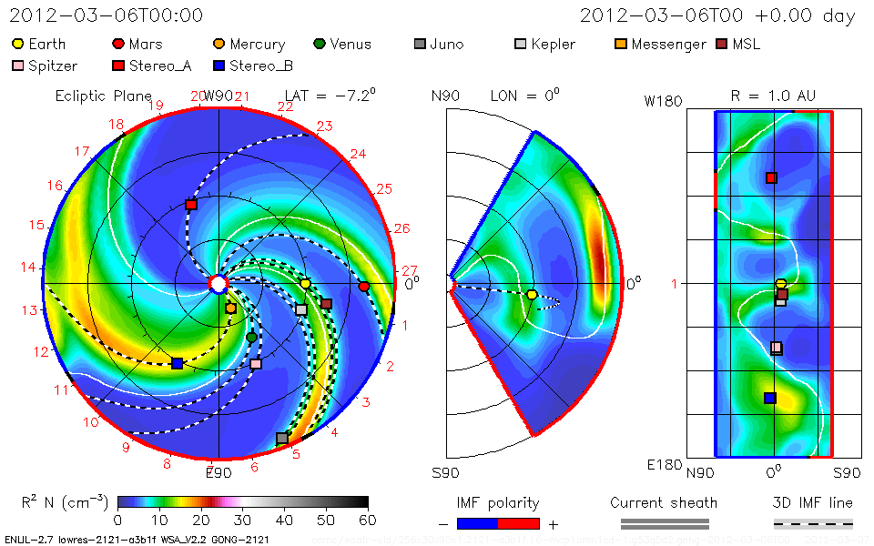
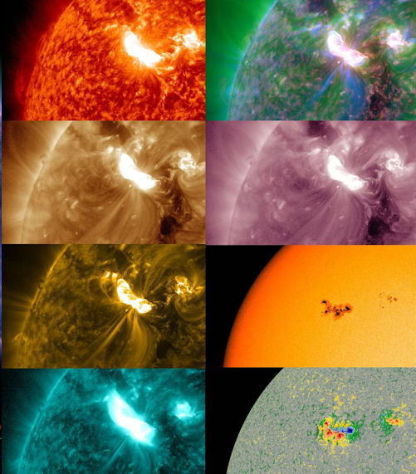
Observing & Modeling Space weather
July 23, 2012, one of the fastest CMEs of the Space Age rocketed away from the western limb of the sun travelling
3500 km/s
STEREO-A was in the line of fire, and the spacecraft was hit by a severe solar radiation storm. It was stronger than any proton event observed since 1976. Without STEREO-A, this major event would have passed unnoticed
A Solar Superstorm Narrowly Missed Earth in July 2012
Surrounding the sun has allowed us to detect major storms that otherwise we might have missed.
3D CME model run from CCMC/iSWA shows how the CME would propagate through the inner solar system.
AR1429 unleashed a powerful X5-class solar flare on 7 March 2012, commencing the "St. Patrick Day storms" of 2012. The blast also propelled a massive coronal mass ejection (CME) toward Earth. NASA's Solar Dynamics Observatory recorded the flare at multiple extreme ultraviolet wavelengths
Courtesy NOAA: http://www.swpc.noaa.gov/

Slide 12
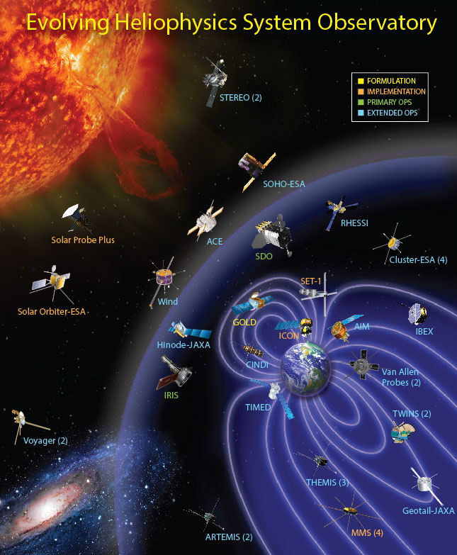
Heliophysics System Observatory
A coordinated and complementary fleet of spacecraft to understand
the Sun and its interactions with Earth and the solar system
Heliophysics has 18 operating missions (on 29 spacecraft): Voyager, Geotail, Wind, SOHO, ACE, Cluster, TIMED, RHESSI, TWINS, Hinode, STEREO, THEMIS/ARTEMIS, AIM, CINDI, IBEX, SDO, Van Allen Probes, IRIS
(Missions in red contribute to operational Space Weather.)
6 missions are in various phases of development:
SET, MMS, SOC, SPP, ICON, and GOLD
12

Slide 13
Looking Forward: New HSO Components
Addition of new HSO component where each component need not carry a comprehensive payload
  The network can grow serendipitously, with key measurements made on distributed platforms
  Single instrument MOOs
  Cubesats dedicated to one or two instruments
  Individual measurement sets add value by complementing the existing network
In addition, we need techniques to assess the value of additional components to the HSO as a whole
  Models of data assimilation effectiveness
  What is the minimum infrastructure?
  How can we assess and maintain system reliability?

Slide 14
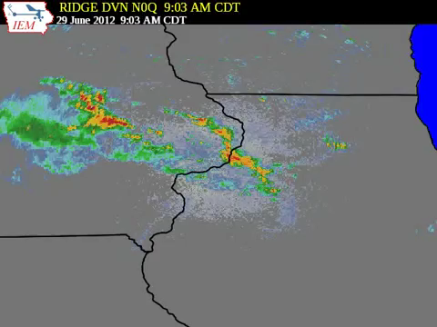
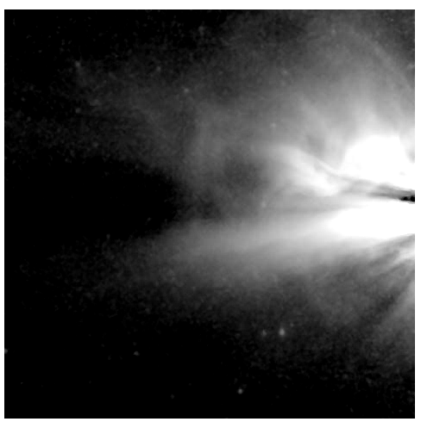
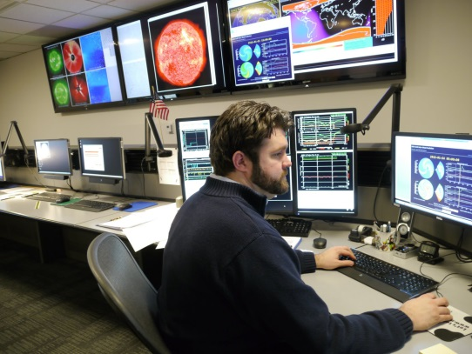
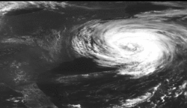
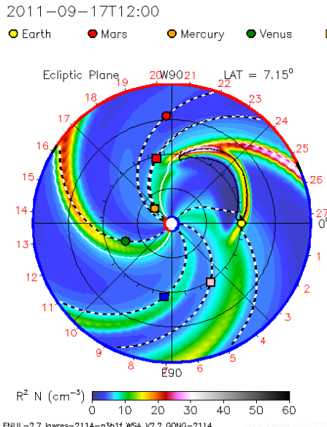
Heliophysics is an environmental science
– a hybrid between meteorology and astrophysics
Weather in the mid-west today is Washington’s weather tomorrow.
Weather on the sun today is space weather in low-Earth orbit later this week
At NOAA’s SWPC, forecaster Dave Marshall sits at the crossroads.
meteorology
astrophysics

Slide 15
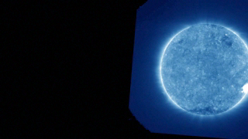
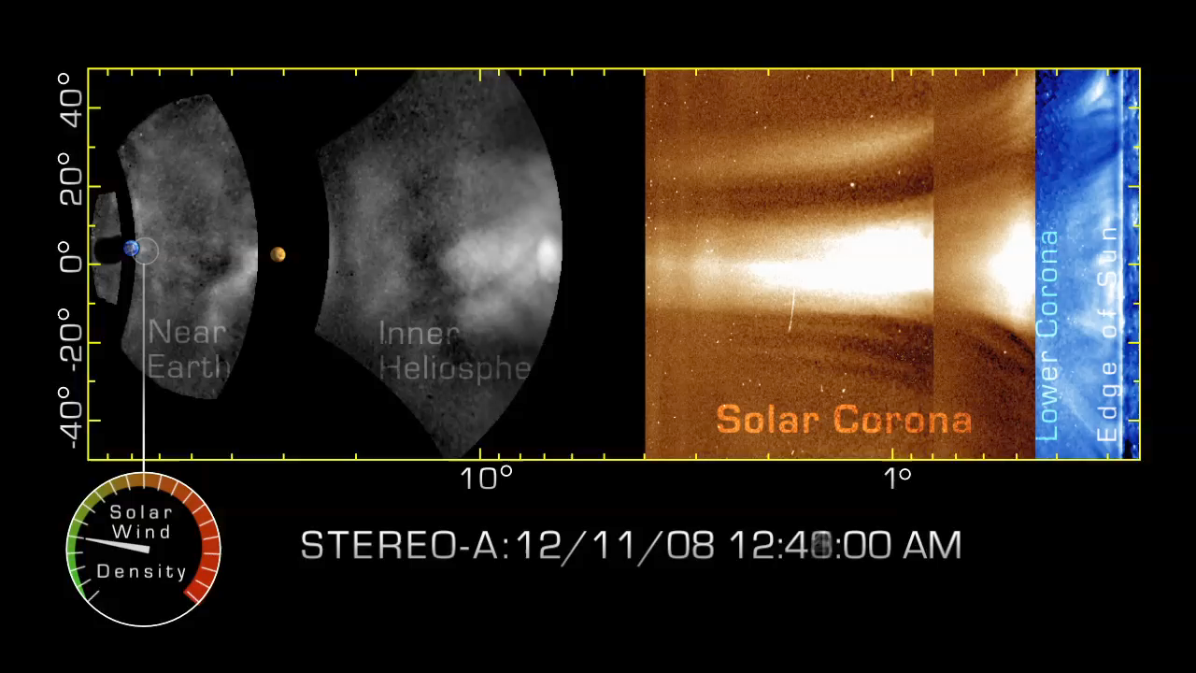
STEREO includes 5 telescopes that monitor the sky at large angles from the Sun
The next frontier in space weather forecasting involves the uninterrupted tracking of storm clouds from the sun to the planets.
NASA's STEREO spacecraft and new data processing techniques have succeeded in tracking space weather events from their origin in the Sun's ultra hot corona to impact with the Earth’s magnetosphere

Slide 16
ILWS/Others Activities
Sponsored COSPAR/ILWS Roadmap:
Advancing space weather science to protect
society’s technological infrastructure (to be published in
Adv. in Sp.Res. with a summary article in Space Weather Journal in Spring, 2015)
COSPAR/ILWS Charge to the Road Map Team:
Focus on high-priority challenges in key areas of research
leading to a better understanding of the space environment and
a demonstrable improvement in the provision of timely, reliable information
pertinent to effects on civiian space- and ground-based systems,
for all stakeholders around the world.
The Road Map prioritized those advances that can be made on short, intermediate and decadal time scales, identifying gaps and opportunities form a predominantly, but not exclusively, geocentric perspective.
Looking forward to M4 announcement
Organization of a week long COSPAR/ILWS/SCOSTEP-VarSITI Workshop
ILWS workshop will merge with COSPAR/SWx and VarSITI to hold a workshop in Goa, India in 25-29th January, 2016
Announcement to come soon.
March 2-6 2015: United Nations/Japan Workshop on Space Weather Workshop “Science and Data Ptoducts from ISWI Instruments”

Slide 17
National Space Weather Program/Office of Science and Technology Policy
NSWP
NSWP Is being reorganized. Stay tuned.
OSTP
Ensuring that US is prepared to respond to and recover from severe space weather storms is a priority to President Obama and to this Administration.
We cannot ignore the potential impact space weather may have on key infrastructures and technologies
including the electric power grid, GPS applications, aviation and satellite operations.
• These technologies form the very backbone of the critical technology infrastructure we rely on for so much of
what we do today.
• In November 2014, in his role as Chair of the National Science and Technology Council (NSTC), and on
behalf of the President of the United States, Dr. John Holdren chartered the interagency
Space Weather Operations, Research, and Mitigation (SWORM) Task Force.
• The Task Force will develop a National Space Weather Strategy (NSWS) that will articulate high-level strategic
goals for enhancing our Nation’s preparedness for a severe space weather event.
• In addition, a Space Weather Action Plan will be developed that will establish a process to implement the
National Strategy.
• Strengthening America’s resilience to space weather is a challenge that will require insight, expertise, and
dedication from many; consequently, this will be a coordinated approach across numerous
Federal Departments and Agencies.
• Both the Strategy and the Action Plan are expected to be complete in 2015.

Slide 18
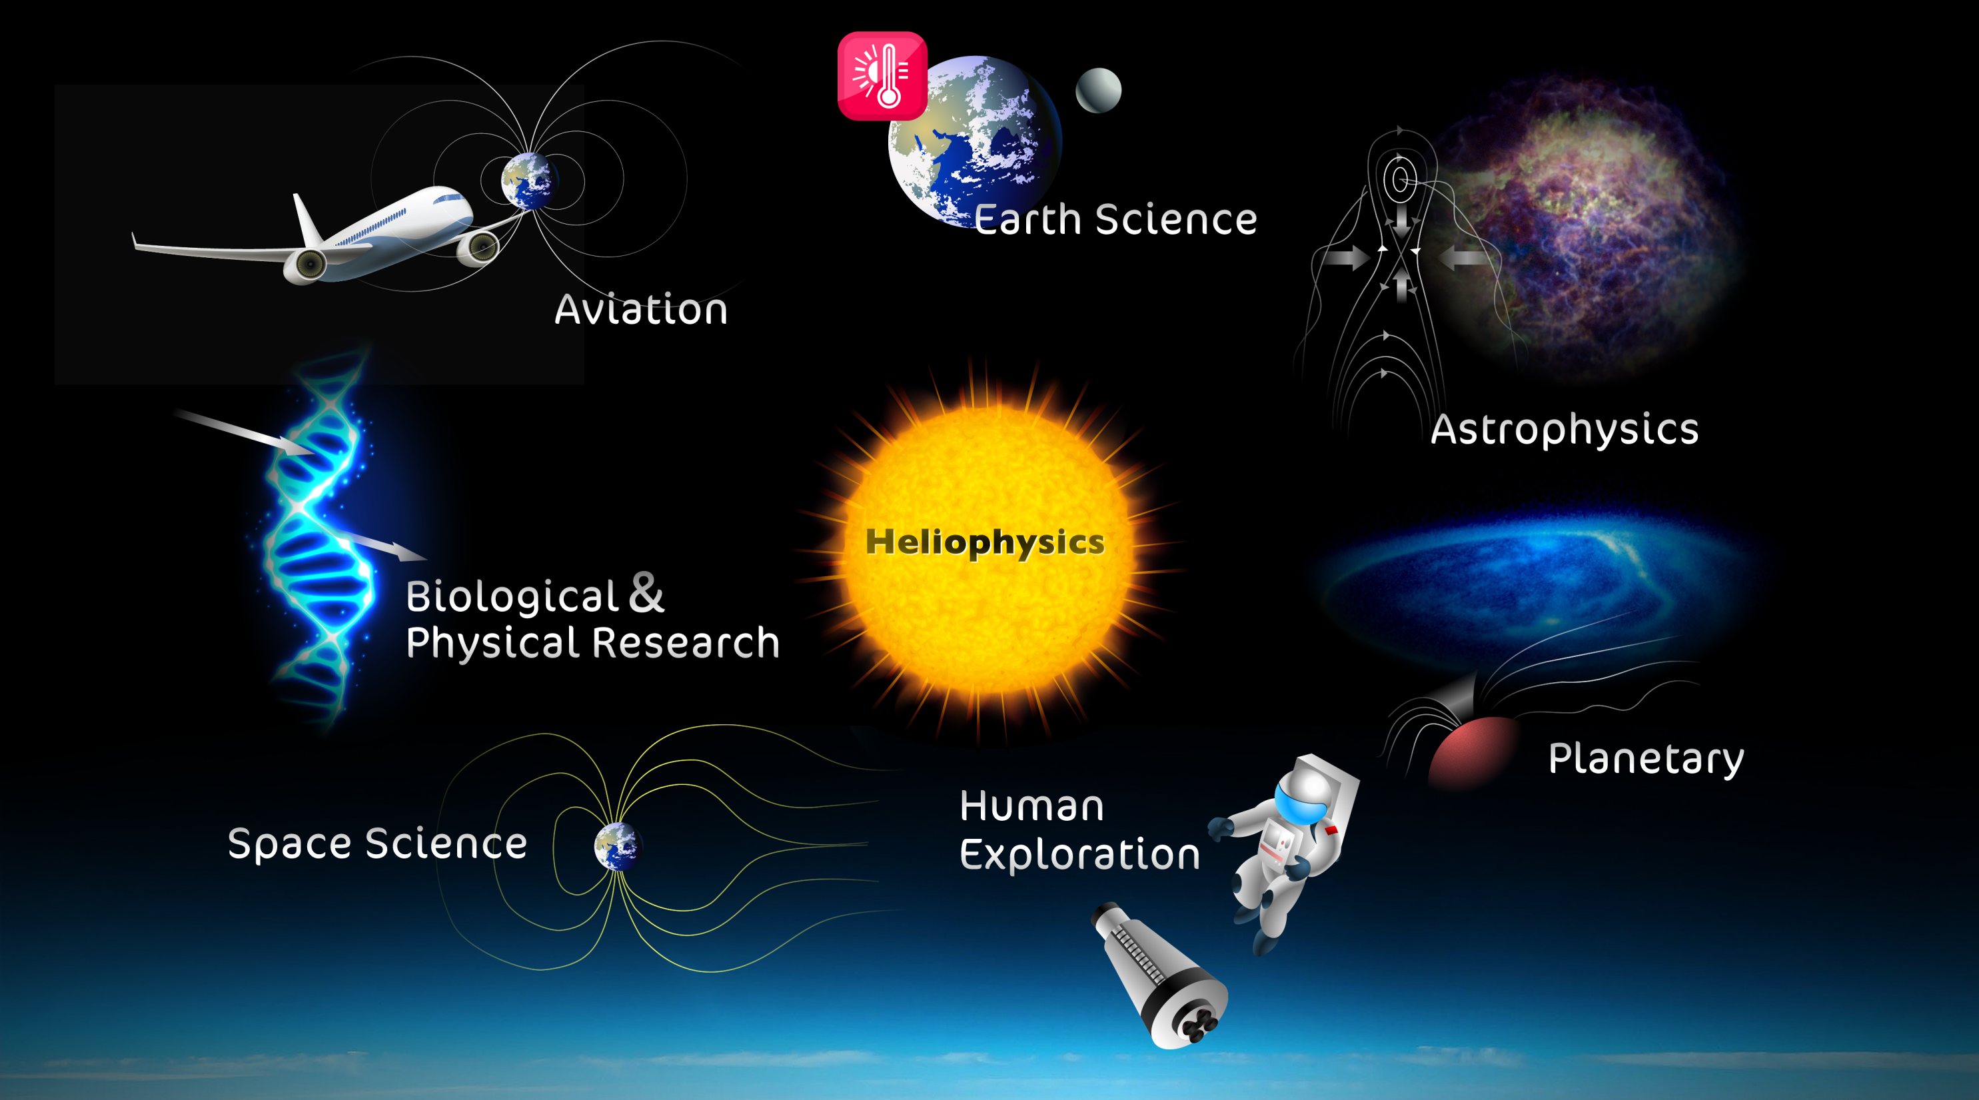
Characterizes Earth’s radiation environment to design reliable electronic subsystems for use in air and space transportation systems
Solar variabiity
On global/regional climate
Solar-stellar connectio,
Habitability of exoplanets
Understanding /modelingradiation from SEPs & GCRs
ILWS
Planetary atmospheres
and their interactions with solar variabilty,(climate & weather)
Quantifies the physics, dynamics, and behavior of the Sun-Earth system over the 11-year solar cycle
Predict solar energetic particle events that affect the safety of humans and technology in space

