Slide 1
Space Weather -
UK Activity
Mark Gibbs, Head of Space Weather
Met Office

Slide 2
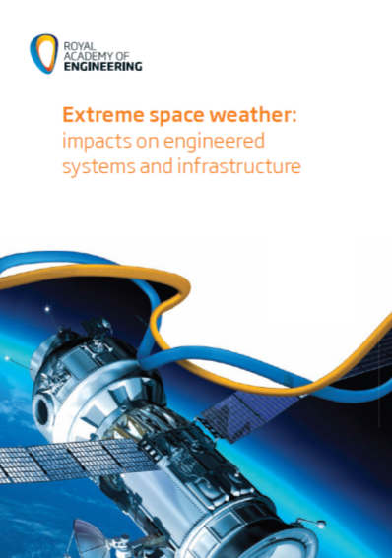
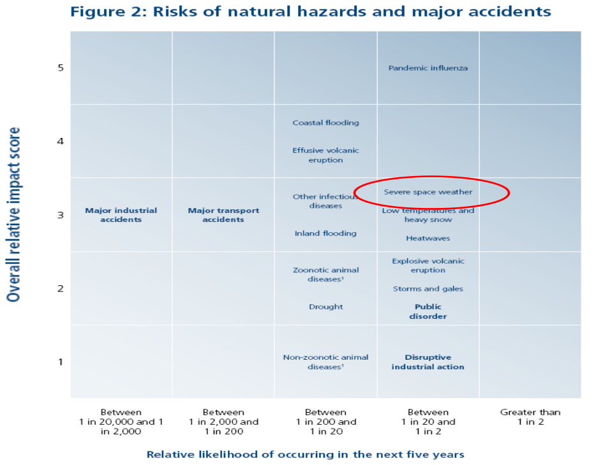
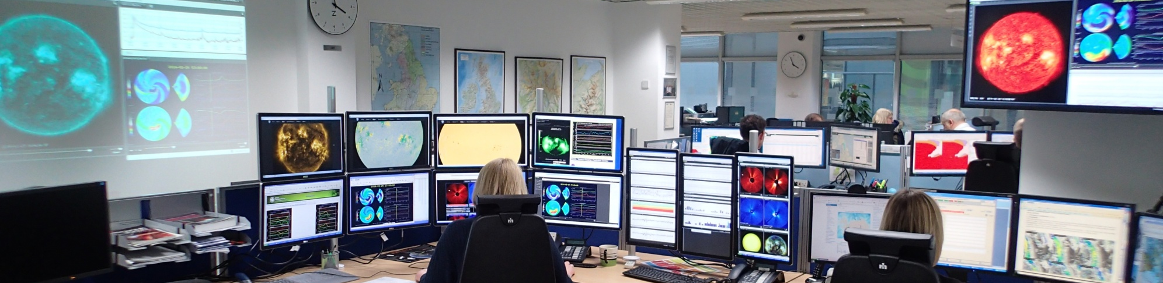
Background
Notes:
Risk of significant event is greatest for 3 to 4 years around the solar max, but predominantly on the downslope from the max. BUT extreme events don’t necessarily occur around solar maximums
2

Slide 3
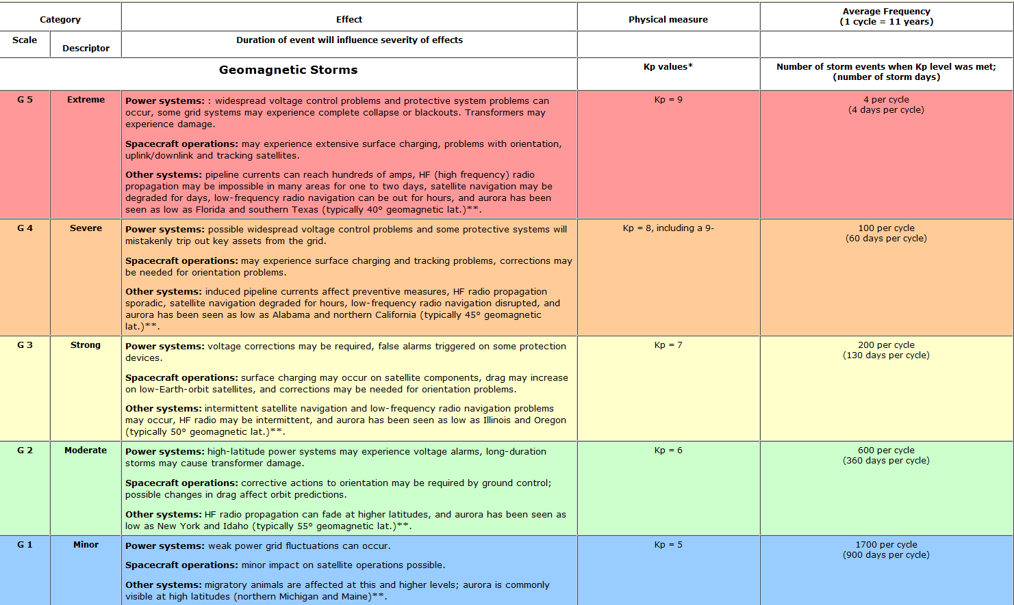
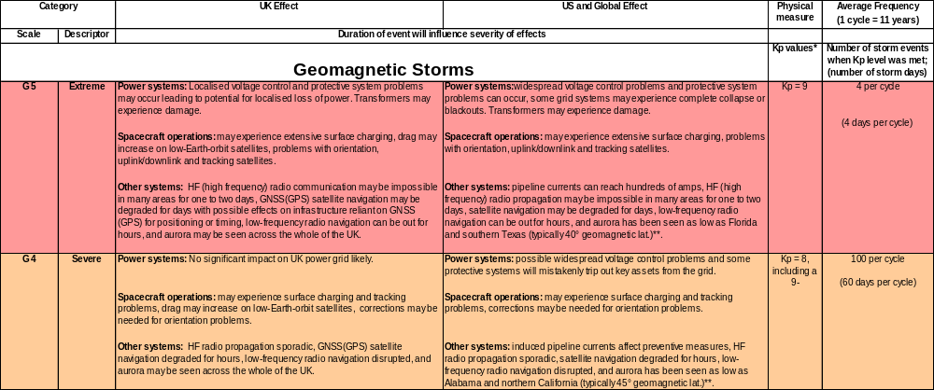
Impact scales

Slide 4
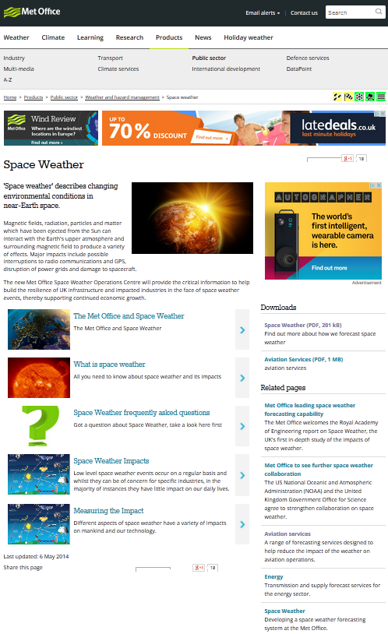
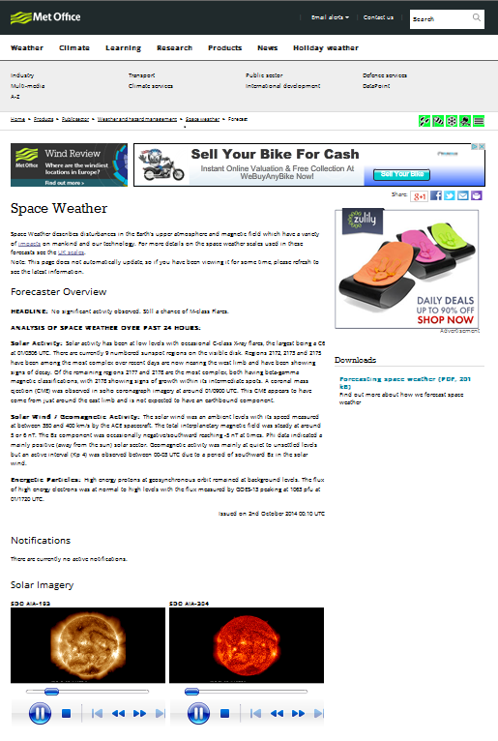
Public pages

Slide 5
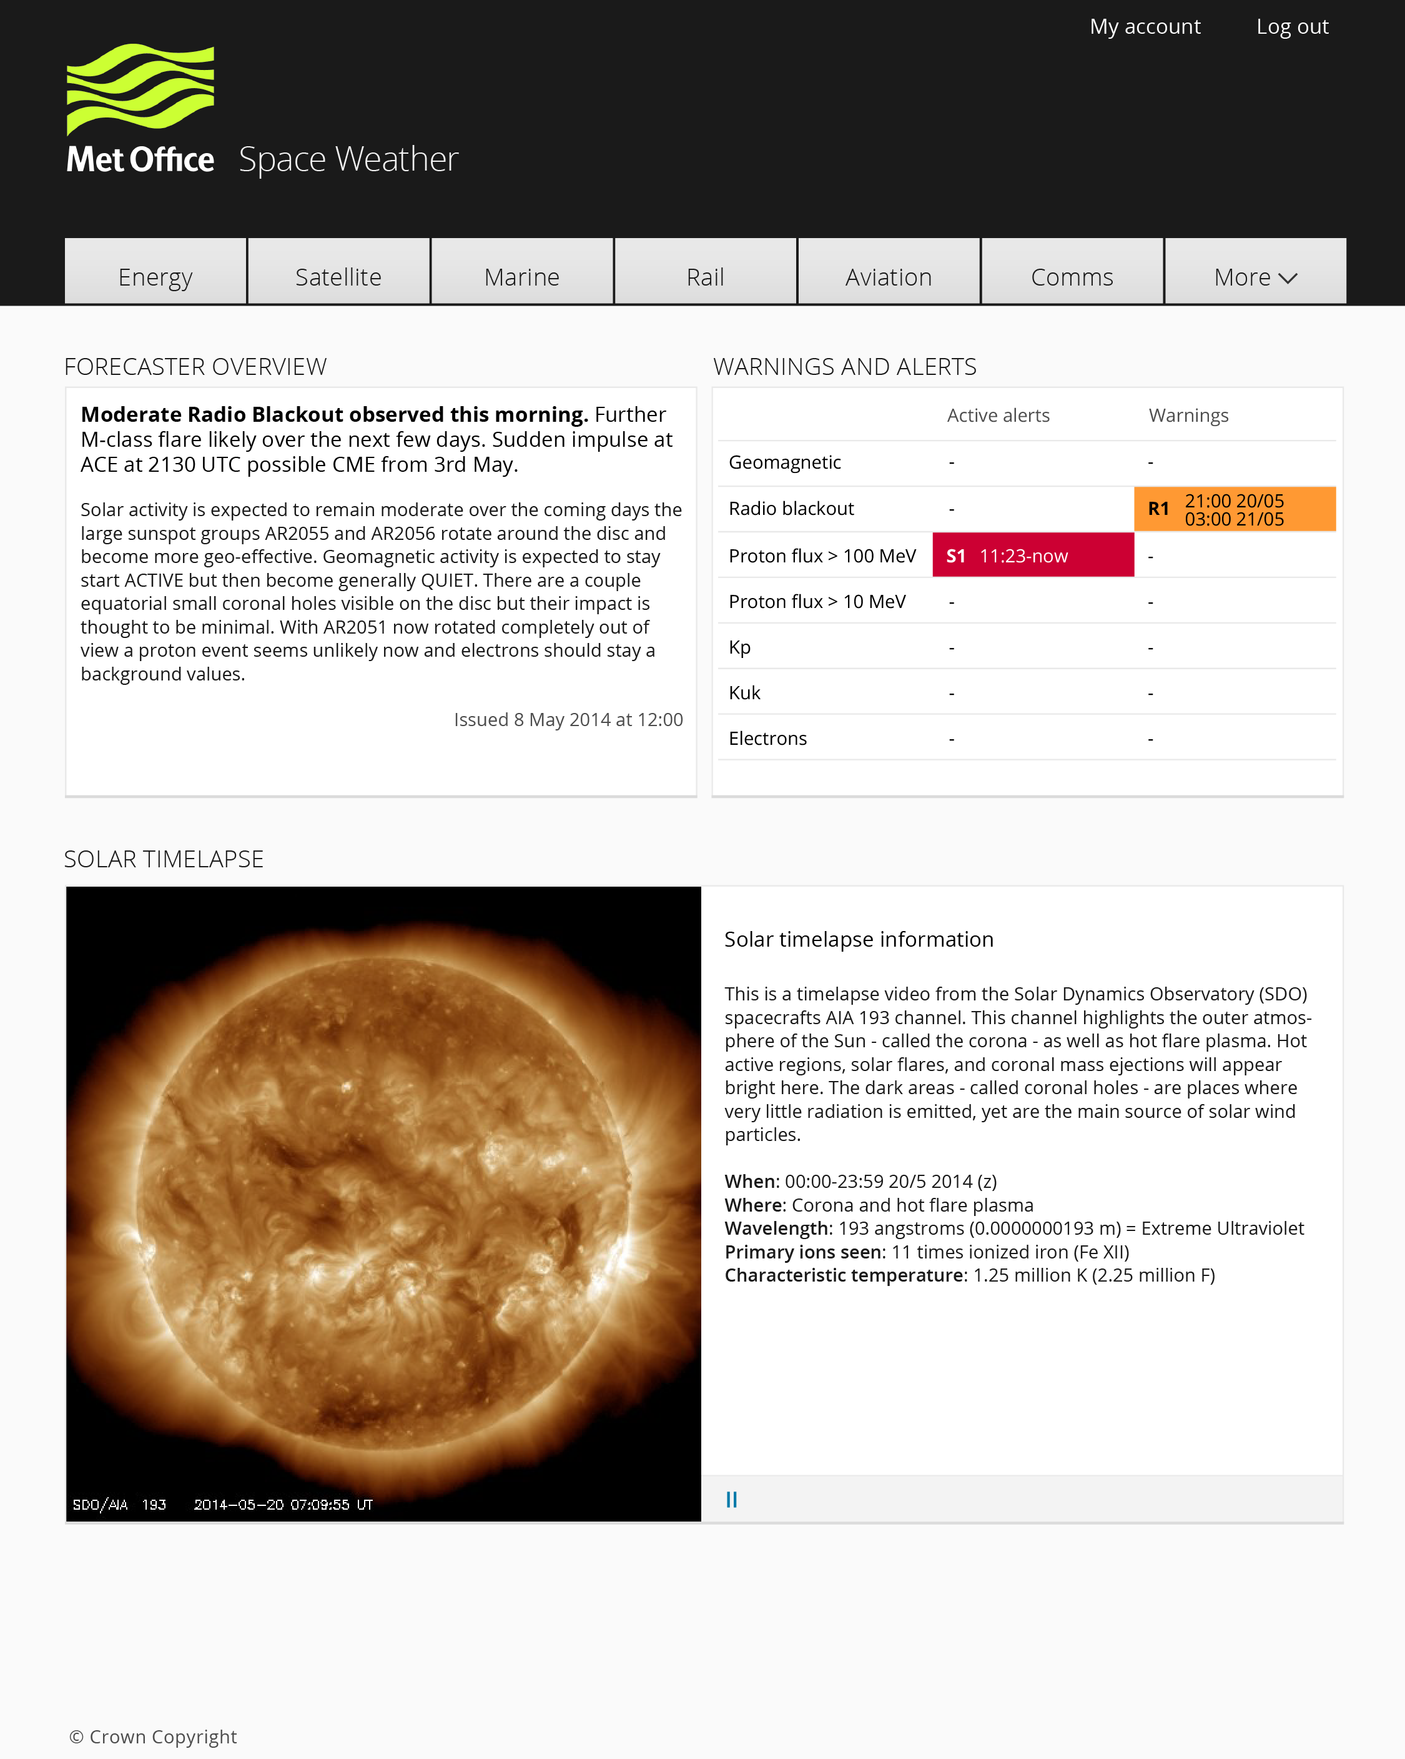
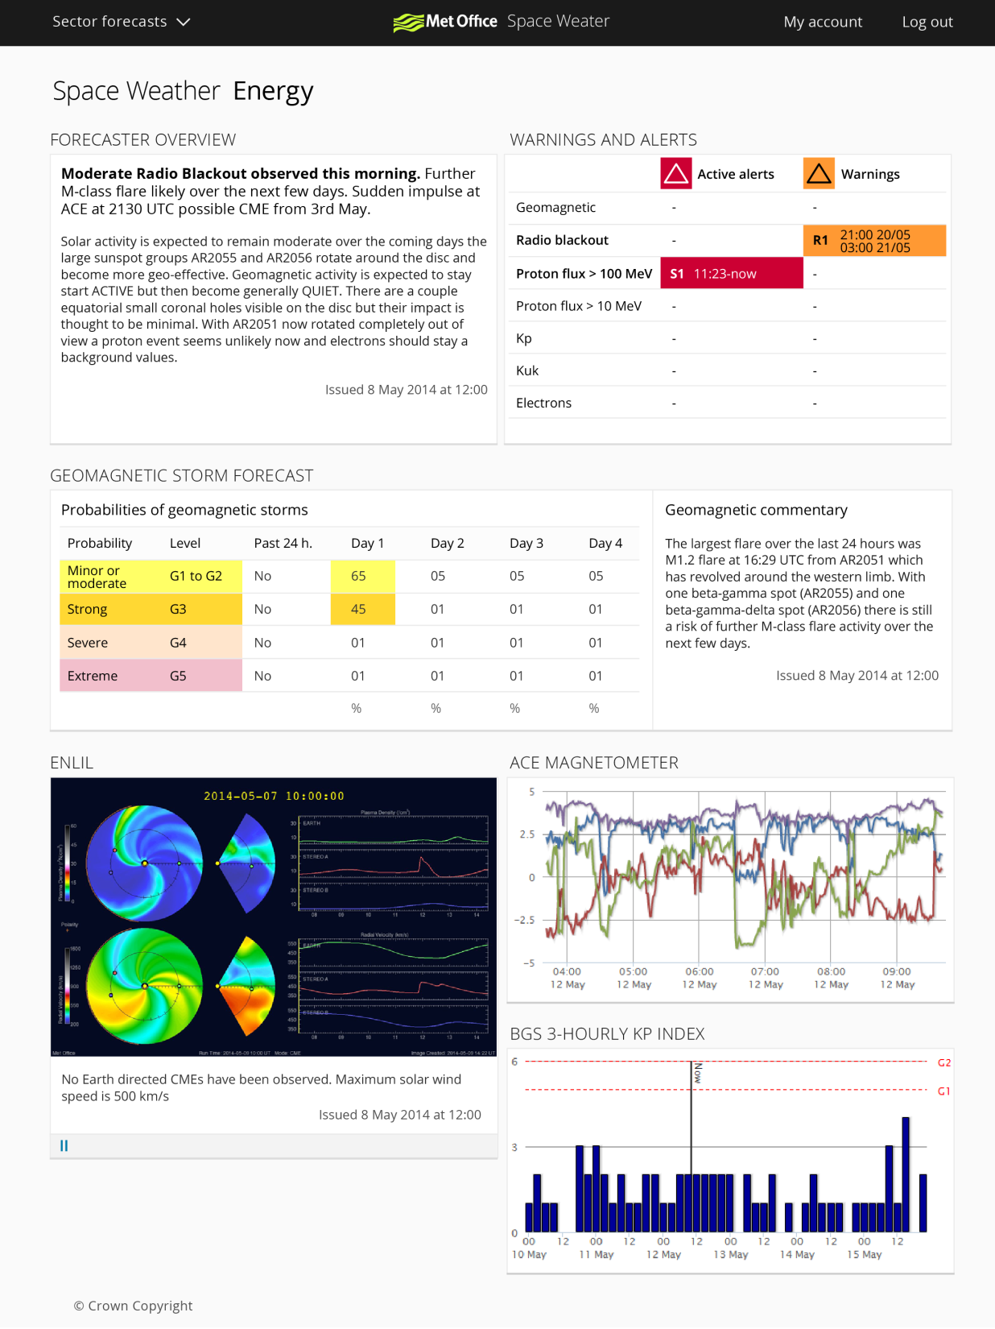

Slide 6
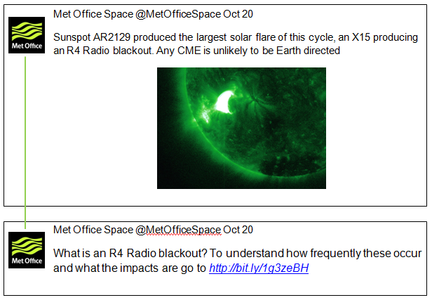

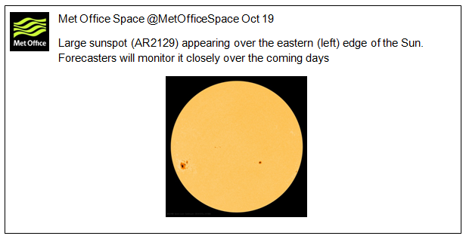
Public communication
Public want information
  become informed
Don’t want to be told only when the ‘big one’ is coming
Information from trusted source
Cross-government communications workshop
  Within government
  Public communications
Joint UK / US workshop on public communication

Slide 7
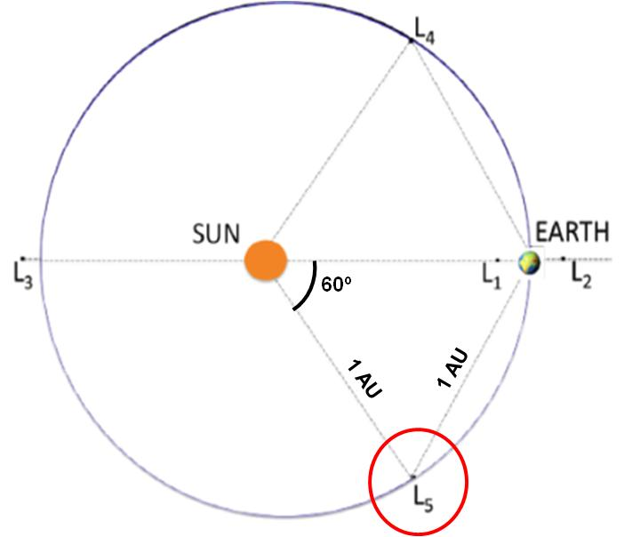
Future work
Socio-economic study
  Cost of space weather
  Benefits of forecasts
  Benefits of monitoring assets
Developing off-Sun-Earth satellite proposal

Slide 8
Mark.gibbs@metoffice.gov.uk
Phone: 07867 501404

Slide 9
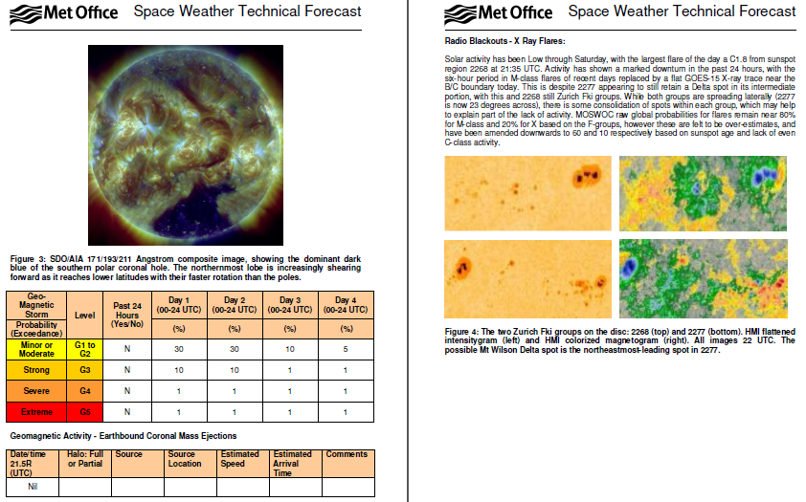
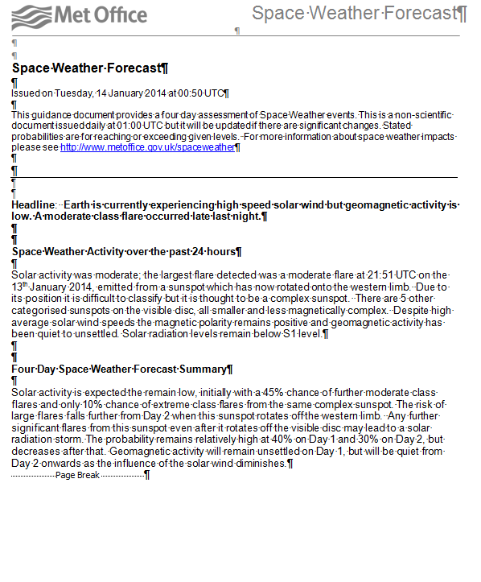
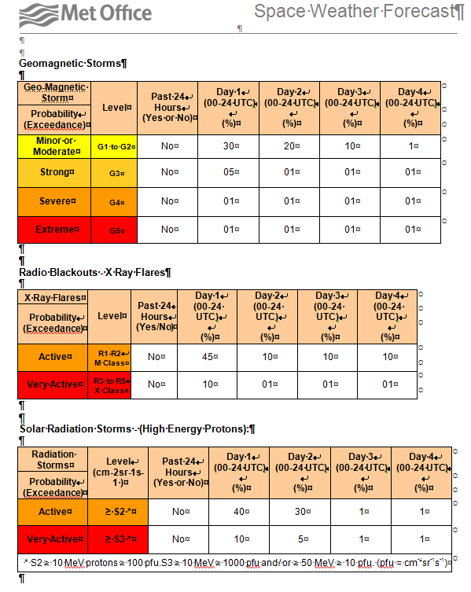
Services

