Slide 1
Space Weather Service in Indonesia
Clara Y. Yatini
National Institute of Aeronautics and Space (LAPAN)
clara@lapan.go.id

Slide 2
Space Weather
The Sun
Interplanetary space
Magnetosphere
Ionosphere

Slide 3

PROGRAMME INTEGRATION
Solar system Dynamics
RESEARCH ON SATELLITE ORBITAL PERTURBATION
Satellite orbital prediction
Information on space debris
Solar activity index prediction
Prediction of the impact of solar activity
SOLAR ACTIVITY RESEARCH
RESEARCH ON REGIONAL MAGNETIC FIELD
RESEARCH ON REGIONAL IONOSPHERE
RESEARCH ON EQUATORIAL UPPER ATMOSFER
Prediction of the communication frequency
Ionospheric correction for position determination
Information on communication disturbance
Information on global atmospheric circulation
Information and prediction of global
atmospheric variability
Information on terrestrial magnetic variability
Information on geomagnetic disturbance

Slide 4
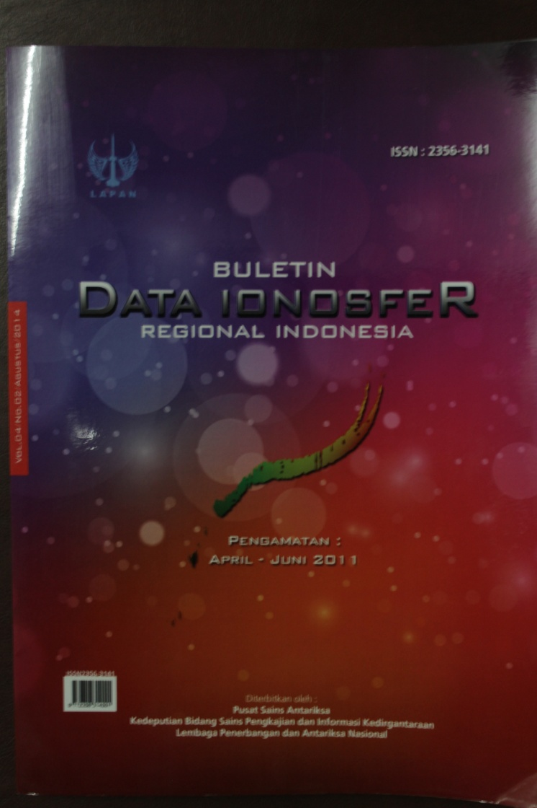
Data
The Sun (Sunspot, solar radio burst)
Geomagnet (magnetic variation)
Ionosfer (ionogram, TEC)

Slide 5
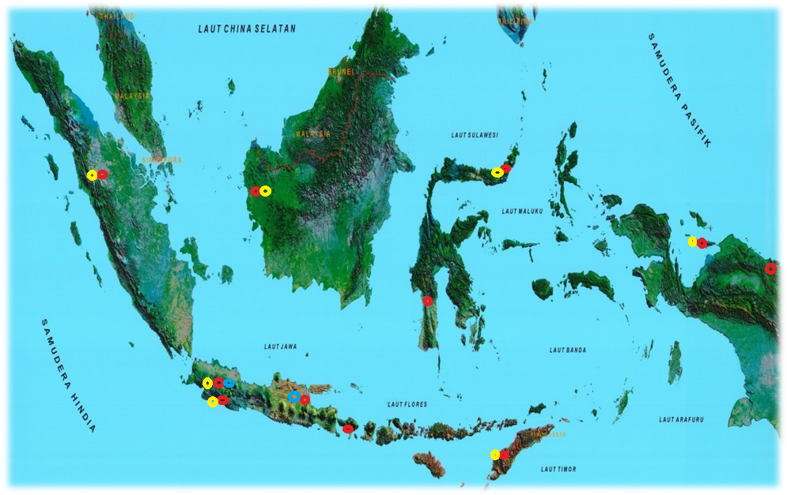
OBSERVATION SITES
Geomagnetic observation
Ionosphere observation
Solar observation

Slide 6
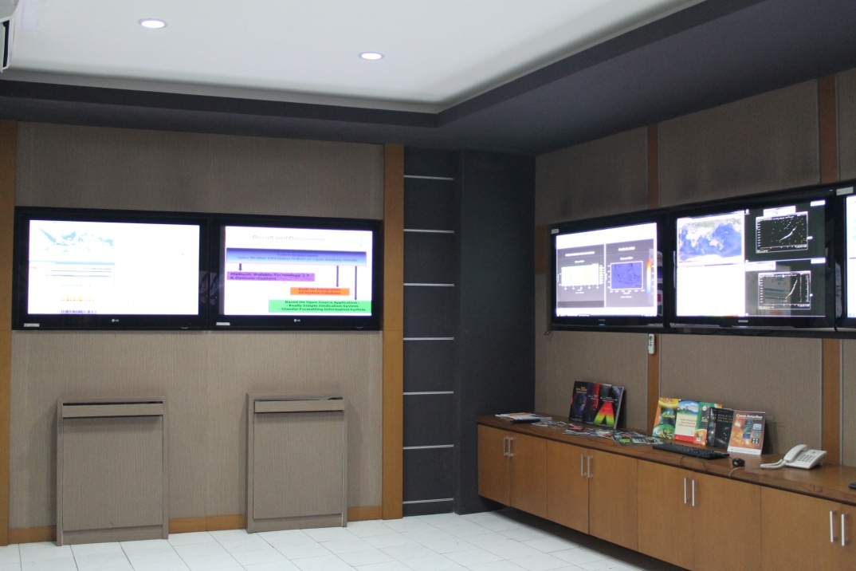
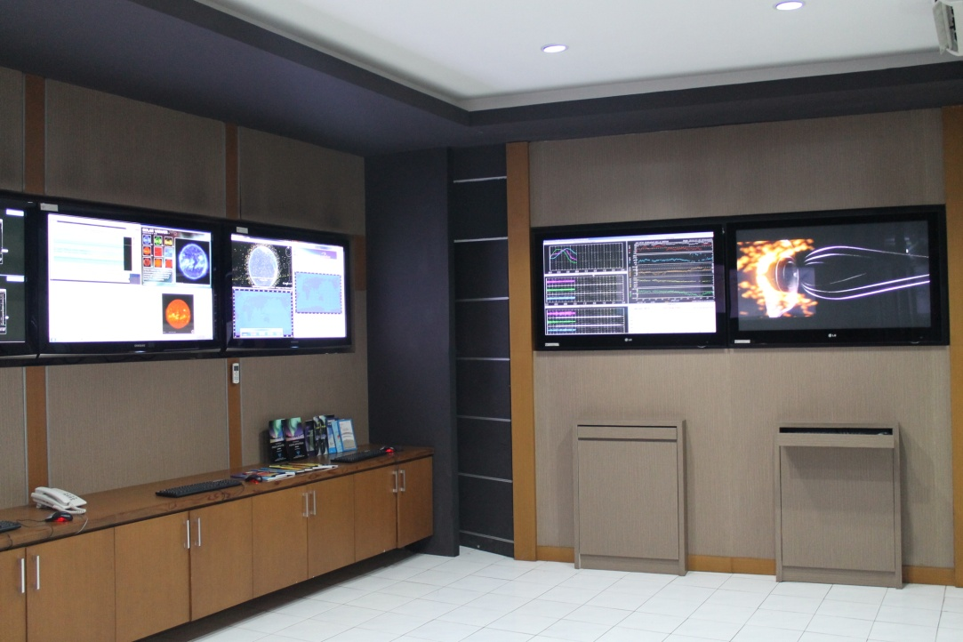
Space Weather Monitoring and Information System (SPICA)

Slide 7
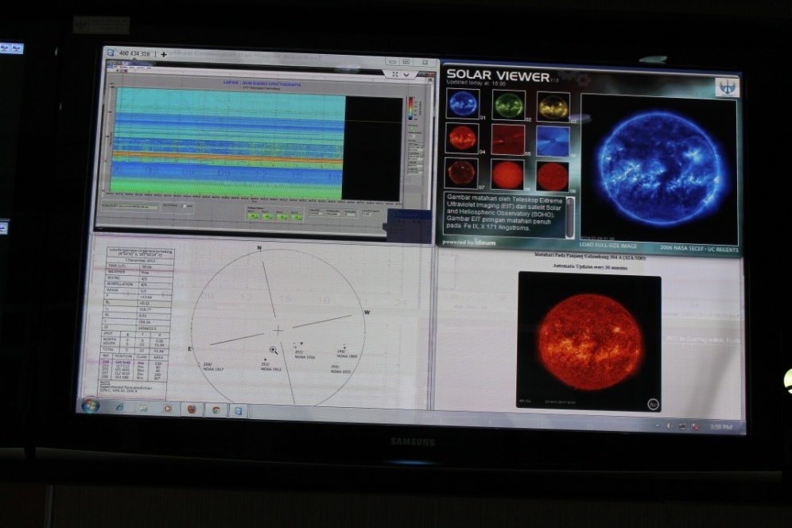
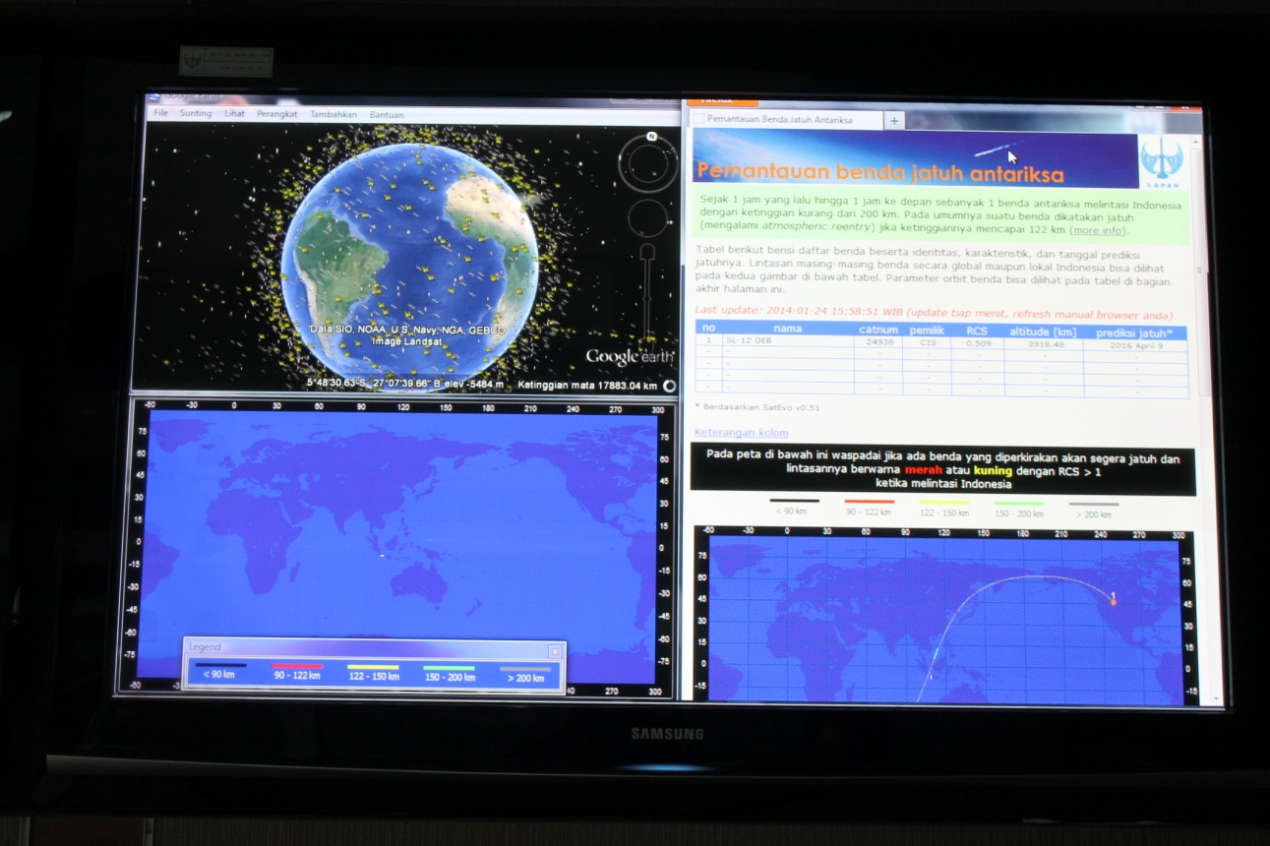
Solar radio burst and sunspot
Monitoring the orbit of satellite crossing over Indonesia region
(updated 1 – 5 min)

Slide 8
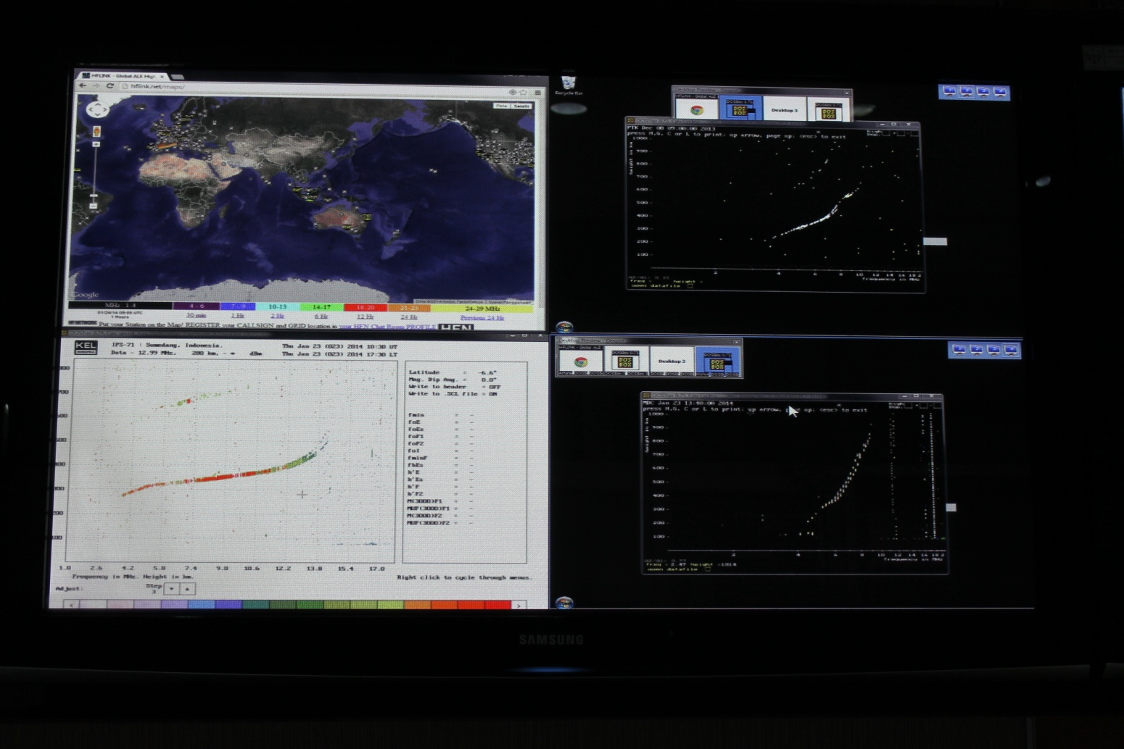
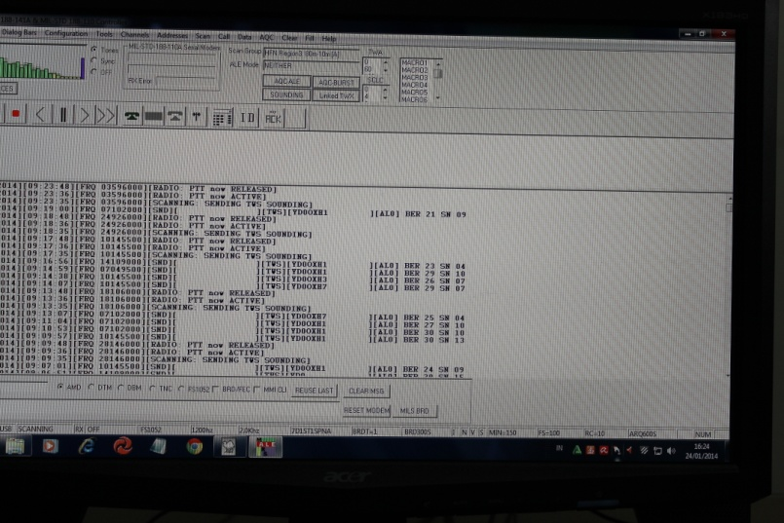
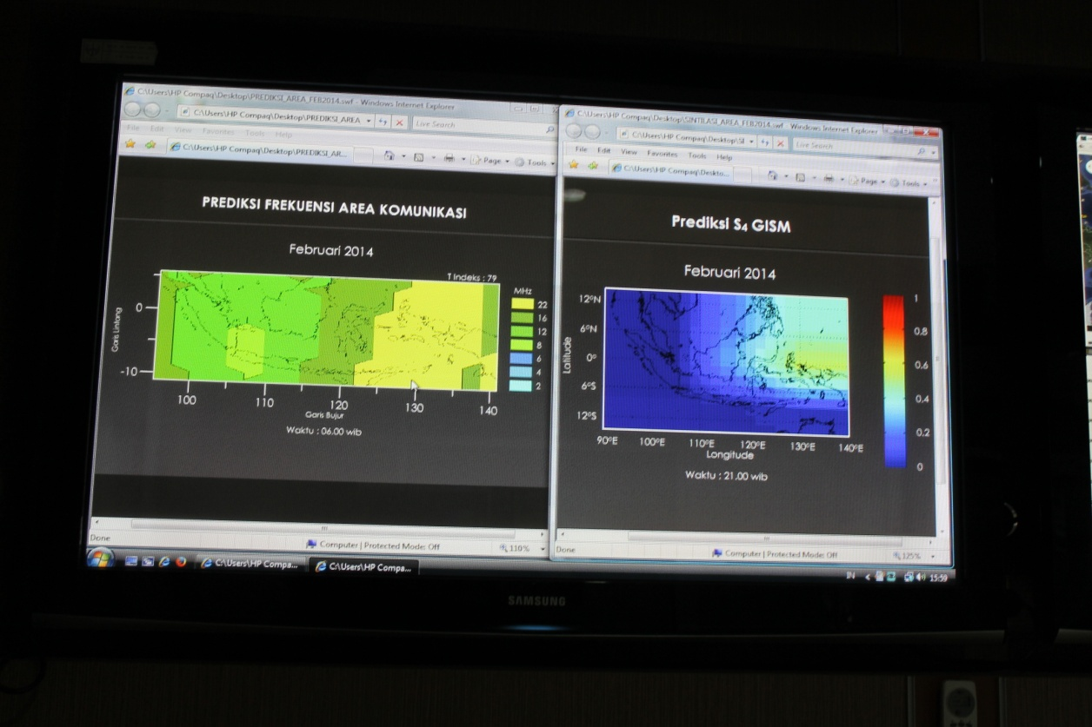
-Radio frequency monitoring (real time)
-Near real time Ionogram
Prediction of radio communication frequency
Prediction of scintillation

Slide 9
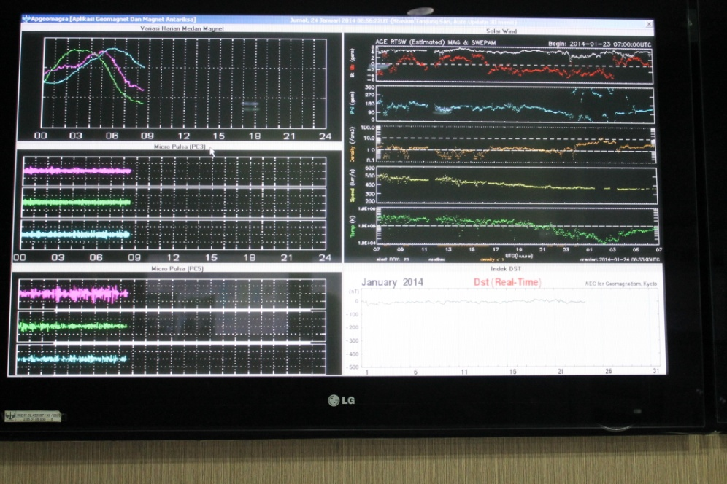
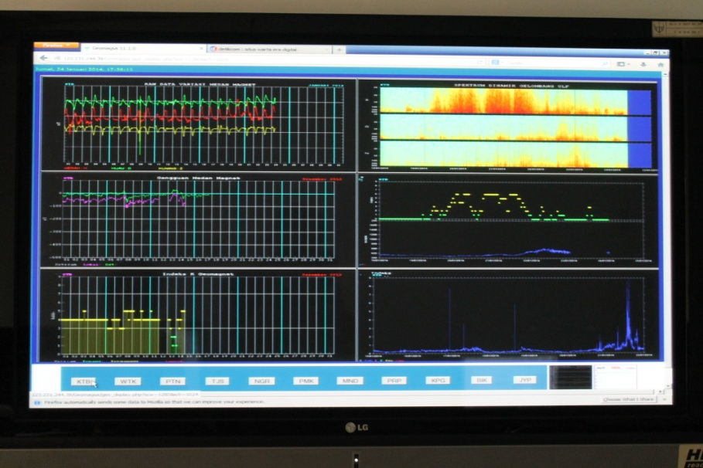
-Geomagnetic variation monitoring (near real time, delay 5 dan 10 min)

Slide 10
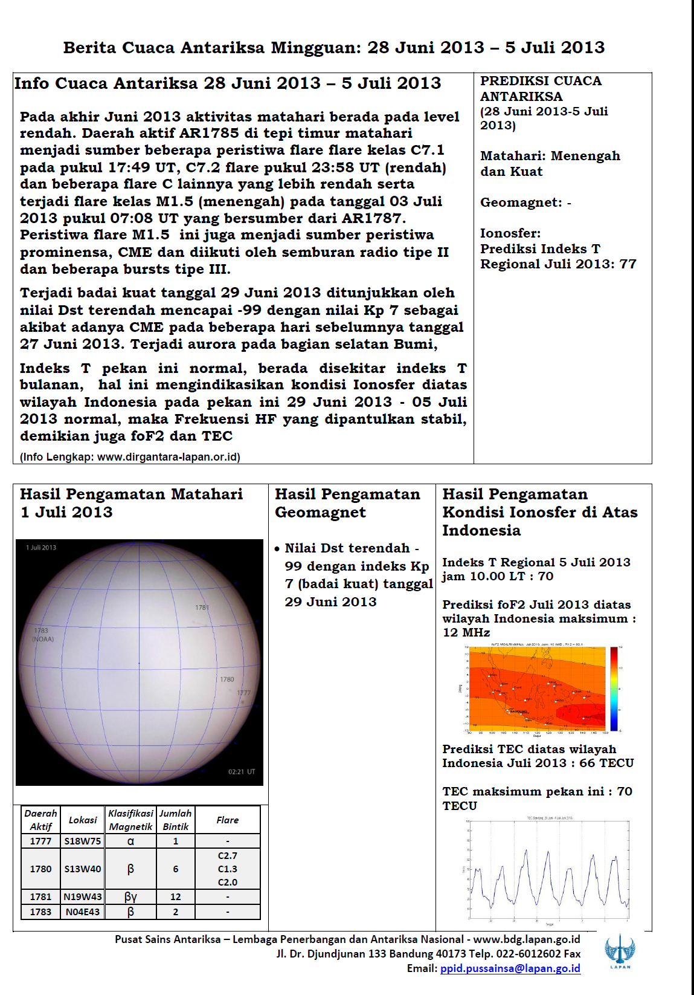
Weekly information:
Sunspot
Flare prediction
Geomagnetic condition
T index
Prediction of foF2, TEC, T index

Slide 11
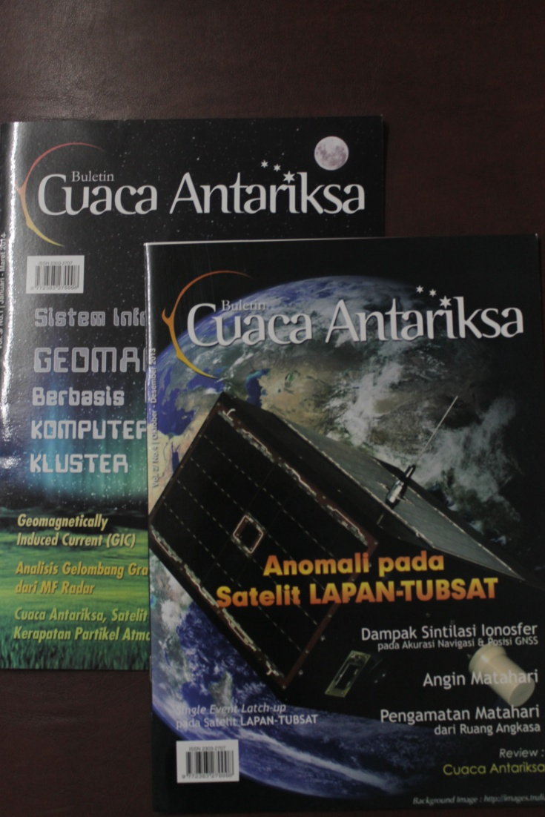
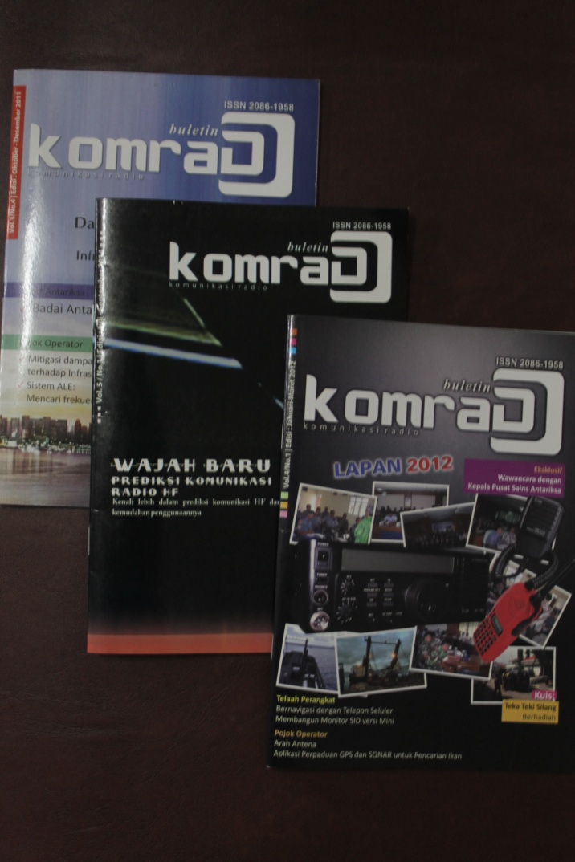
Space Weather popular bulletin

Slide 12
Customers
Government institution which use radio communication (army, remote area)
Provider (communication satellite)

Slide 13


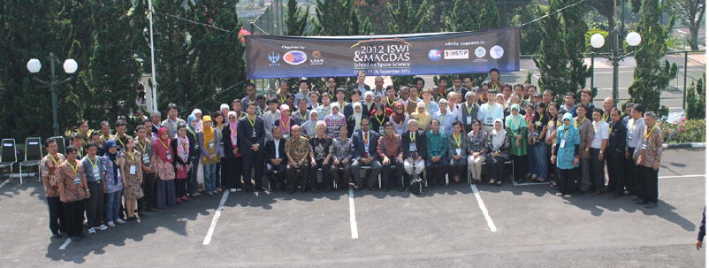
ISWI & MAGDAS School
on Space Weather
September 17‐26, 2012
Notes:
Capacity

Slide 14


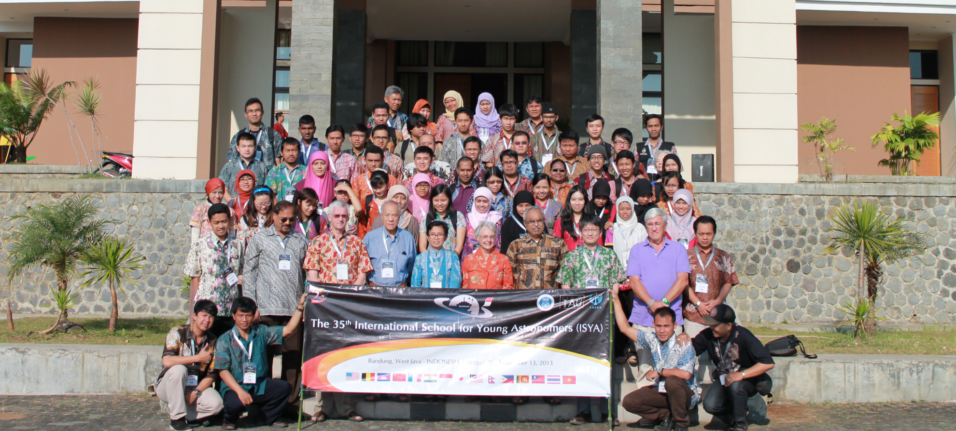
International School for Young Astronomers (ISYA) 26 August – 13 September 2013

Slide 15
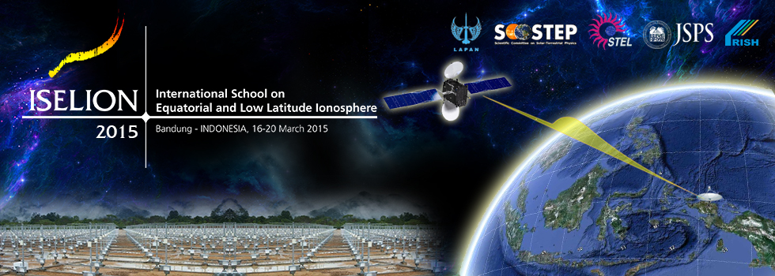
International School on Equatorial and Low Latitude Ionosphere, 16 – 20 March 2015

Slide 16
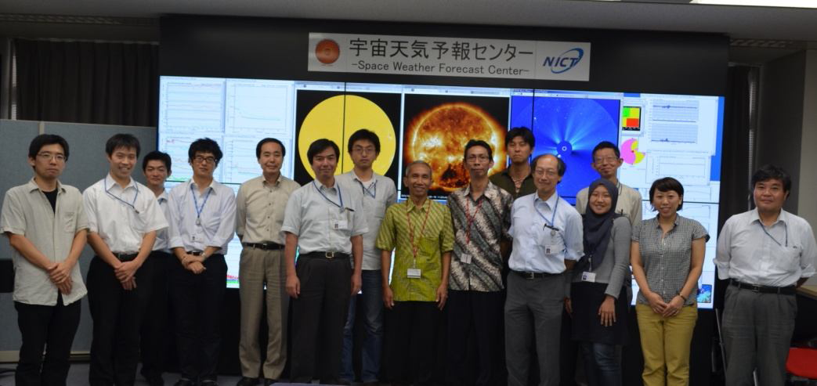
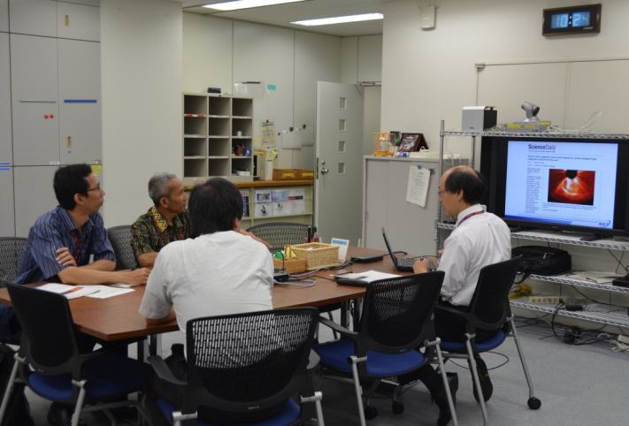
Training on Space Weather Information System in NICT 16 – 18 September 2014

Slide 17
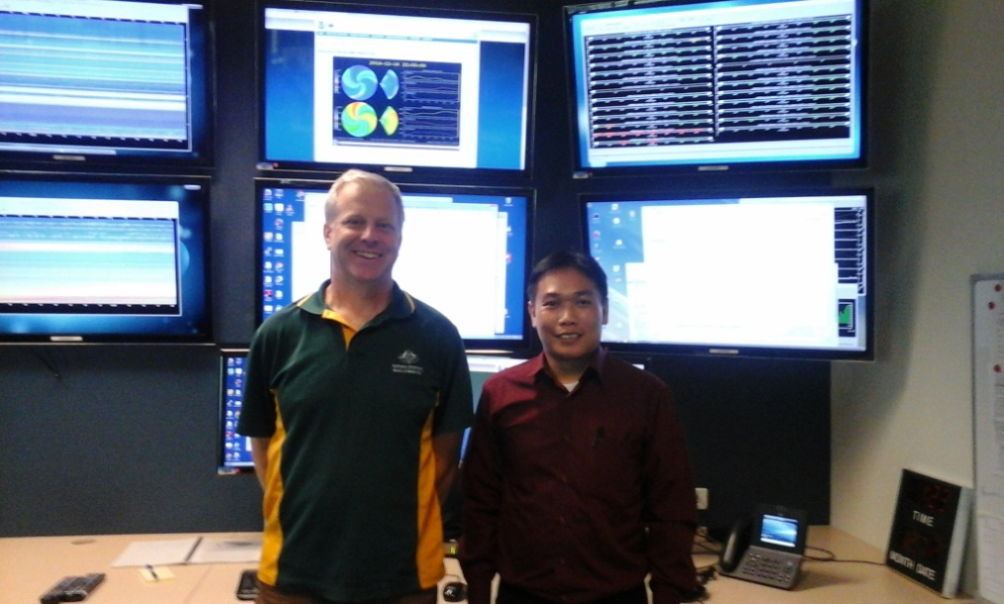
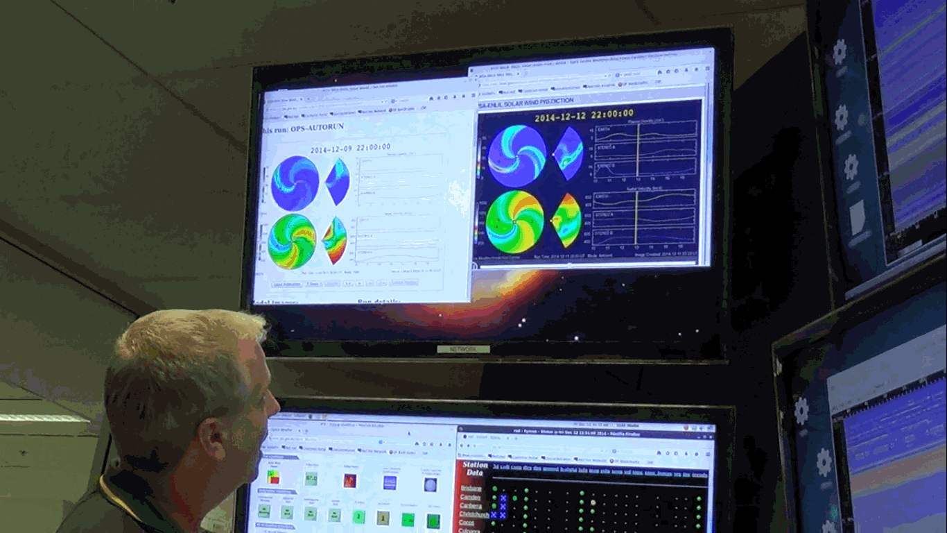
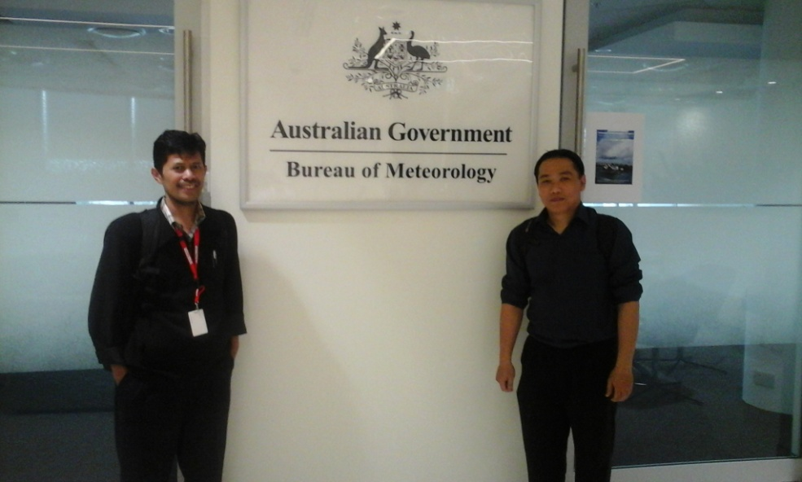
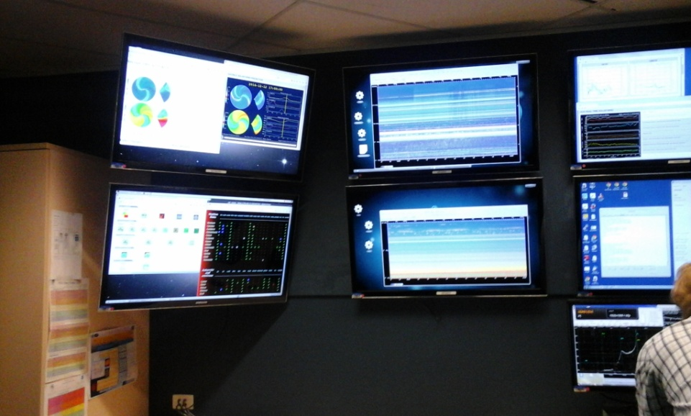
Training in IPS Australia, 6 – 14 December 2014

Slide 18
Problem(s) / Need(s)
Capacity building
Forecaster(s) capability
Stakeholders?

Slide 19
THANK YOU

