Slide 1
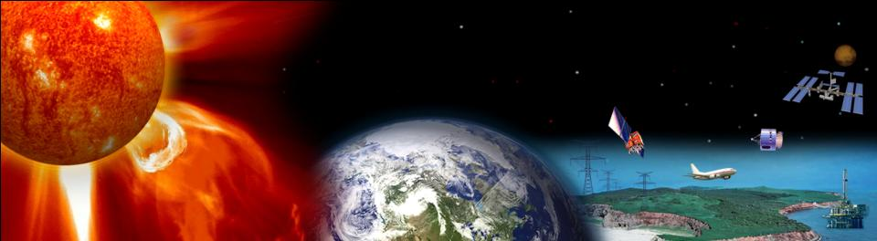

Developing a Space Weather Capability in your Region – Training to Utilize the WMO Space Weather Product Portal
Terry Onsager
Physicist – U.S. National Weather Service, Space Weather Prediction Center
Director – International Space Environment Service
Terry.Onsager@noaa.gov

Slide 2
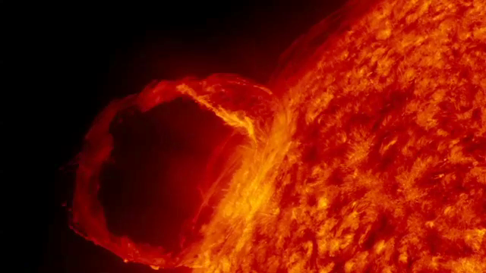
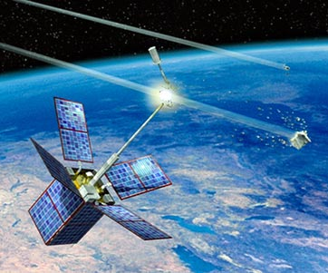


Main Topics
• WMO Space Weather Product Portal
• Training on the use of portal products

Slide 3
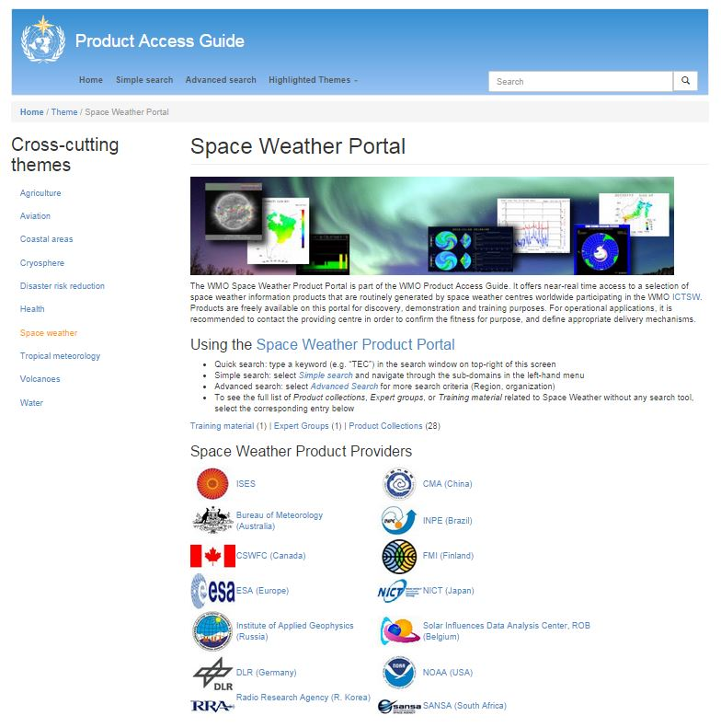

WMO Space Weather Product Portal
Nine countries now contribute space weather products on the portal
• Enhance awareness of available products
• Enable use by partners at no cost
• Increase global participation in space weather services
• Facilitate intercomparison and coordination of products
• Training under development for new users
http://www.wmo-sat.info/product-access-guide/theme/space-weather

Slide 4
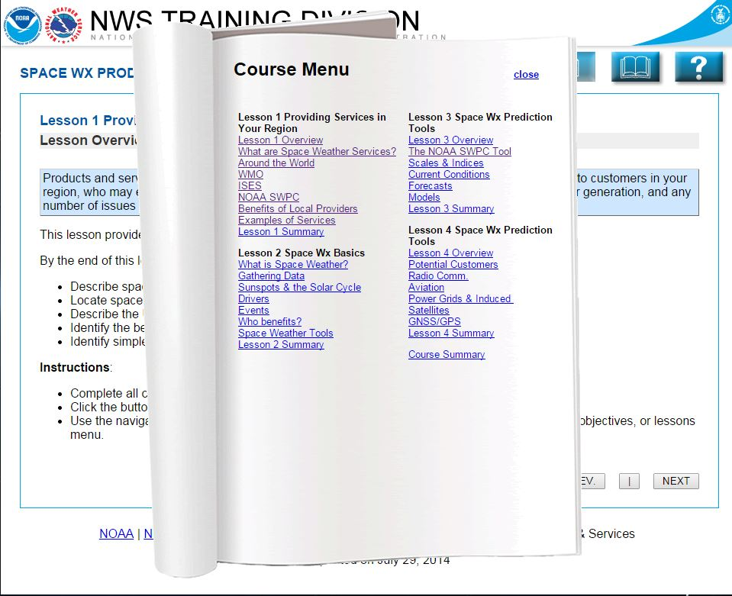
Course Menu

Slide 5
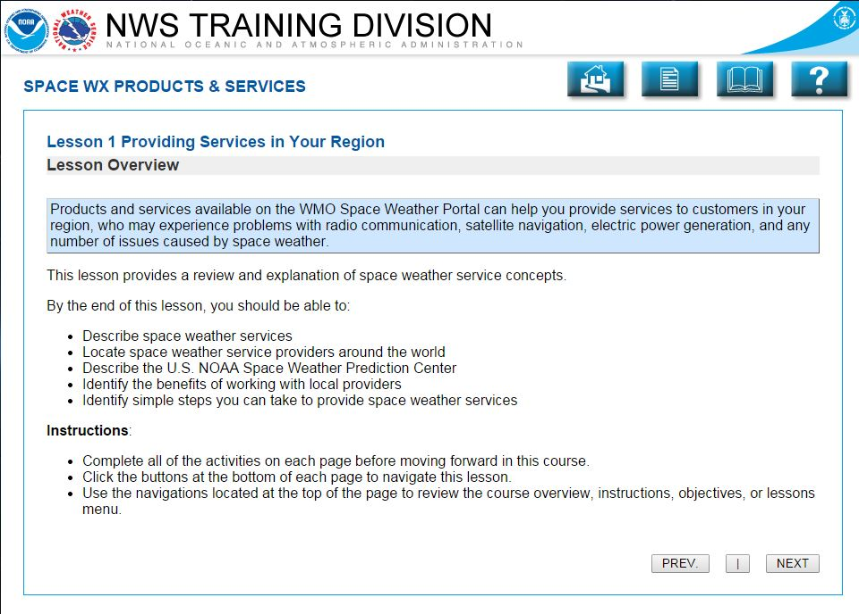
Training Overview

Slide 6
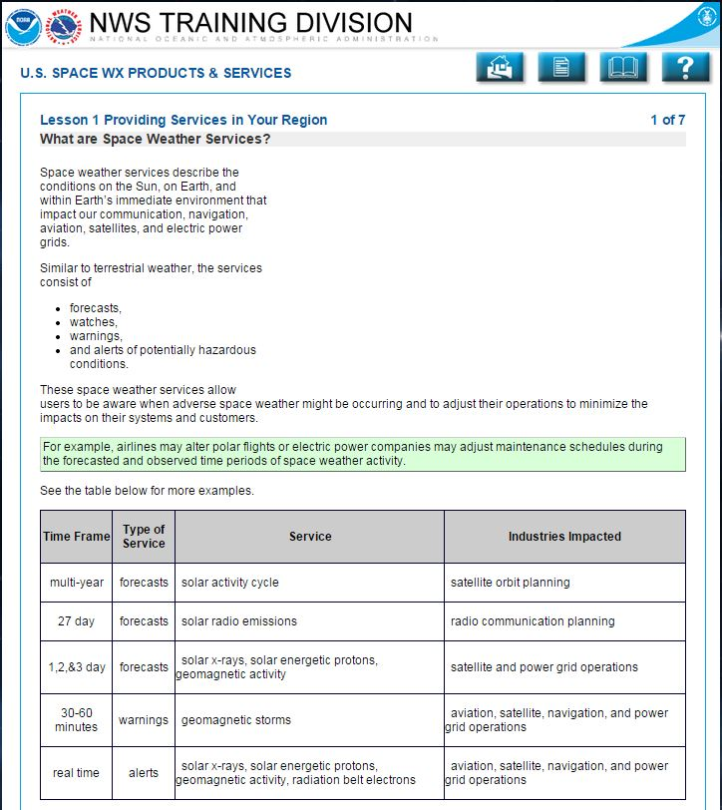
Introduction to Space Weather Products and Services

Slide 7
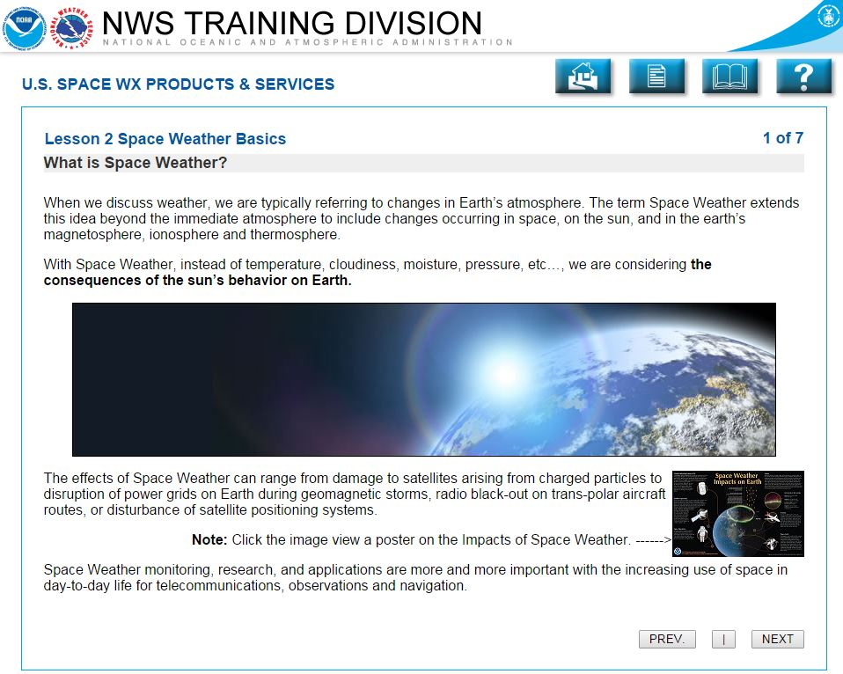
Space Weather Basics

Slide 8
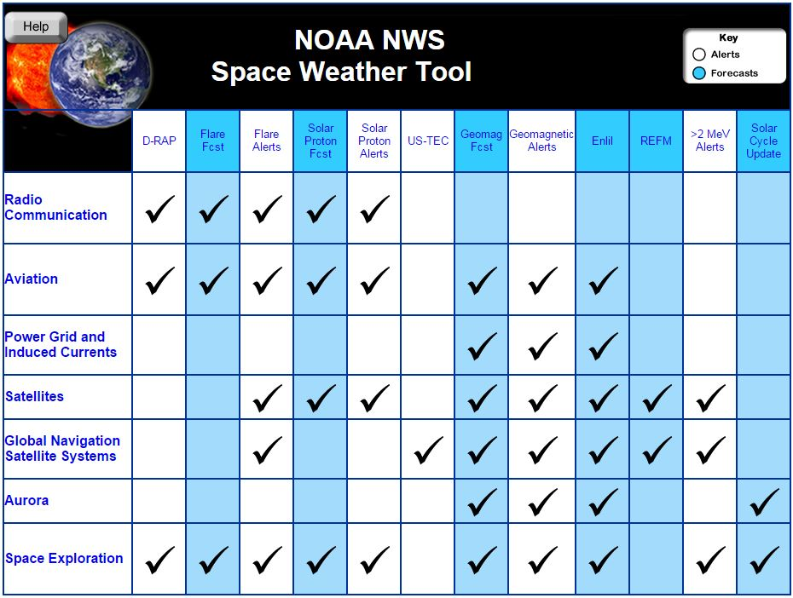
Space Weather Product Tool

Slide 9
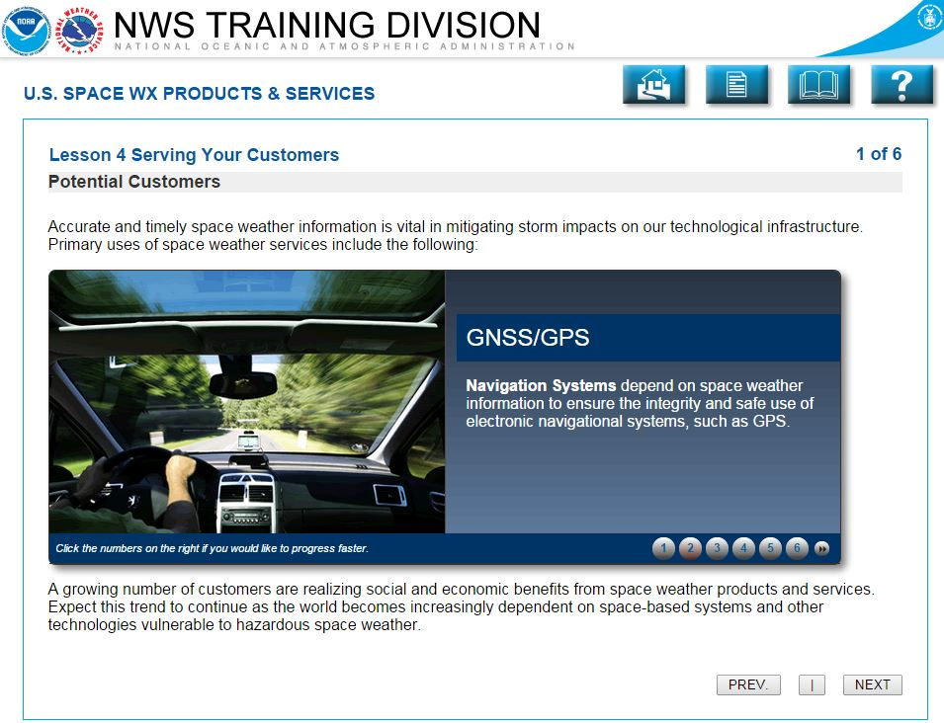
Customer Interaction Scenarios

Slide 10
Summary
• The WMO Space Weather Product Portal allows widespread use of operational products and services from multiple forecast offices
• Portal products can provide global context to assist forecast offices serving local customer needs
• Portal products can be a foundation for development of local products
• Training is being developed to help new or expanding forecast offices benefit from available services

