Slide 1

Space Weather Services to Build Global Resilience
Expert Meeting on Space Weather Services
February 3, 2015 – UNCOPUOS STSC Assembly
Goal: Foster greater global participation in space weather service activities
• How can members benefit from information and services available today?
• What types of services are likely to be needed in various regions?
• How can members expand from a research/education capability to a service capability?
• How can members contribute local data and expertise to the global effort?
Supporting the United Nations Committee on the Peaceful Uses of Outer Space (COPUOS) Scientific and Technical Subcommittee (STSC) Agenda Item on Space Weather

Slide 2
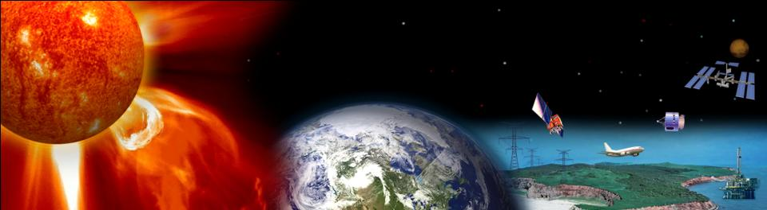

U.S. Space Weather Service Activities and Collaboration Priorities
Terry Onsager
Physicist – U.S. National Weather Service, Space Weather Prediction Center
Director – International Space Environment Service
Terry.Onsager@noaa.gov

Slide 3
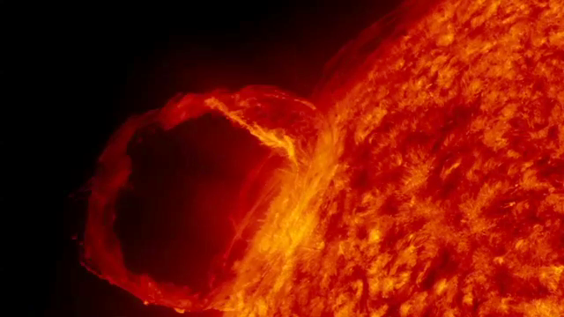
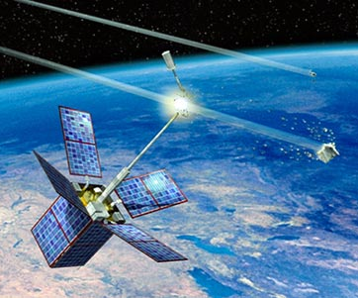

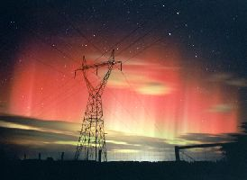
Main Topics
• Customer growth
• National priority needs
• Main U.S. observing systems
• Collaboration needs with service partners

Slide 4
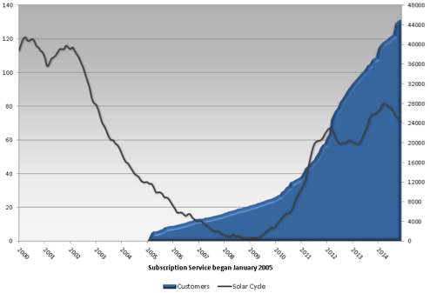
Growth in Subscribers to Space Weather Products
Customer Growth
SWPC Product Subscription Service
Customers Include:
All major airlines
Drilling and oil exploration
Satellite companies
Transportation sector
Emergency responders
Sunspot Number
Number of Subscribers
~25% of customers are International
Subscription service began

Slide 5
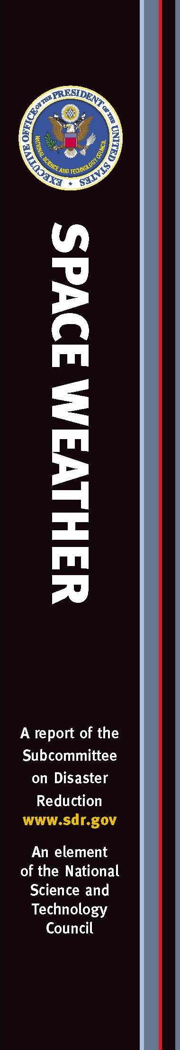
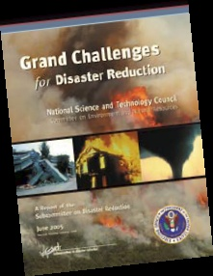
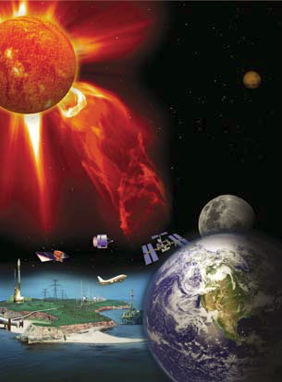
National Emergency-Response Drivers
• Space Weather is included in the Strategic National Risk Assessment
• Geomagnetic Storm standards being developed by the Federal Energy Regulatory Commission
• Interagency Operations Plan being developed by the Federal Emergency Management Agency
• Joint industry-government task force formed for the North American Electric Reliability Corporation
• National and international exercises conducted for the electric power grid and emergency response

Slide 6
Main U.S. Observing Systems Used for
Space Weather Services
• Solar and Solar Wind:
- Solar imagery (SDO, STEREO, SOHO, GOES, GONG, SEON)
- Coronagraph (SOHO, STEREO)
- In-situ solar wind (ACE, DSCOVR (2015), STEREO)
- X-ray, EUV, and radio emissions (GOES, RSTN)
• Magnetosphere
- Energetic protons, electrons, heavy ions (GOES)
- Magnetic field (GOES)
• Earth-surface geomagnetic field
- Magnetic field (USGS)
• Ionosphere
- GPS Continuously Operating Reference Stations (NOAA, IGS)
Most U.S. space weather data are freely available in real time.

Slide 7
Major Forecast Center Products
Daily Forecasts (1-3 day):
- Solar flares
- Solar energetic particles
- Geomagnetic activity
- 10.7 cm radio flux
Event-Driven Warnings and Alerts:
- Warnings: geomagnetic storms, proton events
- Alerts: solar flare, proton event, geomagnetic storm, electron event, solar radio burst
Numerical Models:
- Enlil – background solar wind and CMEs
- Relativistic Electron Forecast Model
- D-Region Absorption Product
- U.S. Total Electron Content
- Ovation Aurora Model

Slide 8
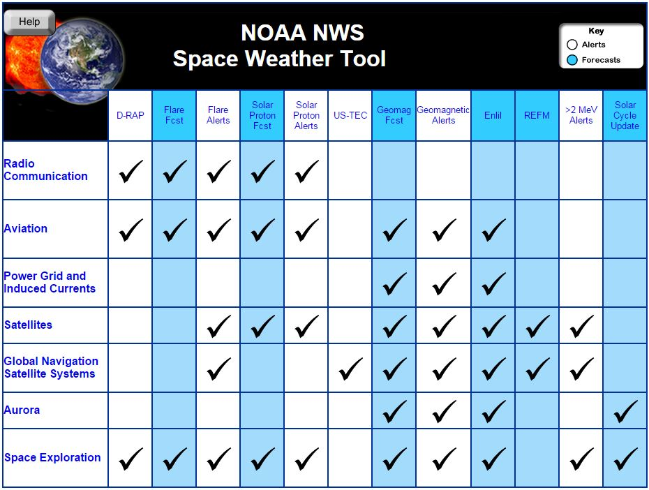
NOAA Products Available for Global Use with Training Under Development

Slide 9
High-Priority Needs for Real-Time Data
In Approximate Priority Order
• Back-up of space-based solar and solar wind measurements
- Receiving antennas for real-time data (e.g., DSCOVR, STEREO, etc.)
- Coronagraph, solar E/M emissions, solar wind plasma and mag field
• Off Sun-Earth-line coronagraph (e.g., L5)
• Ionospheric measurements (ground-based and space-based)
- Global TEC, scintillation, FUV images, electron density profile
• Magnetospheric in-situ measurements
- Energetic electrons and protons, low energetic electrons, mag field
• Earth-surface magnetic field
- Global ground magnetometer data

Slide 10
Research and Modeling Priorities
• Improved accuracy of 1-4 day forecasts of geomagnetic storms
• Localized specifications and forecasts of the impacts of geomagnetic storms at ground level
• Forecasts of ionospheric conditions relevant to GNSS users
• Specifications and forecasts of the radiation environment for satellites and commercial aircraft
• Improved probability of solar active-region eruption, including flare x-rays and energetic particles

Slide 11
Additional Information Sharing with Service Partners
• Alert notifications
• Customer requirements
• Customer impacts
• National contingency plans
• Verification methods and results
• Research/product development progress

