Slide 1


United Nations/Japan
Workshop on Space Weather
“Science and Data Products from ISWI Instruments”
United Nations Office for Outer Space Affairs
Vienna, Austria
Fukuoka, Japan, 2-6 March 2015

Slide 2

UN/Japan Workshop on Space Weather
Hosted by the International Center for Space Weather Science and Education (ICSWSE) of Kyushu University, on behalf of the Government of Japan
Workshop Webpage: http://www.unoosa.org/oosa/en/SAP/act2015/japan/index.html

Slide 3
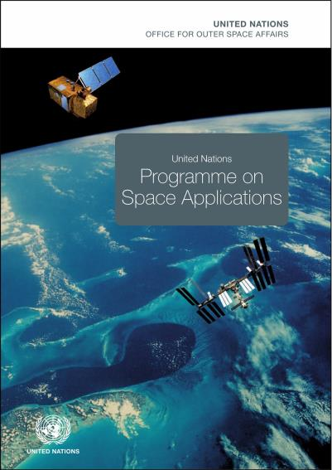
United Nations Programme on Space Applications
Established in response to recommendations of the first UNISPACE conference in 1968
Became operational in 1971
Implemented by UNOOSA
United Nations Expert on Space Applications
UNISPACE’82 in 1982, and UNISPACE III in 1999, further expanded the mandate of the Programme
http://www.unoosa.org/oosa/en/SAP/history.html

Slide 4
Programme Implementation
Basic Space Science Initiative (BSSI)
Basic Space Technology Initiative (BSTI)
Human Space Technology Initiative (HSTI)
Regional Centres for Space Science and Technology Education, affiliated to the United Nations
Fellowship Programmes
Conferences and Workshops
on specific space applications

Slide 5
Basic Space Science Initiative (BSSI)
Mission
Support the growth of small research groups in universities and
research institutions in the developing countries in the fields of astronomy and space science.
Basic Space Science Workshops
(1991-2004)
International Heliophysical Year 2007
(2005-2008)
International Space
Weather Initiative
(2009-2013)

Slide 6
UN/Japan Workshop and COPUOS
Linking the Workshop to the Space Weather agenda item in COPUOS
Linking the Workshop to the activities taking place in:
  Expert Group C (Long-term sustainability of outer space activities)
  Workshop on Space Weather Services (3 February 2015)
  United Nations Space Weather Expert Group (4 February 2015)

Slide 7
Workshop Objectives
Assess the status of space weather instruments (in-situ, space-borne), space weather data access, availability and collection and modeling efforts
Support the continued the deployment of ground-based ISWI instrument arrays and data exploitation
Continue efforts in space weather capacity building and education.
Discuss standardization, sharing and wider, timely use of space weather data, including for operational purposes
Review international cooperation activities towards global space-weather monitoring capabilities

Slide 8
Workshop Programme – Thematic Sessions
Space- and ground-based space weather instrumentation
Solar weather
Solar wind and inter-planetary medium
Magnetosphere
Ionosphere
Atmosphere
Coupling processes
Sun-to-Earth space weather modeling
Space weather impact and awareness

Slide 9
Workshop Programme
Full Day Solar-Terrestrial Environment Data Analysis Workshop
Hands-on activities (tbc)
Panel Discussions on the following topics (proposed):
  Future of ISWI and ISWI Instrument Network
  International Cooperation in Space Weather and Data Distribution
  ISWI Data Utilization and Operational Use

Slide 10
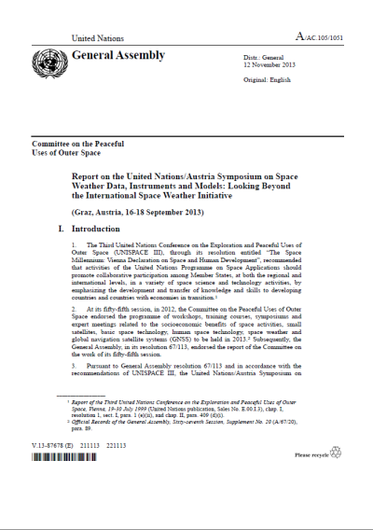
Workshop Report
Official UN document (A/AC.105/xxx) edited and available in the six official UN languages
Contains summary, observations and recommendations of the Workshop
Submitted to UN Member States through COPUOS
Could contribute to future considerations on space weather science in the UN

Slide 11
Thank you for your attention!
Office for Outer Space Affairs
United Nations Office at Vienna
Vienna International Centre
P.O. Box 500, 1400 Vienna, Austria
Email: werner.balogh@unoosa.org
Tel: +43-1-26060-4952

