Slide 1

The International Space Weather Initiative
Secretariat
Nat Gopalswamy Executive Director
George Maeda Newsletter Editor
Mitko Danov Webmaster
Sharafat Gadimova UN Liaison
Pat Doherty: Meeting Coordination
Steering Committee
Christine Amory-Mazaudier Masaki Fujimoto Sharafat Gadimova Katya Georgieva
Nat Gopalswamy (chair) Keith Groves
Lika Guhathakurta Norbert Jakowski Ian Mann Christian Monstein Terry Onsager Babatunde Rabiu Jean-Pierre Raulin Deborah Scherrer Kazunari Shibata Chi Wang and Akimasa Yoshikawa
ISWI-sectretariat.org
~80 Member countries

Slide 2
Overview
Since 2005, IHY/ISWI has created a large community of space weather scientists in developing countries
Many have matured to be scientists of international recognition
ISWI community readily understands the need for forecasting service
ISWI scientists have established space weather centers: e.g. Mexico, South Korea
Synergy with regional networks such as the Balkan, Black Sea and Caspian Sea Regional Network on Space Weather Studies (bbc-network.org) – Sun and Geosphere Journal
Provided forum for the development of African Geosciences Society during ISWI workshops

Slide 3
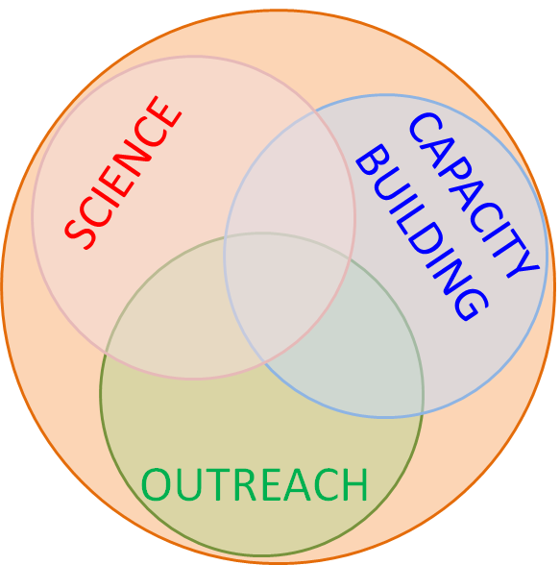
ISWI, ILWS, & SCOSTEP
International Organizations interested in
complementary aspects of the Sun – Earth System
ISWI: International Space Weather Initiative (ground)
ILWS: International Living with a Star (space)
SCOSTEP: Scientific Committee on Solar Terrestrial Physics (long-term science projects)
ISWI is a program of international cooperation
to advance the space weather science by a
combination of instrument deployment,
analysis and interpretation of space weather data

Slide 4
ISWI Instrument Program
Placing small inexpensive instruments in new geographical locations can provide new science
Distributed observatories began during IHY 2007 and continue to provide useful data as ISWI instruments
The lead scientist or principle investigator provides instrumentation (or fabrication plans) for the instruments in the array
Host country provides operation support after training during UN/ISWI workshops
All science shared within team
New partnerships established at ISWI-UN Workshops
Long-term goal is to establish infrastructure for efficient distribution of ISWI data

Slide 5
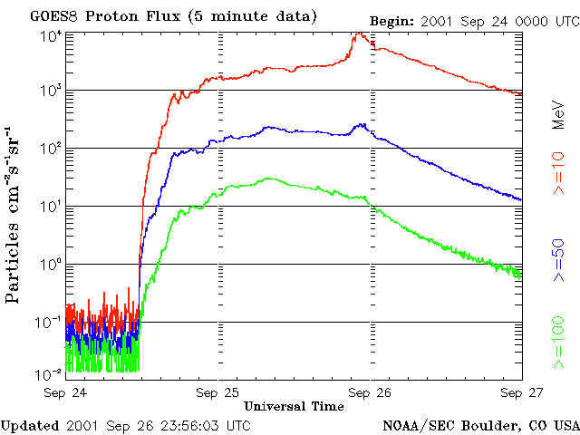
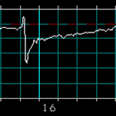
ISWI Instruments in Sun-Earth Connection
10,000
Dst (nT)
0
Also solar
flare effects
CMEs
- 100
- 200
- 300
0.1
CIR
- 400
- 500
UT (h)
Radio telescope network
H-alpha Telescope network
Particle detector networks
SEPs
Magnetic storms
?
Combine with in-situ
space measurements
Combine with remote-sensing
space- and ground-based
measurements
Space systems
Airplanes
atmosphere
Space systems
Magnetosphere
Ionosphere
Atmosphere
Ground
magnetometer networks
GPS receiver networks
VLF receiver network
Atmospheric instruments

Slide 6
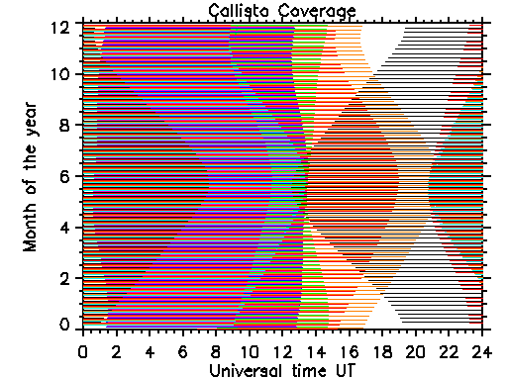
Current CALLISTO Coverage of the Sun
Hole
MONTH OF THE YEAR
UNIVERSAL TIME
Hole

Slide 7
17 Instrument Concepts from 8 Countries
17 Approved Instrument Concepts: AMMA, AMBER, AWESOME/SID, CALLISTO, CHAIN, CIDR, GIFDS, GMDN, LISN, MAGDAS, OMTI, RENOIR, SOFIE, SAVNET, SCINDA, SEVAN, UEV
from Armenia (1), Brazil (1), France (1), Germany (2), Israel (1), Japan (4), Switzerland (1), and USA (6)
Details about the projects and Lead Scientists in: iswi-secretariat.org

Slide 8
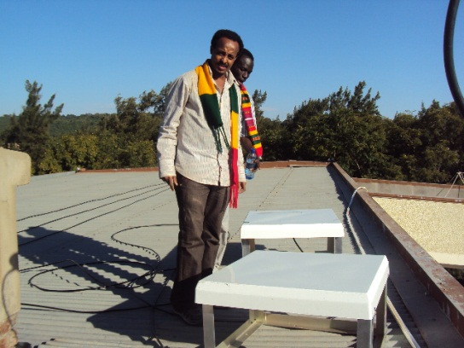
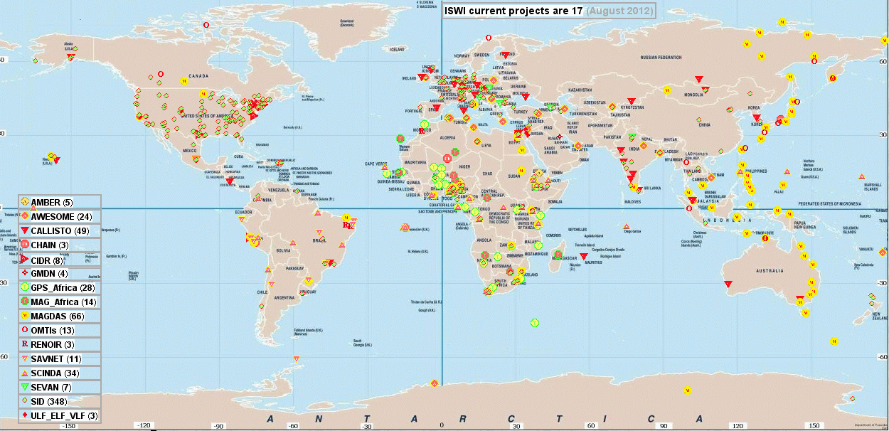
ISWI Instrument Sites
Scientists from developing and developed nations work together
Students and faculty participate at all levels of the instrument project and science
Data gaps closed due to deployment in crucial locations
Heavy focus on Africa, with added schools and workshops

Slide 9
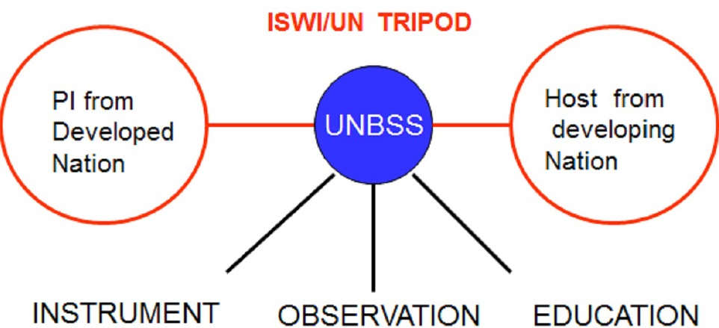
The UN Connection
GNSS
for Space Weather Applications
More from C. Amory-Mazaudier and Werner Balogh

Slide 10
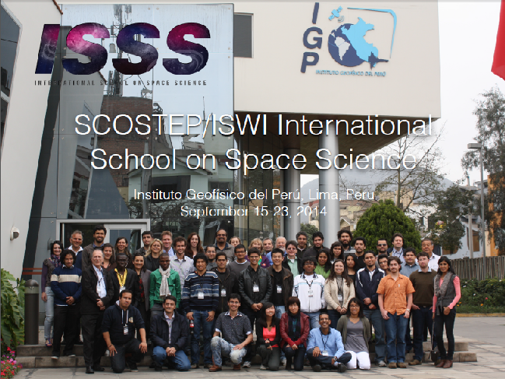
Capacity Building
Recent schools in
Indonesia, Kenya, & Peru
in cooperation
with SCOSTEP
Lectures are available online
in SCOSTEP and ISWI websites

Slide 11
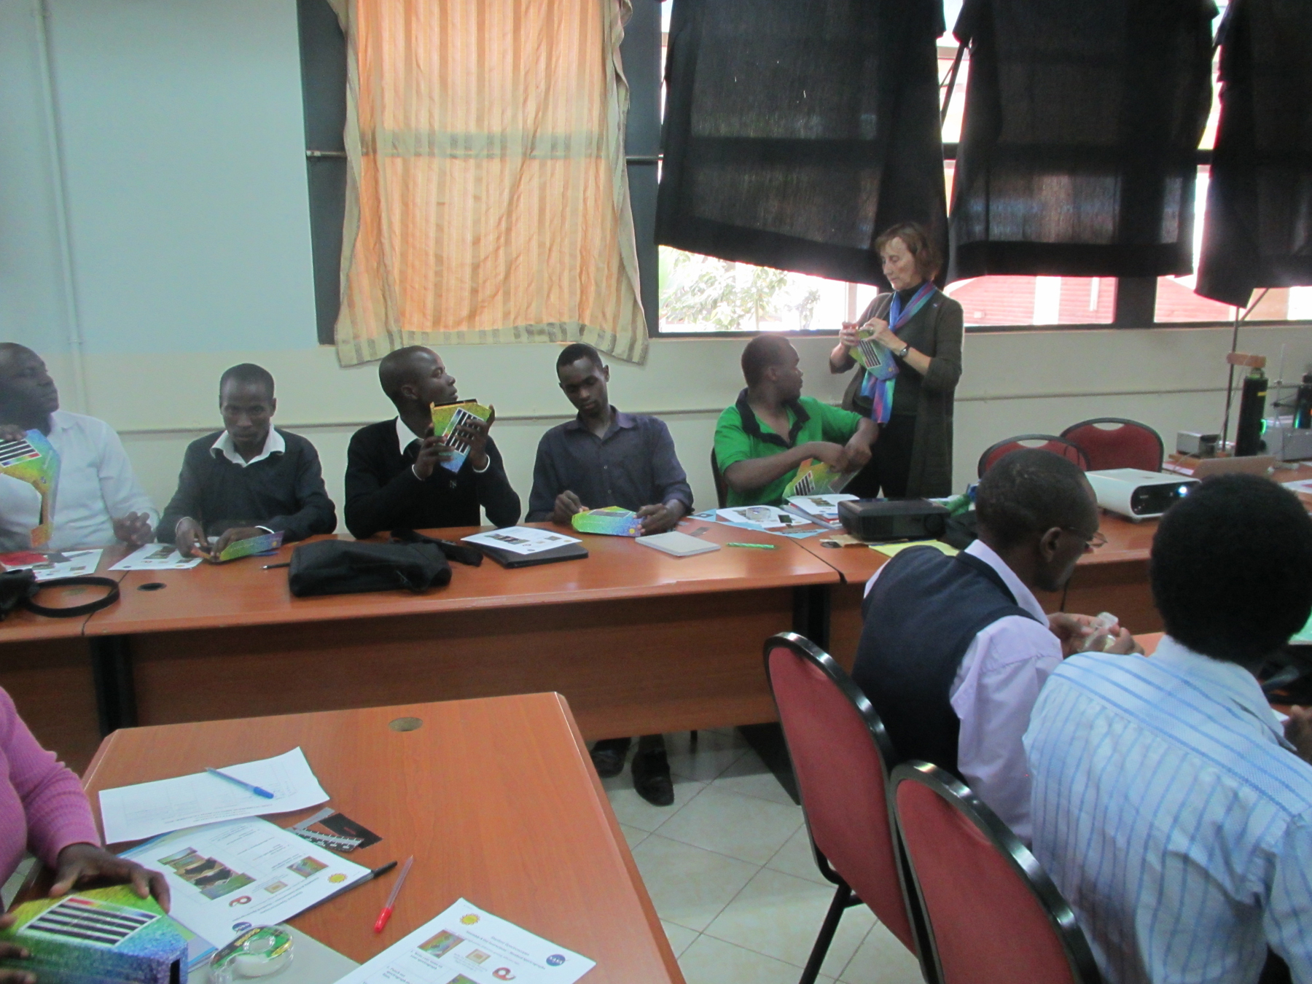
Debbie Scherrer explains
how to make a spectrograph
during the teacher workshop in Kenya
Outreach:
Teacher
workshops
Lectures in
local high schools

Slide 12
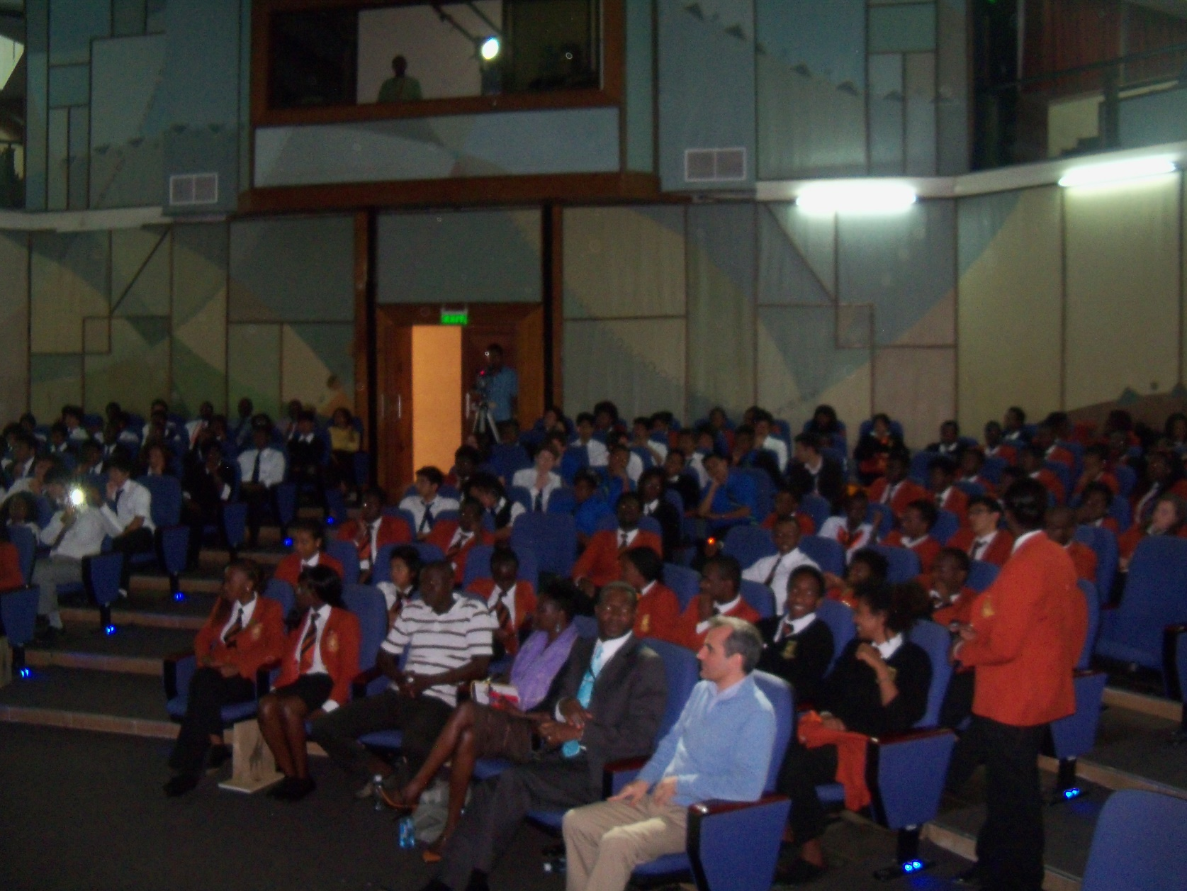
Lecture in a Nairobi High School
Dalmiro Maia
in Brooksfield School
in Nairobi

Slide 13
Summary
ISWI is a program of international cooperation in space weather activities: science, capacity building, and outreach
Active in about 80 countries
Has synergistic relationship with many international organizations
ISWI welcomes interaction with the space weather service community

