Slide 1

Space Weather Services to Build Global Resilience
Expert Meeting on Space Weather Services
February 3, 2015 – UNCOPUOS STSC Assembly
Goal: Foster greater global participation in space weather service activities
• How can members benefit from information and services available today?
• What types of services are likely to be needed in various regions?
• How can members expand from a research/education capability to a service capability?
• How can members contribute local data and expertise to the global effort?
Supporting the United Nations Committee on the Peaceful Uses of Outer Space (COPUOS) Scientific and Technical Subcommittee (STSC) Agenda Item on Space Weather

Slide 2


International Space Environment Service
Terry Onsager
Physicist – U.S. National Weather Service, Space Weather Prediction Center
Director – International Space Environment Service
Terry.Onsager@noaa.gov

Slide 3


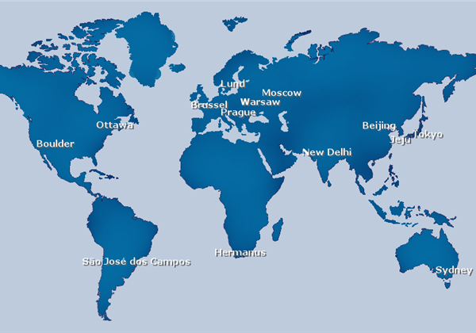
International Space Environment Service
Coordinating space weather services since 1962
• Improved service coordination is a priority
• Endorsed by national governments as space weather service providers
• Provide local users with targeted services
• Promote exchange of data and information
• Close collaboration with WMO
16 Regional Warning Centers
4 Associate Warning Centers
1 Collaborative Expert Center
UK
Graz
www.spaceweather.org

Slide 4
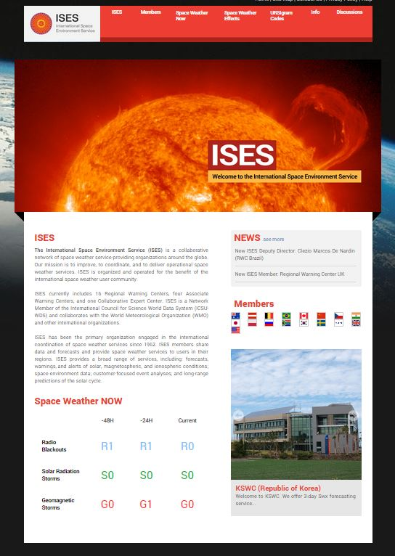
Becoming a Member of ISES
Three membership categories:
• Regional Warning Centers (RWC)
- Primary distribution sites for products and services
- National government endorsement
• Associate Warning Centers (AWC)
- Affiliated with an RWC
- Allows regional distribution of effort
• Collaborative Expert Centers (CEC)
- Space weather expertise
- Conduct service activities
- Participate with future opportunity to become an RWC or AWC

Slide 5
Current ISES Actions
• Maintain knowledge of ICAO actions and coordinate service delivery as needed
• Investigate the distribution of space weather products via the WMO Information System
• Define regions of applicability of key space weather products to assist global users
• Develop rapid exchange mechanism for information exchange among Regional Warning Centers – supports aviation and extreme events
• Conduct a forecast verification workshop (April, 2015)

Slide 6
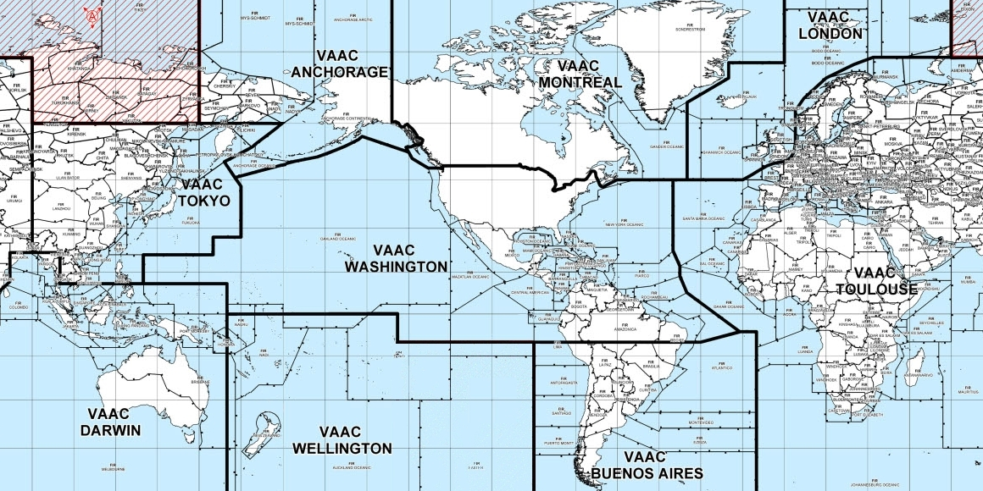
Aviation Meteorology
Global/Regional Functions
Global
Wide Area Forecast Centers (WAFC)
WAFC (Washington)
WAFC (London)
Backup
Volcanic Ash Advisory Centers (VAAC)
Regional
VAAC
VAAC
VAAC
…
Meteorological Watch Organizations (MWO)
Local
MWO
MWO
MWO
MWO
…
…
Airport
Airport
Airport
Airport
WAFC
WAFC

Slide 7
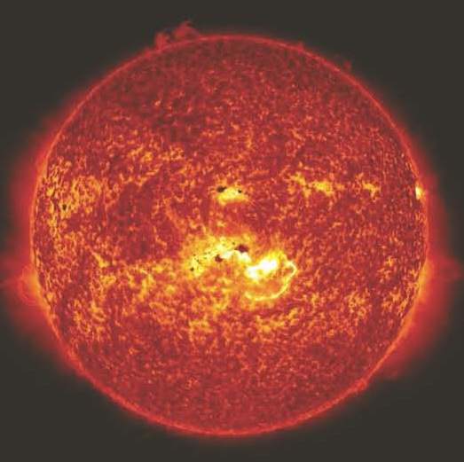

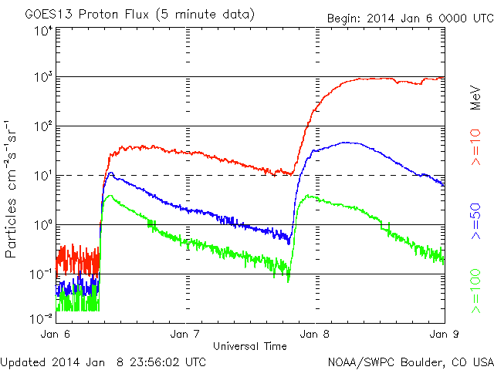
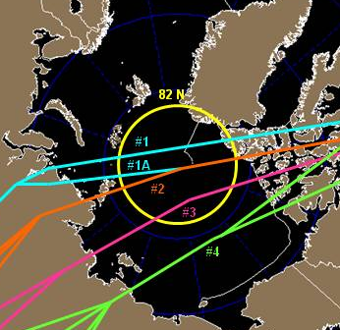
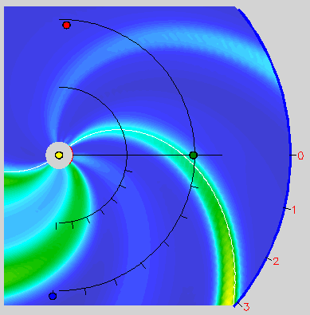
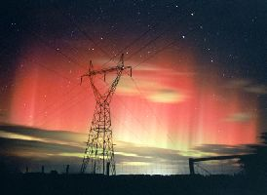
Space Weather - Global Functions
Global-scale phenomena can be addressed by a limited number of centers
Solar Flares – Forecasts, Warnings, and Alerts
Solar Protons – Forecasts, Warnings, and Alerts
Geomagnetic – Forecasts and Warnings
Storms

Slide 8
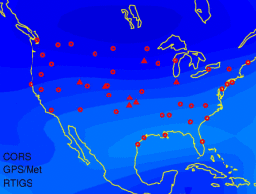
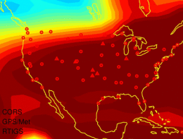
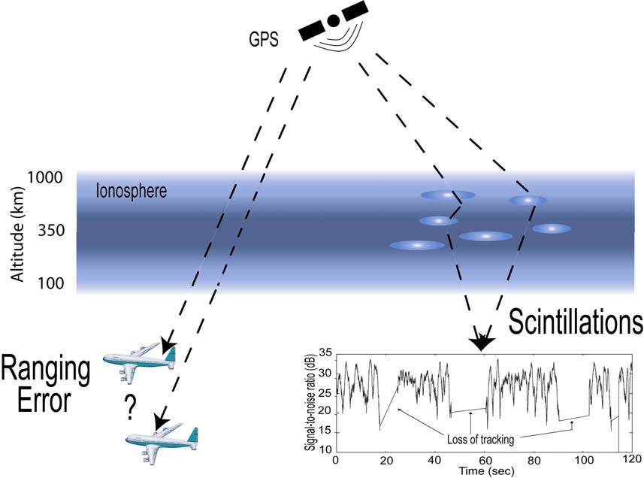

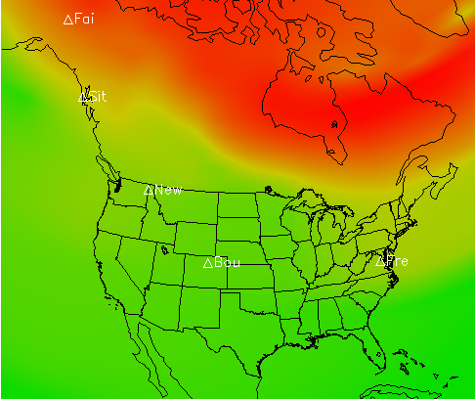
Space Weather - Regional Functions
Regional-scale phenomena must be addressed by a distributed network
Ionospheric – Total Electron Content
Disturbances
Ionospheric – Scintillation
Disturbances
Geomagnetic – Alerts and Local Impacts
Storms

Slide 9
Summary
• There is a growing, global need for improved services and for consistent, coordinated observations and operational information
• Coordination on observations, services, and research is essential to improving our global resilience to space weather
• ISES is recognized as the primary entity responsible for space weather services
• The coordination of global and regional services will be an important future issue
• ISES and WMO are actively engaged in defining service needs and observing requirements, identifying gaps, and coordinating efforts
• New members are encourage to join ISES as RWC, AWC, or CEC

