Slide 1
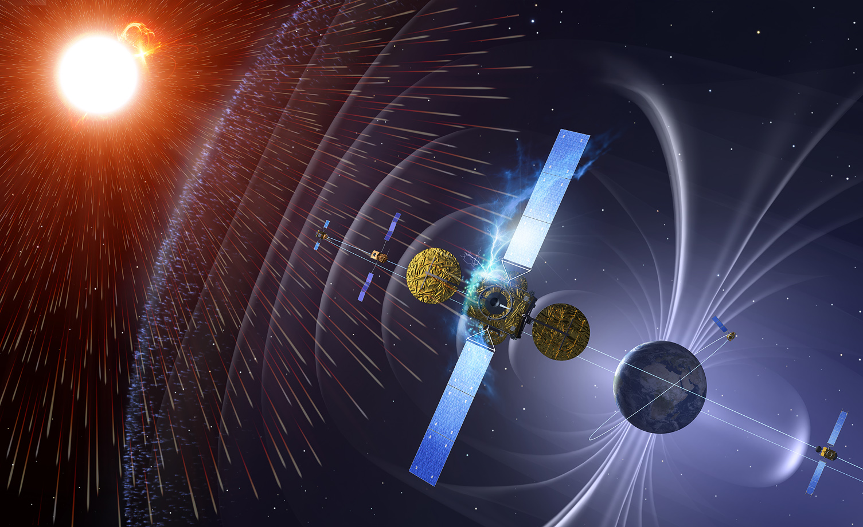


ESA SSA Space Weather Activities
Space Weather Services to Build Global Resilience Workshop
Vienna, 3rd February 2015
Juha-Pekka Luntama
SSA Space Weather Segment Manager

Slide 2
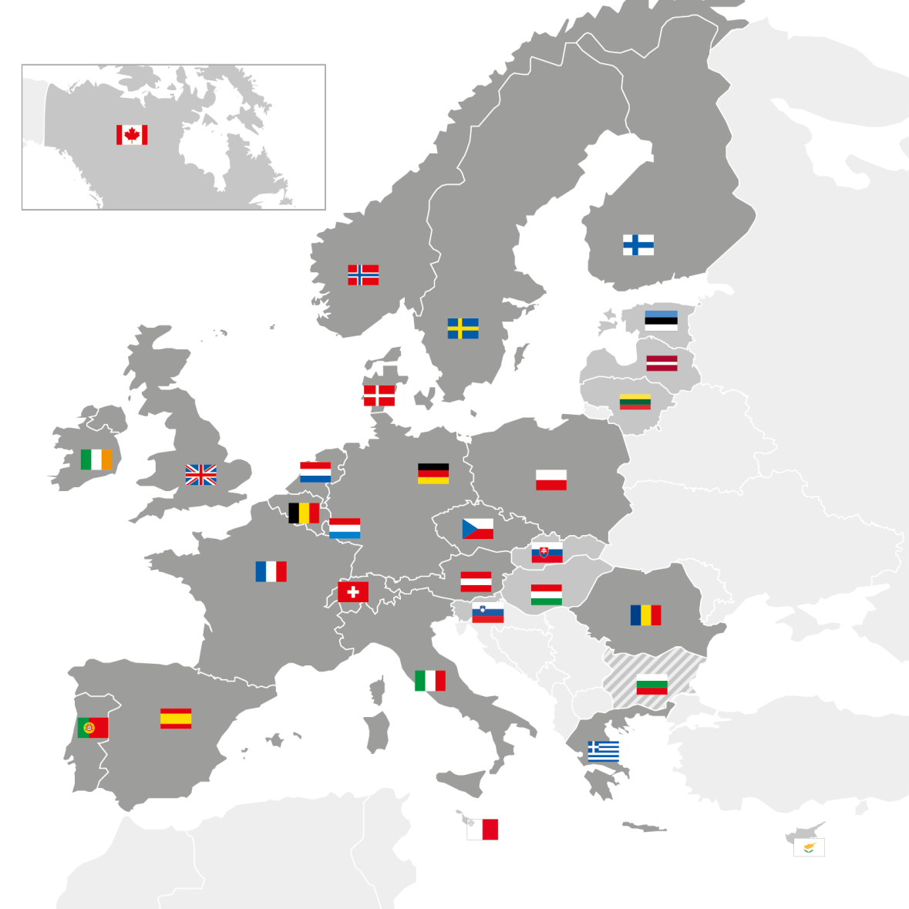
Europea Space Agency
ESA has 20 Member States: 18 states of the EU (AT, BE, CZ, DE, DK, ES, FI, FR, IT, GR, IE, LU, NL, PT, PL, RO, SE, UK) plus Norway and Switzerland.
Eight other EU states have Cooperation Agreements with ESA: Estonia, Slovenia, Hungary, Cyprus, Latvia, Lithuania, Malta and the Slovak Republic. Bulgaria is negotiating a Cooperation Agreement. Discussions are ongoing with Croatia.
Canada takes part in some programmes under a long-standing Cooperation Agreement.

Slide 3
ESA Space Situational Awareness (SSA) Programme
ESA SSA Programme has 18 Member States
13 member states in SSA P1
15 member states in SSA P2
Programme has three segments:
Space Surveillance and Tracking
Space Weather
Near Earth Objects
All member states are participating SWE activities
SWE service developments are based on expertise and assets in the member states
=> federated service concept

Slide 4
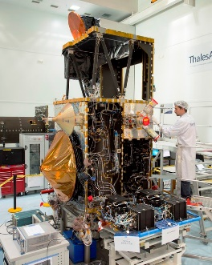
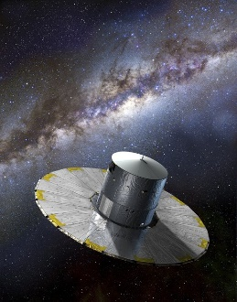
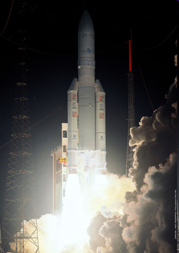
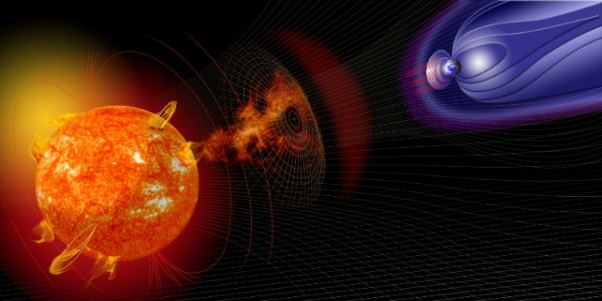
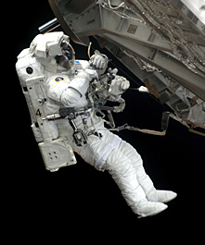
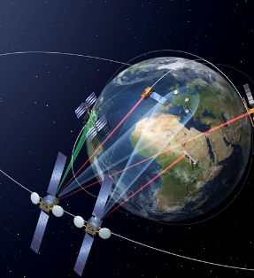
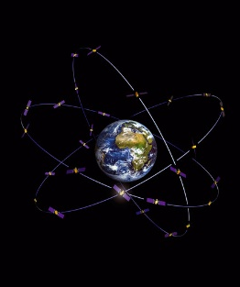
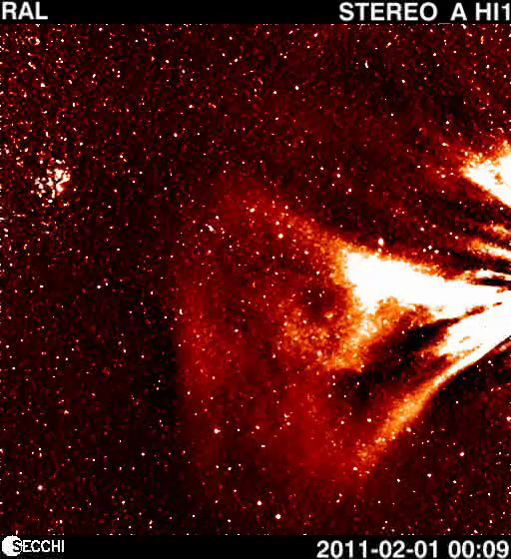
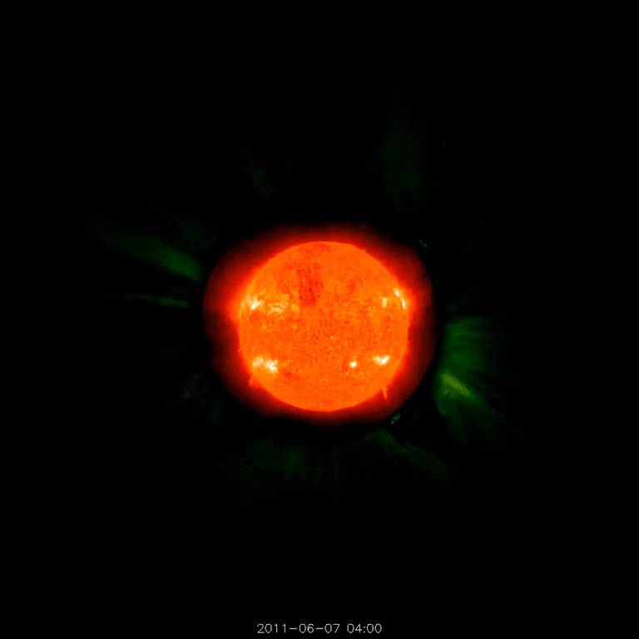
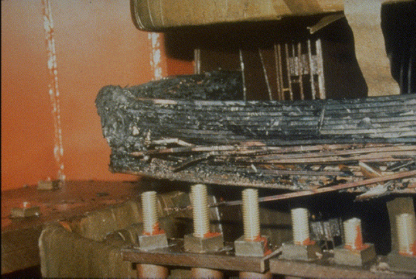
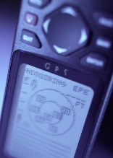
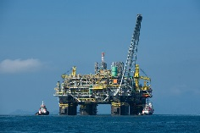

Objectives for ESA SSA SWE segment
Detection and forecasting of the Space Weather events and its effects on European space assets and ground based infrastructure
Mission requirements
Customer requirements
System requirements
Dialogue with the users
Service reviews
User raised tickets
Requirements,
User feedback
SSA SWE system
Tailored
services
User helpdesk
Online tools and services
SWE alerts
Data and product dissemination
Data archive
Tailored SWE bulletins
Picture: Minnesota Power Electric.

Slide 5
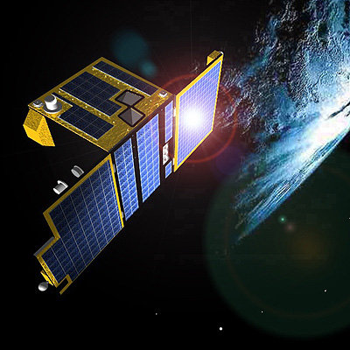

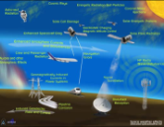
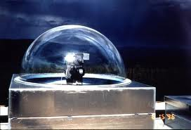
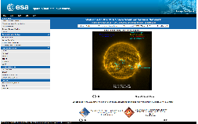
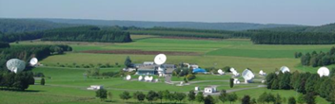
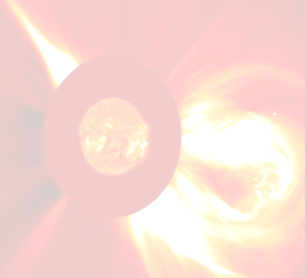
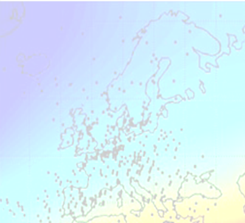
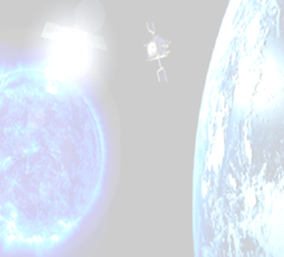
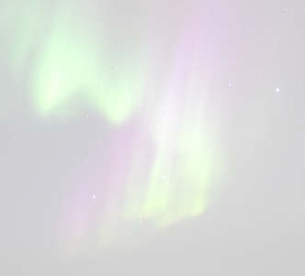
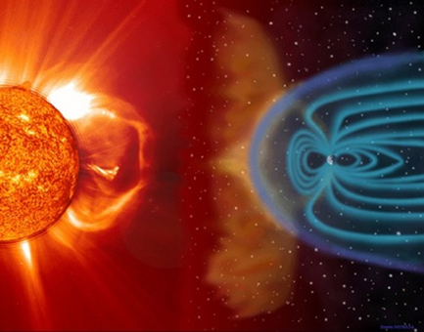
ESA SSA SWE system in development
SSA-SWE Users
SSA and collaborating sensor systems
Federated data archives
SSA-SWE
Service Portal
swe.ssa.esa.int
SWE Data Centre
SSCC
Space Pole, Belgium
SWE Expert Service Centres
Solar
Weather
Ionospheric Weather
Space
Radiation
Geomagnetic Conditions
Heliospheric Weather
European expert groups and centres of excellence

Slide 6
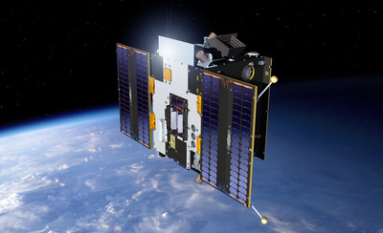
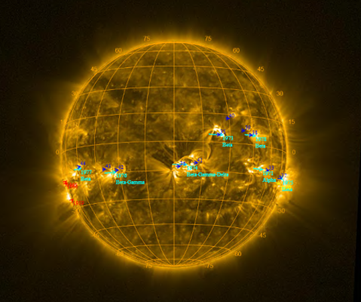
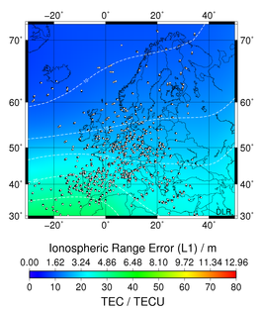
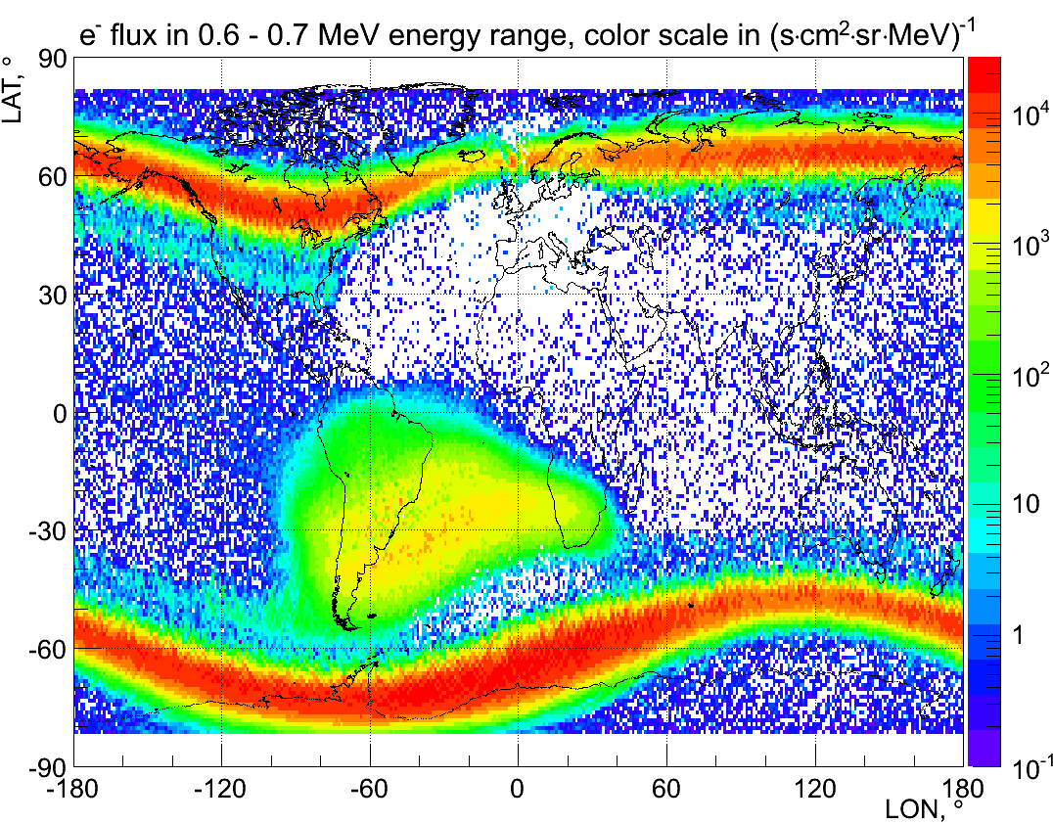
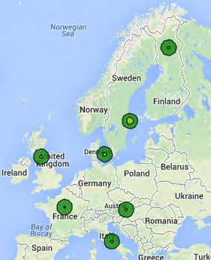
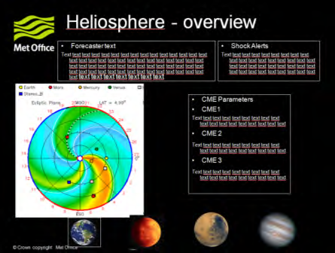
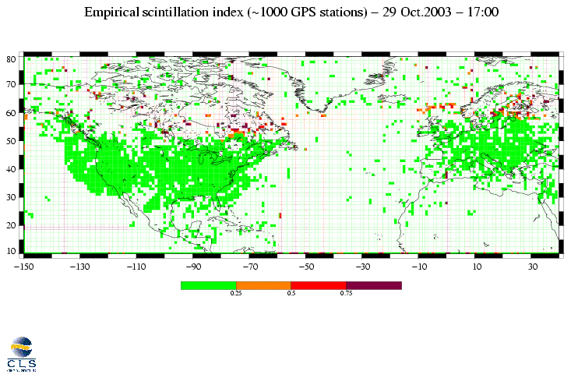
Expert Service Centres (ESCs)
ESCs are internationally distributed centres of expertise focussed on a specific SWE domain:
  Solar Weather: Expertise on solar drivers of the space weather
  Space Radiation: Expertise on radiation environment in space and for aviation
  Ionospheric Weather: Expertise on the ionized upper layers of
  the atmosphere
  Geomagnetic Environment: Expertise on variations in the Earth’s magnetic field
  Heliospheric weather: Expertise on magnetospheric response to solar wind disturbances

Slide 7
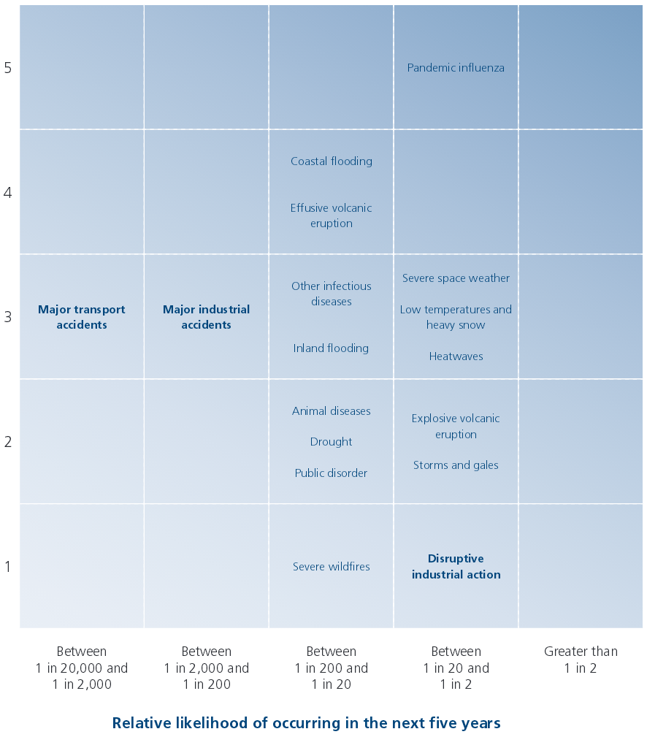
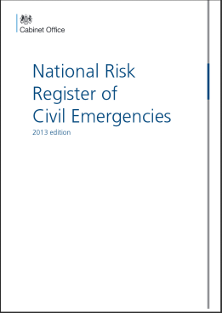
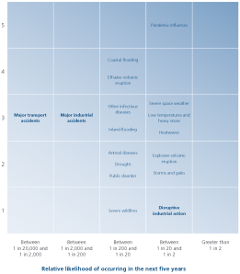
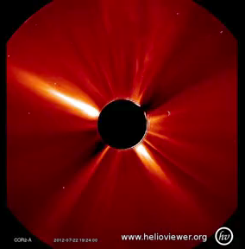
SWE risk assessment and ESA SSA Programme
Risk assessment is carried out at national level in ESA member states => national risk register
ESA provides technical support for national assessments
=> SWE risks on space infrastructure and ground segment
ESA also helps national agencies and industry to define and exercise hazard scenarios
=> workshops with NCPAs ongoing for NEO events and in preparation for SWE
SSA Programme is working closely with end users
  Definition and enhancements of the user requirements
  Reviews of the available services
  User participation into development of new services
SSA Programme is raising and maintaining awareness of the SWE hazard
Credit: NASA/STEREO

Slide 8

COSPAR Capacity Building Workshops
2-3 workshops per year on scientific topics covered by COSPAR
Commissions & Panels.
  Space weather related proposals welcome and encouraged!
Exposure to scientific best practices + practical training in use of data and analysis tools
Encourage scientific use of space data by scientists in emerging countries & foster links with wider international scientific community
Target participants from final year postgraduate students to young university faculty members in emerging countries
Usually 25-35 participants + lecturing team
On selection COSPAR provides financial support up to 25 kEuro towards workshop costs
List of past workshops: https://cosparhq.cnes.fr/events/cb-workshops.
Contact: Mariano Menzez (mariano@astro.rug.nl; PCB chair), Alexi Glover (alexi.glover@esa.int; PCB vice chair, Space Weather)

Slide 9


THANK YOU
swe.ssa.esa.int
www.esa.int

