Slide 1
National efforts to address space weather risks and customer needs
Mamoru Ishii
Space Weather and Environment Informatics Laboratory
Applied Electromagnetic Research Institute
National Institute of Information and Communications Technology
4-2-1 Nukui-kita, Koganei 184-8795 JAPAN
Notes:
Good morning. I am Mamoru Ishii from National Institute of Information and communications technology. Today I would like to introduce our activity of space weather.

Slide 2

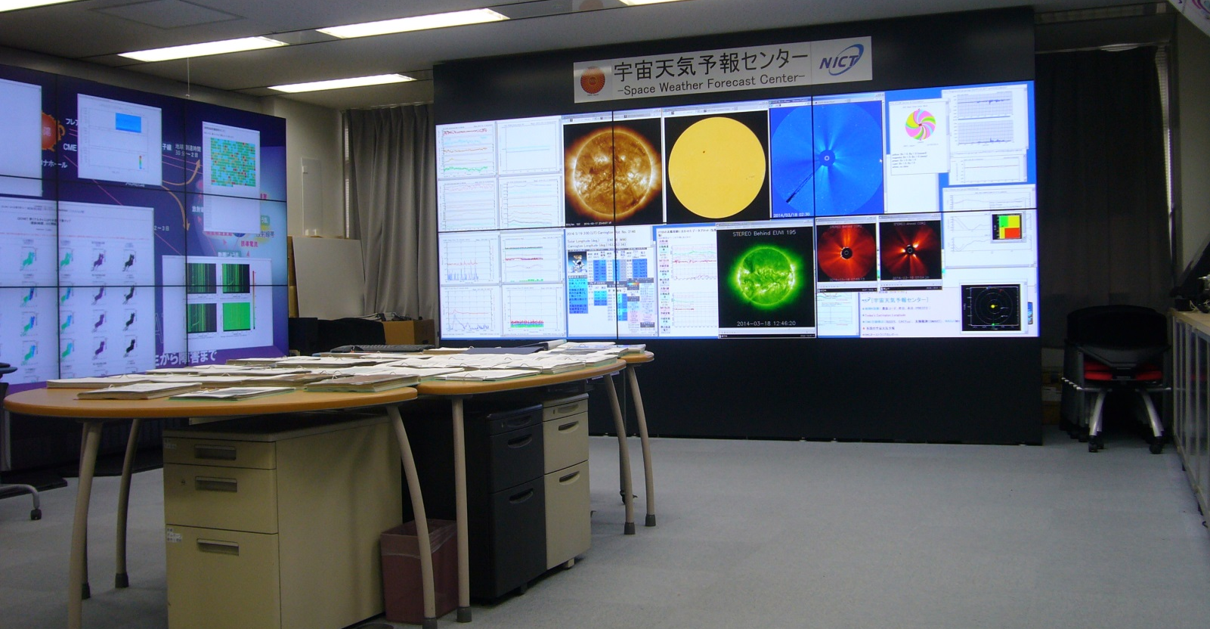
NICT Space Weather Forecast Center
Forecast information and data exchange and sharing among ISES SW forecast center
Real-time space weather monitoring
Solar activity and space environment are provided with Web, email RSS and FAX. Press release for significant event.
Simulation results
Flare forecast
Magnetic field forecast
High-energy particle forecast
HF propagation forecast
Web access:
158,057/month
（May, 2013）
No. of e-mail addressee：
9,271
Domestic users: satellite operator, aviation office and companies, power plant companies, HF telecommunicator /broadcaster, resource survey, Univ. and research institutes, amateur HF operators
Notes:
We manage operational space weather forecast. We have a briefing of space weather at 2;30pm every day and provide forecast information on 3pm via email, web and FAX. The forecast items are flare, magnetic field, high-energy particle and HF propagation. Web access is about 160 thousand every month and the number of email adressee is over nine thousand. The main users of our information are satellite operator, aviation office and companies, power plant companies and so on.

Slide 3

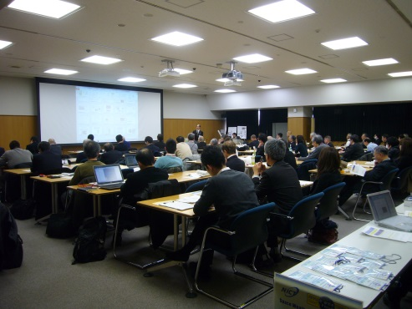
Communications with customers
・Survey of potential space weather customers
Period：2013-14
method：
Mapping of potential customers
Extract the address of potential customers
Contact by telephone (23 fields 50 organizations)
face to face interview (10 organizations)
Airplane pilot, resource survey, power plant,
aviation, management of astronouts ,
Needs: provide SWx information even if the user has no knowledge of SWx, training program of SWx
Action: renewal of Web, building training program of SWx
・SWx users forum
General information of SWx
How to use NICT SWx data
Guest speakers relative to SWx

Slide 4
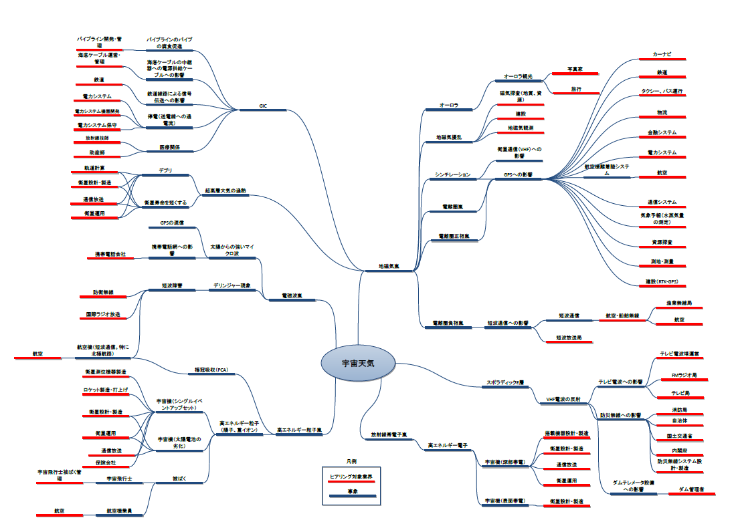
Mapping of potential customers

Slide 5



Relation of Needs-Seeds in SWx
Solar Terr. Phys.
SWx the social needs
Sun
IPS
Magnetosphere/Ionosphere
influence
Social hazard/needs
Disturbance of magnetosphere
Death Valley
Death Valley
Coronal Hall
High speed
solar wind
Satellite anomary
Hazard to satellite operation
Increase radiatoin
Increase of high energy particle
Human radiation
Plasma cloud
Hazard to human activity in space
CME/CIR
Disturbance of ionosphere
HF propagation
Hazard to aviation
X-ray
Ionization of lower ionophsere
Hazard to telecom, broadcast
Soalr flare
Disability of GNSS
Increase of high energy particle
Increase of electron density
Hazard to positioning
society
Increase of ionospheric current
Change the satellite orbit
Academic institute
Expanding upper atmosphere
Hazard to power line
GIC
SWx becomes Indispensable information for their task
Study of nknown process
Ground conductivity distribution

Slide 6
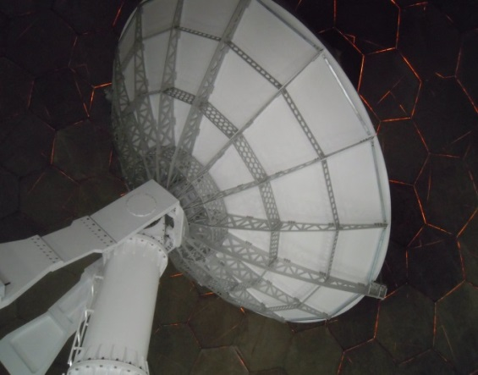
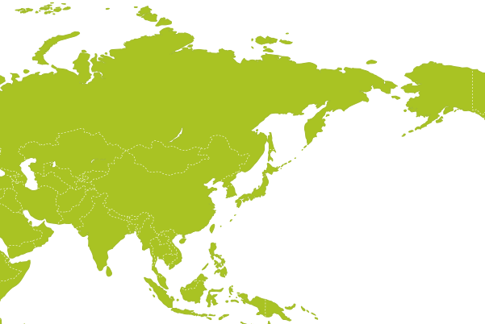
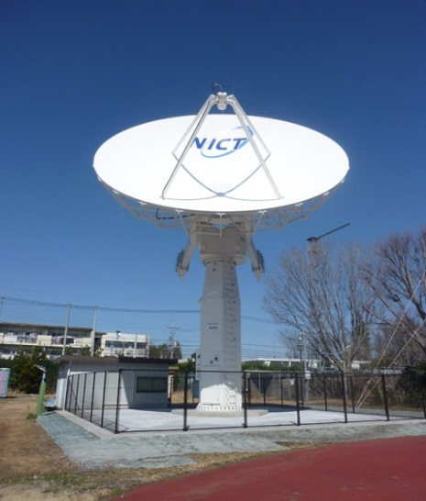
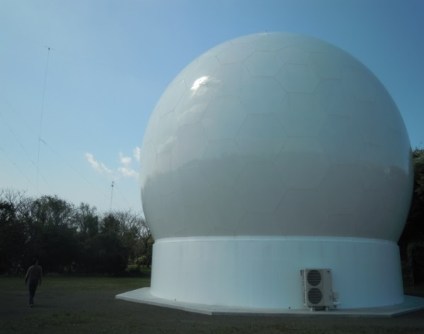
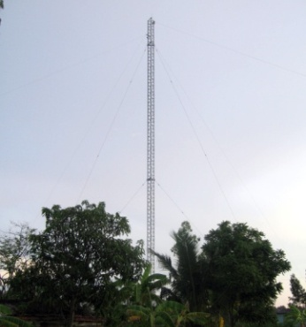
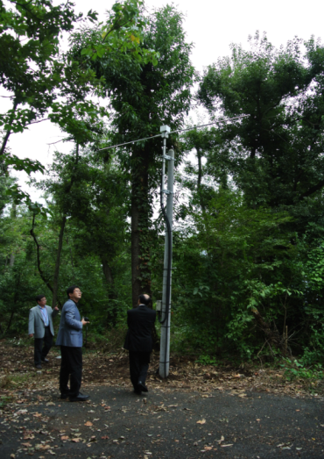
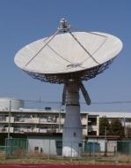

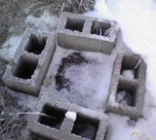
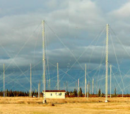
NICT SWx Obs. Network
Mar. 2014
Mar. 2014
Far East Mag.＆HF radar network
ACE receiver antenna
Solar Radio telescope
Ionosonde
Operational Ionosphere Obs. Network ＆Sun and Solar obs. systems
Sun and Solar wind
Mar. 2015
2016-2020?
Magnetometer
Syowa, Antarctica
SEALION
Oct. 2014
HF radar
New Ionosonde
system

Slide 7
Available Data
Observing data
  Domestic and antarctic ionogram since IGY
  SEALION ionogram, GPS and scintillation data
  Magnetometer data
  Solar radio data : Hiraiso(present) and Yamagawa(near future)
Simulation data archive
  Comparing with observation results for evaluation and scientific discussion
  MHD magnetosphere model
  GAIA: atmospheric/ionospheric model

Slide 8
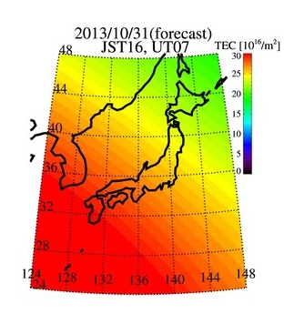
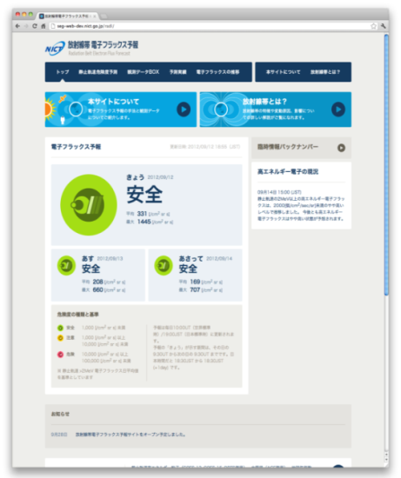
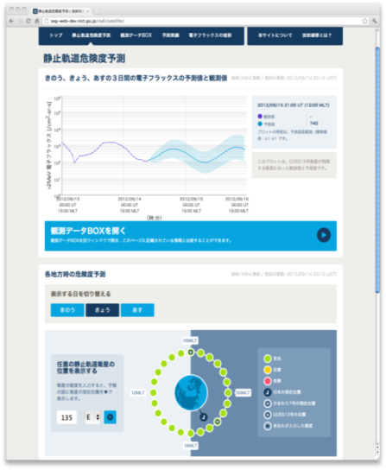
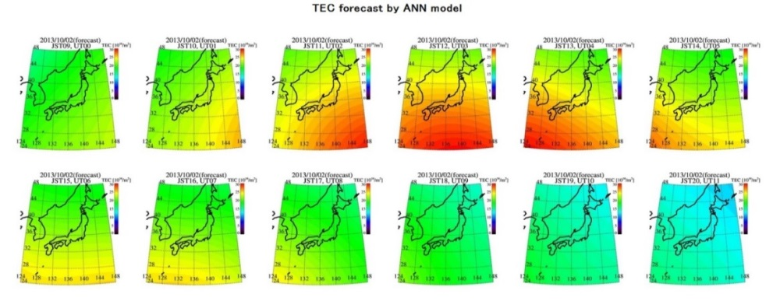
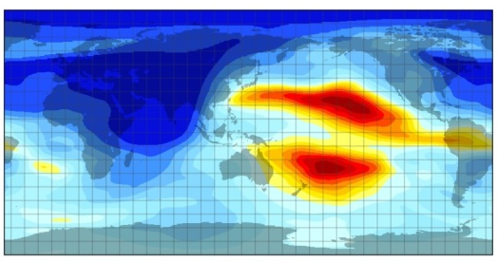
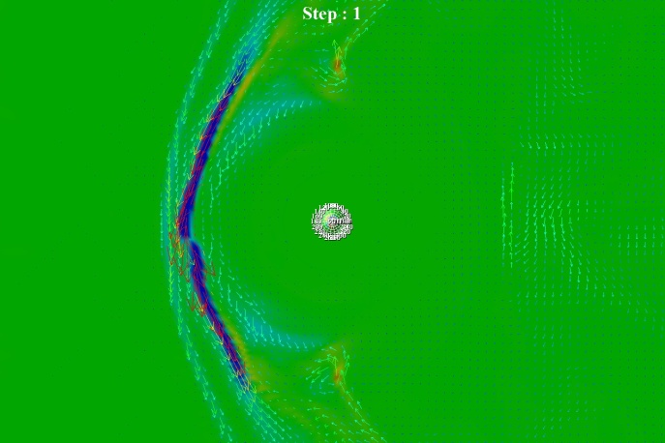
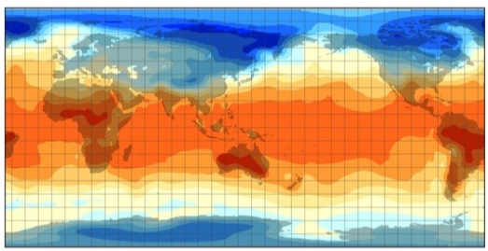
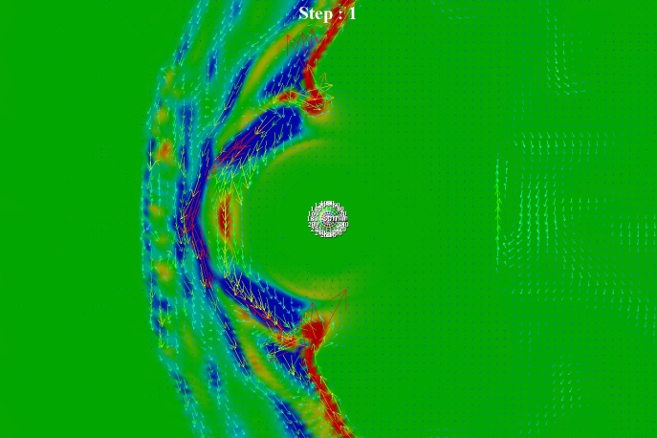
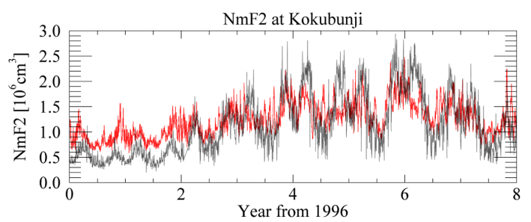
Model/simulation
Empirical Model
Empirical model of radiation belt using multi-parameter as input parameters
TEC map forecast system using season and solar activity as input parameters
Ionosphere
Radiation belt
Snap shot example of Atmosphere-Ionosphere connection model “GAIA” with meteorological realistic analysis data
Even in dynamic pressure (V*V*D) is
same, magnetospheric impact is more severely affected by velocity increase
Density increase
Ion density (alt.300km）
Surface temperature
Velocity increase
J₀ E₀ =4.0×10⁻¹³[W/m³]
Increase dynamo current
-40
0
40
Numerical code
Notes:
This is schematic plot shown our model and simulation activity. Vertical and horizontal axis shows the kinds of model and their region, respectively.
This is TEC map forecasting model with empirical code, this is the model named GAIA which is connecting numerical code from the ground to the ionosphere. This is the initial results of long-term variation of NmF2. The result still has some difference between observatoin and the simulation and now we are improving the code.
This is the empirical model of radiation belt using multi-parameter as input parameters which is already on service, and this is the magnetospheric numerical code . This case shows that even in the same dynamic pressure, magnetosphere is more sensitive to velocity variation.

Slide 9
Highest priority needs –
Ionospheric information above ocean
Precise ionospheric model is necessary for use of aviation and radio infrastructure, e.g., telecommunication, broadcast and GNSS.
For that, It is necessary to get ionospheric information above ocean.
Candidate of observation methods
  Oblique sounding with ionosonde
  Trans equatorial propagation
  GPS buoy
  Satellite occultation

Slide 10
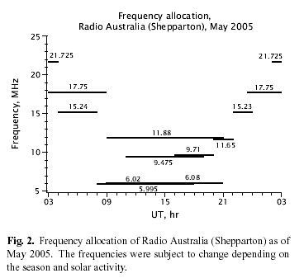
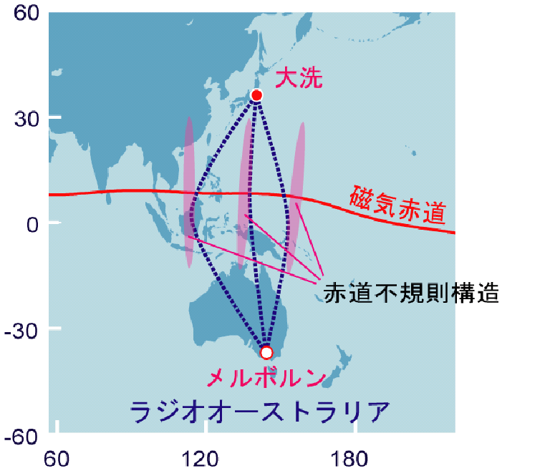
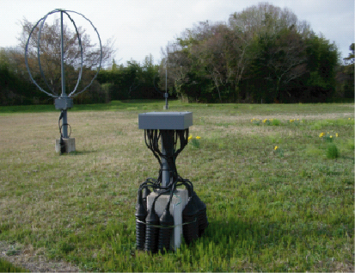
Trans-Equatorial Propagation (TEP)
Oarai
Equatorial Ionospheric
disturbances
Melbourne
Radio Austlaria

Slide 11
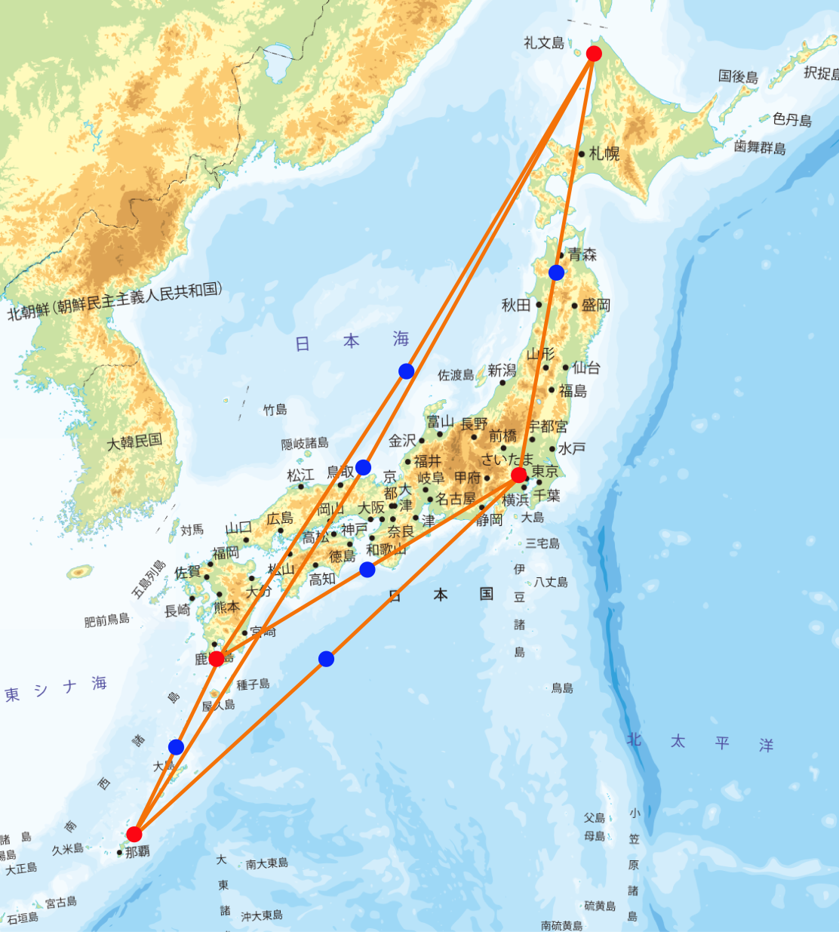
Oblique sounding with ionosondes
NICT are now routinely operates oblique sounding ionogram every 15 min.
NICT and KSWC are discussing international oblique sounding project with VIPIR system.
Development and observation with simple receivers will make possible to increase observation points.

Slide 12
agenda
Customers and national needs (or potential customers if you are considering new services)
Services you provide (or that you are considering providing)
Data you use and make available (or that you need)
Highest priority needs
How others can benefit from your data, services, customer knowledge, etc.

Slide 13
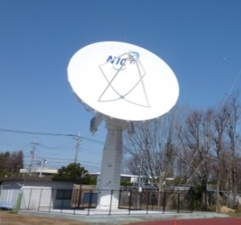
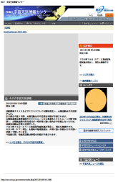
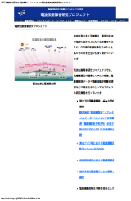



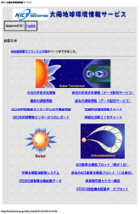
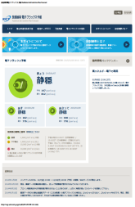



Unify/simplify of Web structure
Background
Actions
Necessity to provide huge No. of SWx data with high security
Increase of data needs and new observation, solar radio, VIPIR
Complicated structure with long-period operation
Unifying Web server on NICT information system office
Provide new observation data
Easy access of data by restructuring the Web
Unify the forecast/data site which are operating independently
Unify the Web server into NICT information system office
Observation/simulation in domestic/international
present：several independent system

