Slide 1
A new data format to promote international exchange and share of GNSS-TEC data
T. Tsugawa¹, S. Saito², M. Nishioka¹, A. Saito³,
Y. Otsuka⁴, and M. Ishii¹
¹ NICT, ² ENRI, ³ Kyoto University, ⁴ Nagoya University

Slide 2
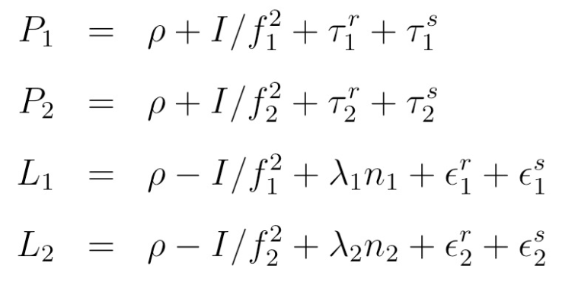
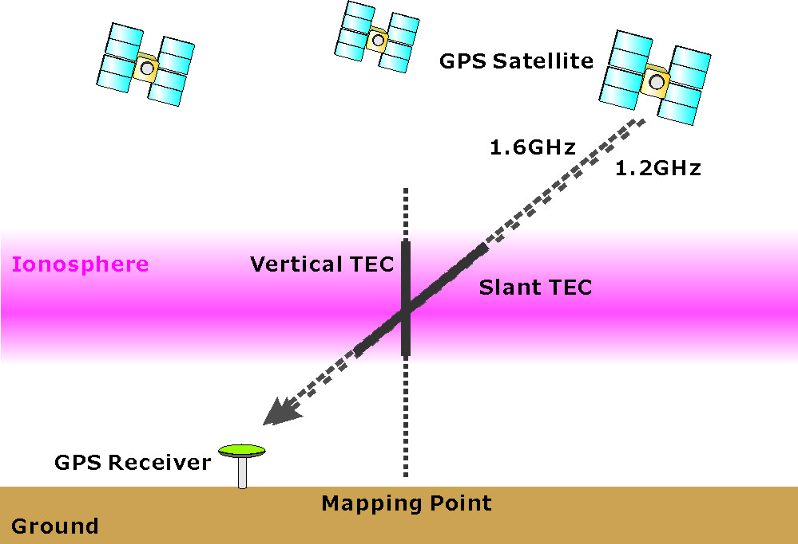
GNSS-TEC Observations
Total electron content (TEC) can be derived by comparing the pseudorange/phase delays of the two GPS signals.
P₁ P₂: Pseudorange
L₁ L₂: Carrier phase
I: Total electron content
f₁, f₂: Frequency
ρ: True range between the GPS satellite and receiver
TEC is a measure of integrated electron density in 1m² column.
Spatial resolution of TEC map depends on the number of GNSS satellites and GNSS receivers distribution.

Slide 3
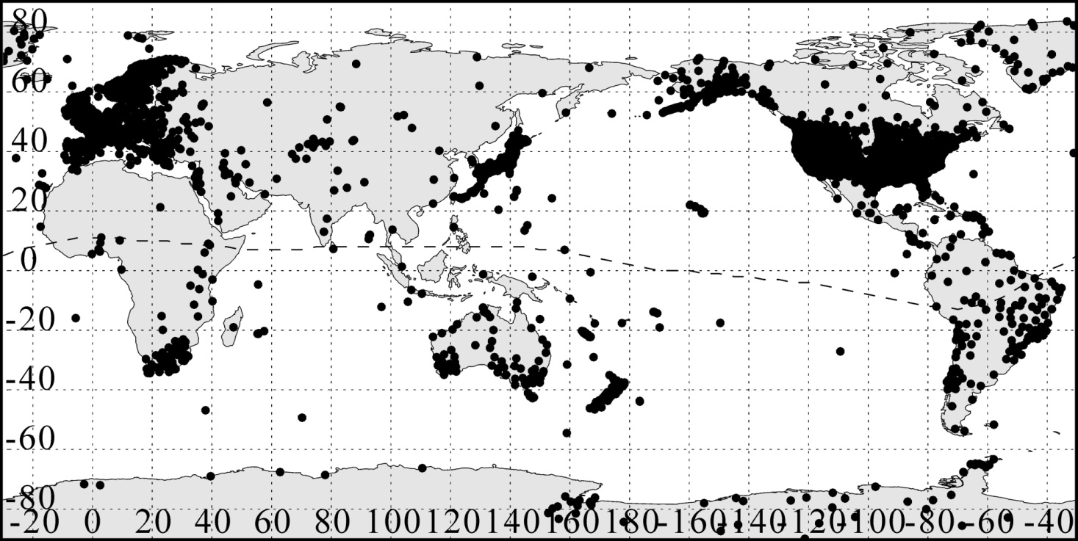
GNSS Receiver Networks
GNSS receiver networks whose data is available online (more than 6,000 receivers as of Jan. 2013).

Slide 4
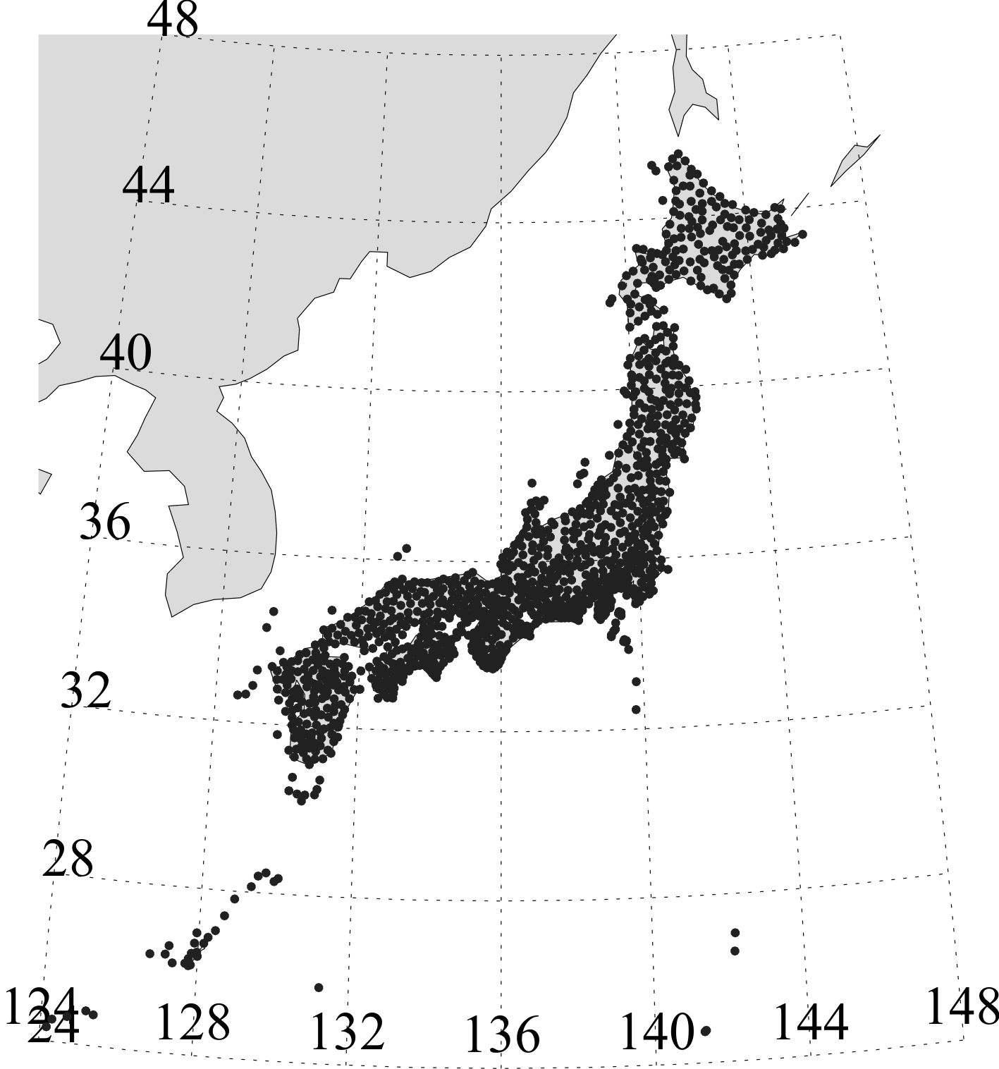
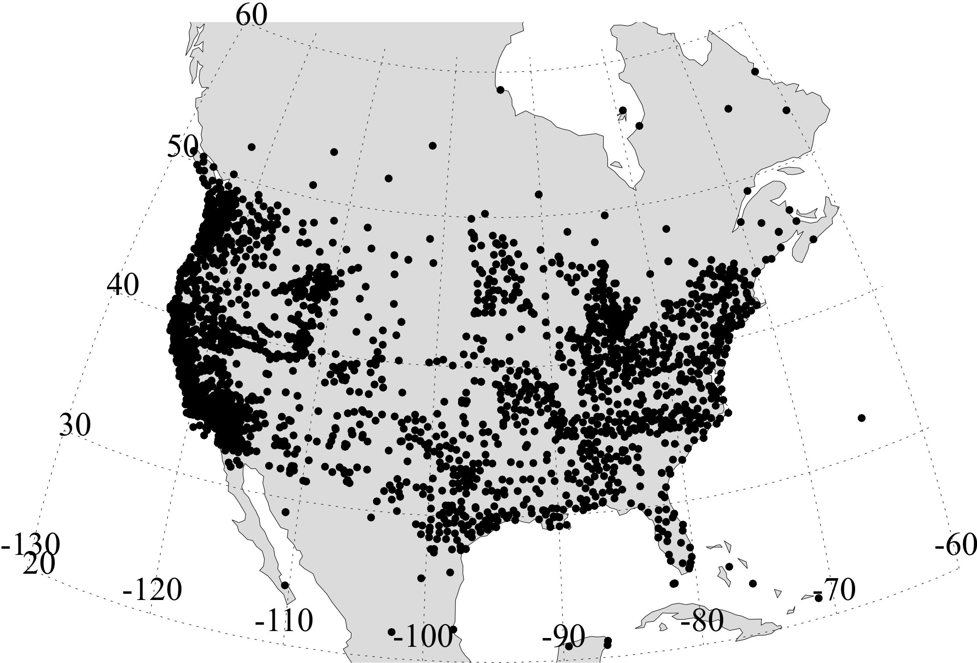
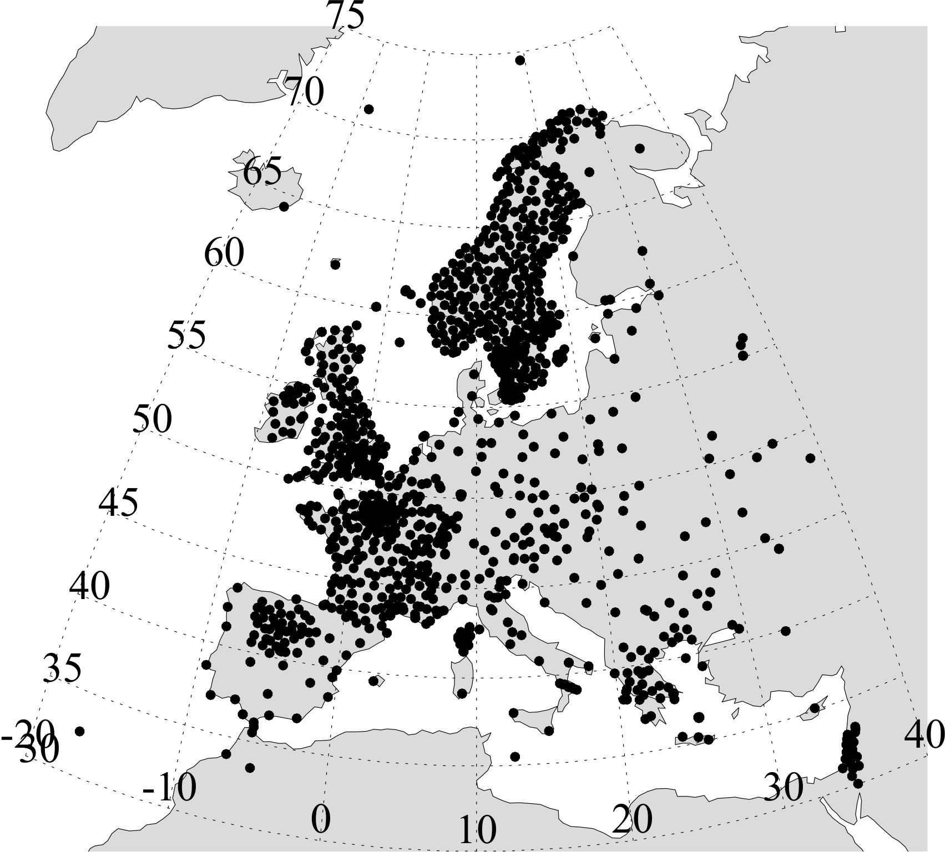
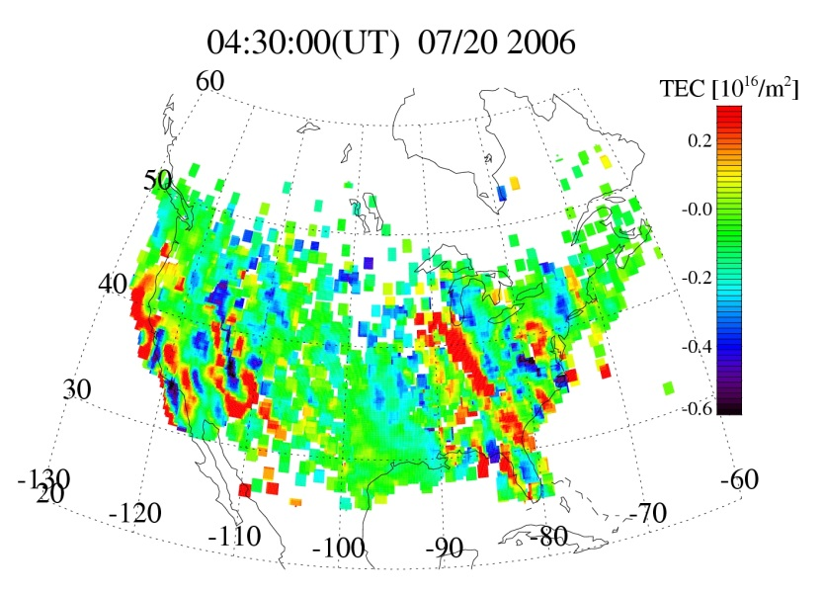
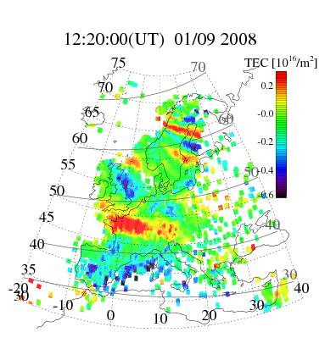
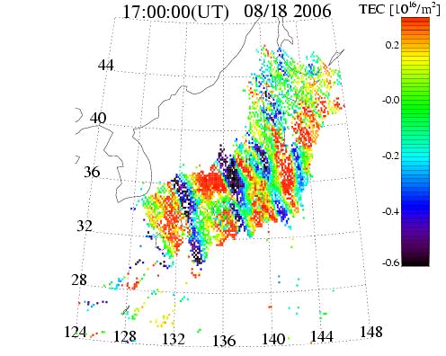
High resolution GPS-TEC maps
Region
# of GPS Rec.
JAPAN
~1,200 receivers
N. America
~2,700 receivers
Europe
~1,200 receivers
Detrended
TEC Map
(60-min
Window)
[Tsugawa et al., 2011].
[Tsugawa et al., 2007].
[Otsuka et al., 2012].

Slide 5
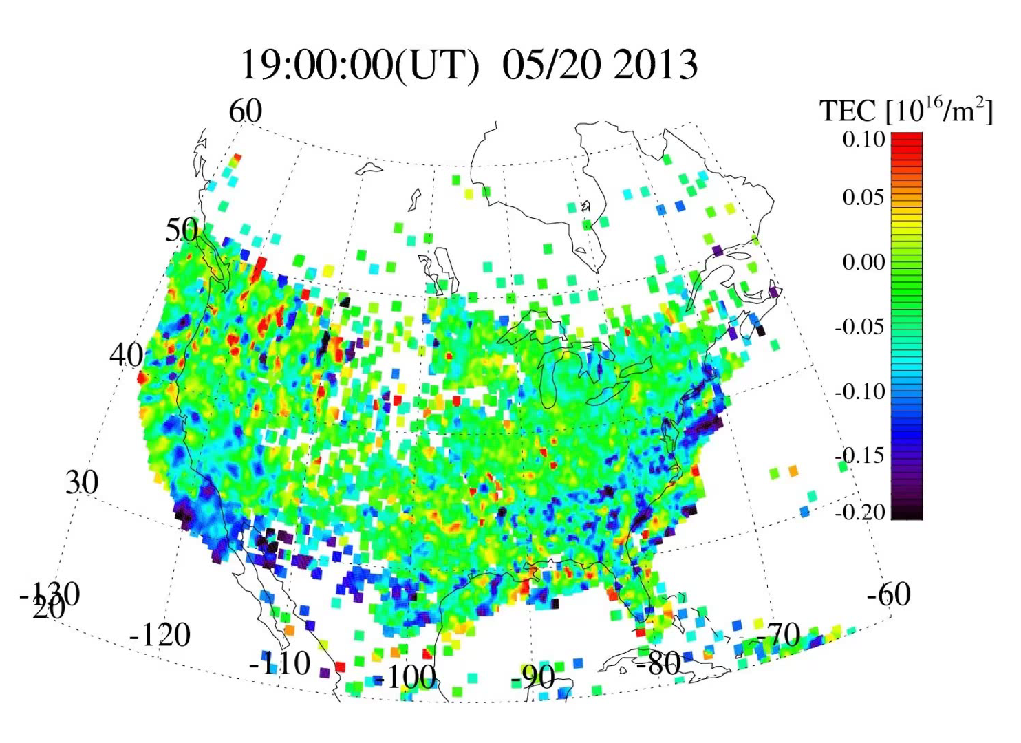
Ionospheric variations after massive tornados

Slide 6
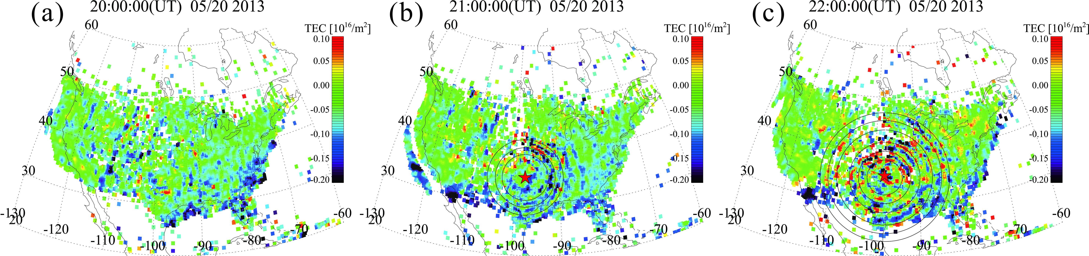
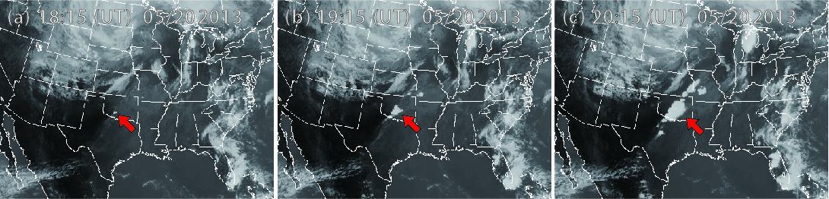
Ionospheric variations after massive tornados
[Nishioka et al., GRL, 2013]
Clear long-lasting concentric waves detected by the high-resolution TEC maps after massive tornados in North America.
The peak-to-peak amplitude was ~1% of the background TEC.

Slide 7
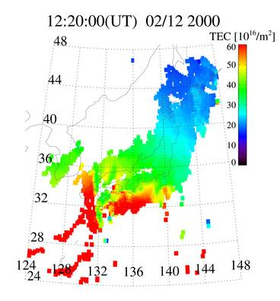
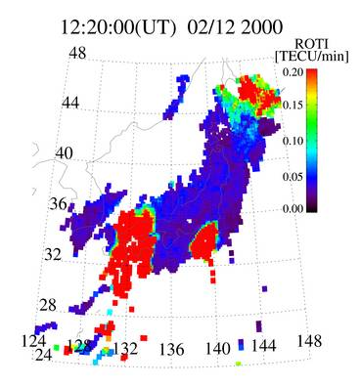
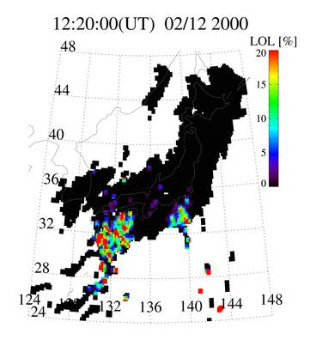
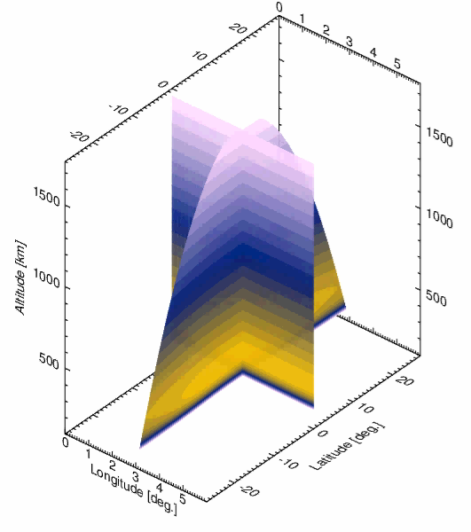
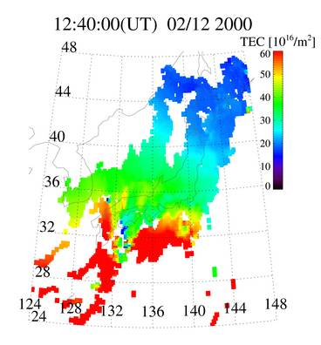
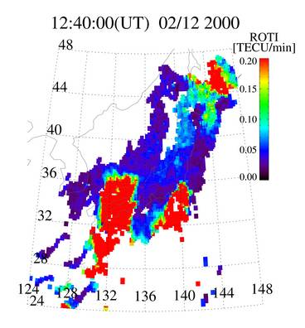
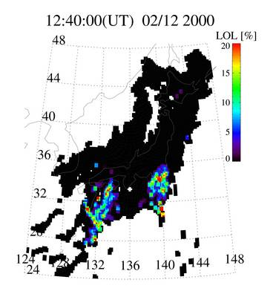
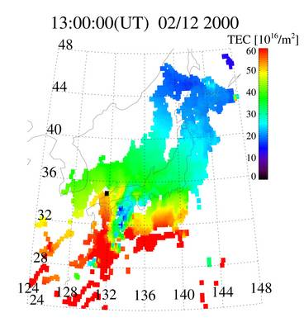
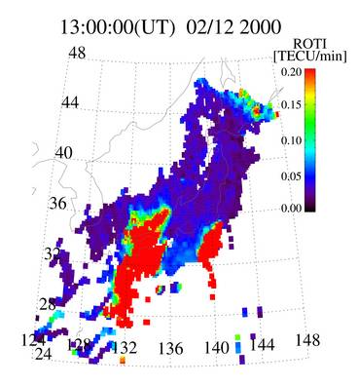
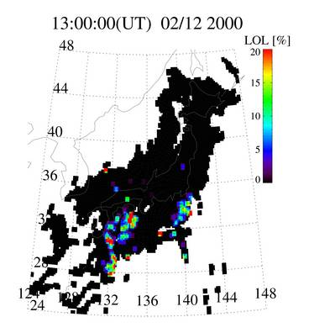
GPS-TEC Observations for Space Weather
Absolute TEC
ROTI (~10km scale irregularity)
Loss-of-Lock (~100m scale irregularity)
12:20 UT
(21:20 JST)
12:40 UT
(21:40 JST)
13:00 UT
(22:00 JST)
3D simulation of plasma bubble [Courtesy of Dr. T. Yokoyama (NICT) ]

Slide 8
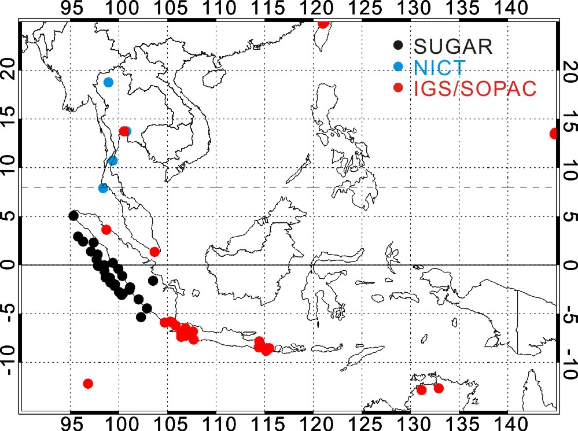
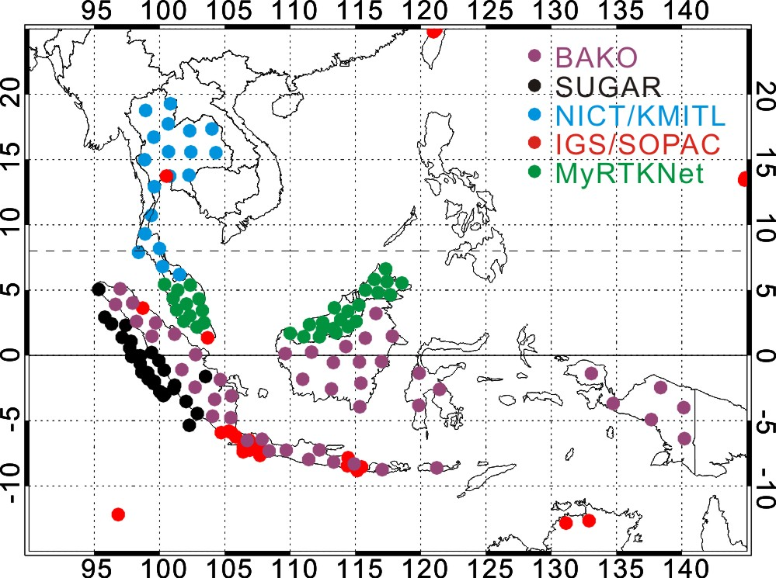
Southeast Asian GNSS Networks
Available for Ionospheric Researches
Present
Near Future Image
TID?
TID
EIA?
EIA
Plasma Bubble?
Plasma Bubble
EIA?
EIA
TID?
TID
The GPS-TEC maps greatly contribute to the ionospheric researches and the nowcast/forecast of space weather.
However, it is difficult for a government and/or a data provider to provide the original GNSS receiver data abroad due to political and/or economic reasons because the raw data of GNSS receiver including multi-frequency carrier phase and psuedorange information are important and valuable

Slide 9
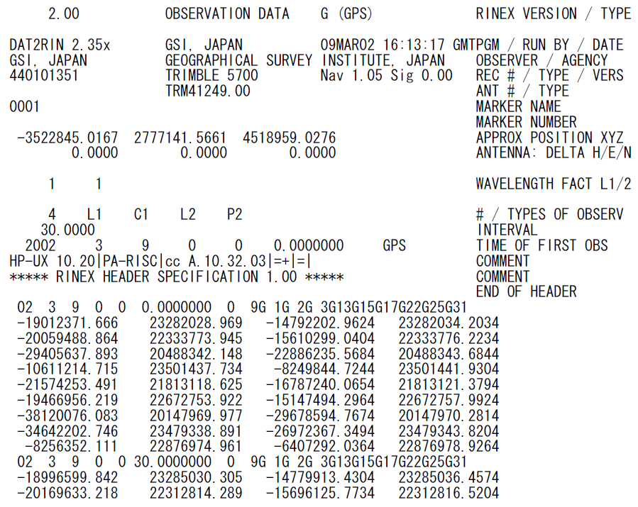
GPS Observation Data （RINEX ver.2 format）
Filename: ssssdddh.yyo
ssss: marker name
ddd: day of the year
h: file sequence number
yy: 2-digit year
Header Part
year, month, day, hour, min, sec, flag, # of PRNs, PRNs
1 epoch
RINEX (Receiver Independent Exchange Format) is a de facto standard in exchanging GNSS observation data and potential users of GTEX would be familiar with RINEX.

Slide 10
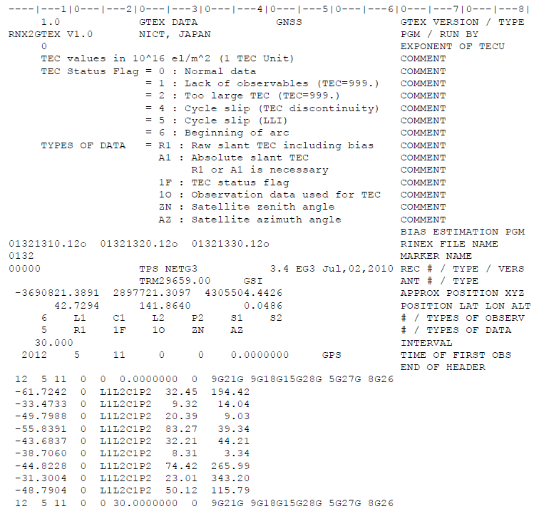
GNSS-TEC exchange (GTEX) format (v1.0)
Filename: ssssdddh.yy_TEC
ssss: marker name
ddd: day of the year
h: file sequence number
yy: 2-digit year
Header Part
RINEX files used to derive slant TEC
Rec. Position in Lat, Lon, Alt
Types of obs. in RINEX
Types of data product
Interval according to RINEX
year, month, day, hour, min, sec, flag, # of PRNs, PRNs
sTEC, TEC flag, Used RINEX observation data, sat. zenith angle, azimuth angle for PRN21
1 epoch

Slide 11
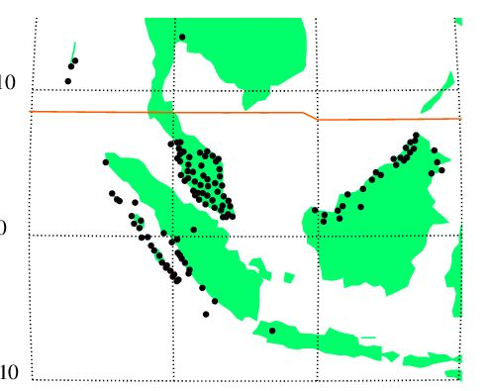
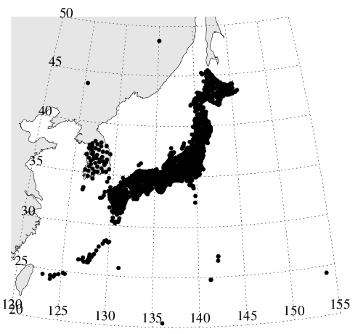
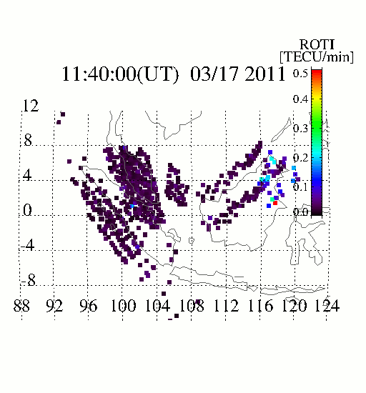
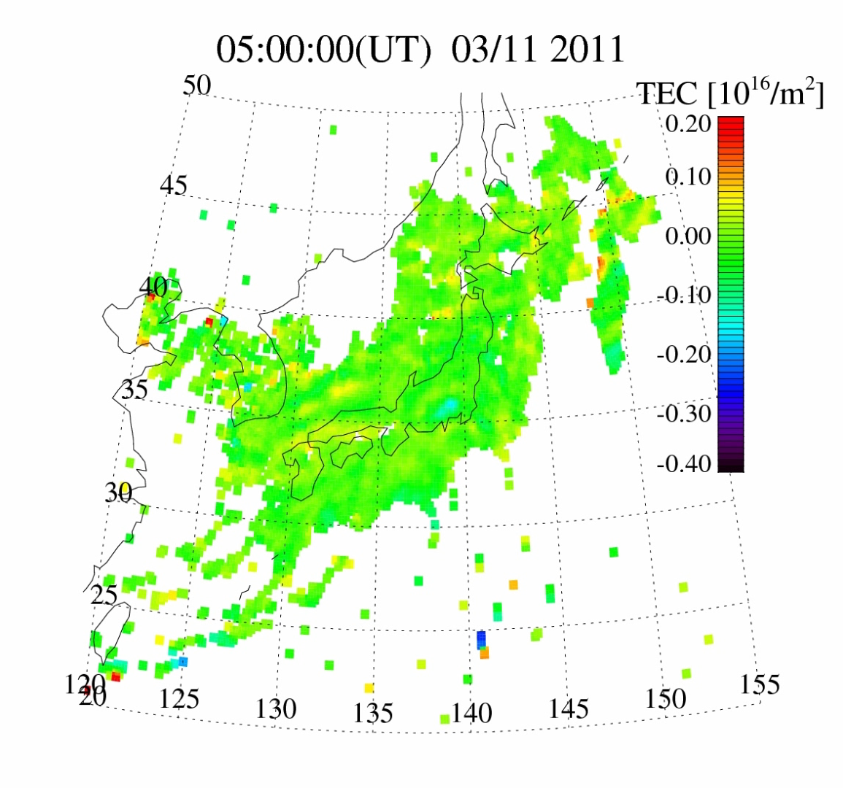
GNSS-TEC data sharing based on GTEX
NICT have developed the database of “GTEX” data for more than 6,000 GNSS receivers in the world. These data are available via the NICT science cloud.
Since the 1st AOSWA workshop, we started sharing the GTEX data among some countries.
GEONET
GPS receiver network in Japan and South Korea.
GTEX data in South Korea were provided by KMA.
MyRTKnet
GPS receiver network from which UKM derived GTEX data
[Courtesy of Suhaila M Buhari (UKM, Malaysia)]
KMA
SuGAr
TEC maps detected concentric structures after the 2011 Tohoku EQ.
ROTI maps detected plasma bubble structures and propagations.

Slide 12
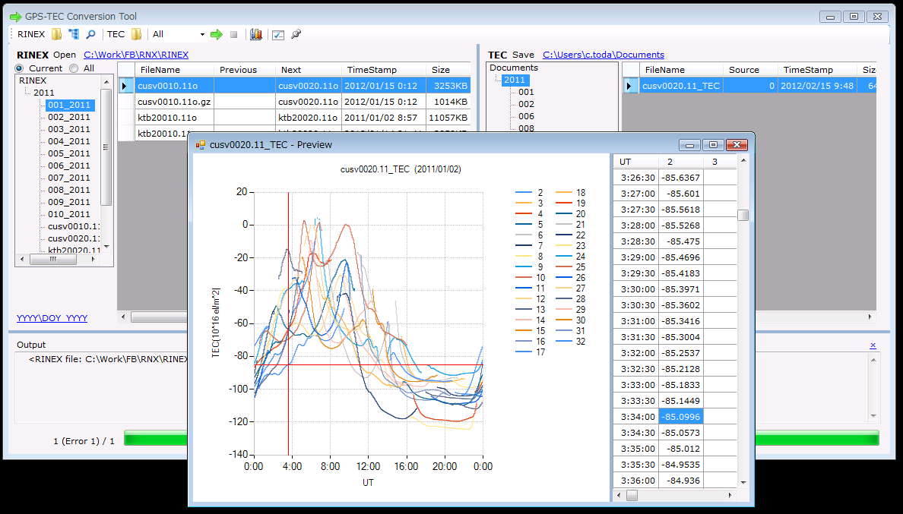
RINEX-to-GTEX Data conversion tool: RNX2GTEX
We have developed software products to convert RINEX data to GTEX data.
RNX2GTEX (ver. 0.1) for Linux/Unix consists in a set of programs written in fortran 77 and a shell script. The RNX2GTEX for Linux/Unix is available from the website:
http://seg-web.nict.go.jp/GPS/DRAWING-TEC/software/RNX2GTEX.tgz
RNX2GTEX for Windows XP/Vista/7 is also available from the website:
http://seg-web.nict.go.jp/GPS/DRAWING-TEC/software/RNX2GTEX_WIN.zip
NICT has developed the database of GTEX (ver. 0.1) derived from all the available online GNSS receiver data from 2000 to the current. This database is available via NICT Science Cloud (http://sc-web.nict.go.jp/ ) .
RNX2GTEX for Windows is an application for creating GTEX data files from RINEX data using explorer-like GUI.

Slide 13
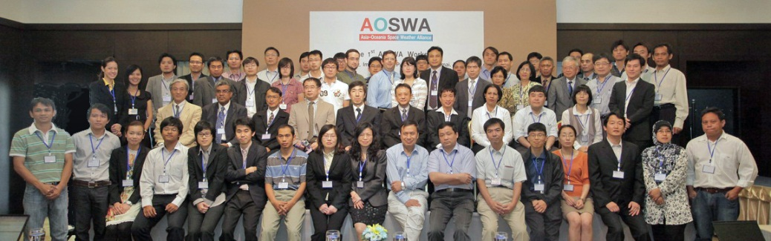
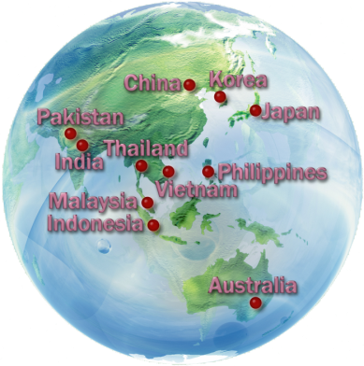
Asia-Oceania Space Weather Alliance: AOSWA
http://aoswa.nict.go.jp
Objective: make a regional linkage of information of space weather for operations and researches
GTEX data sharing is one of important topics.
The 1st AOSWA workshop at Chiang Mai, Thailand during 22-24 February 2012.
- 10 countries, 30 organizations, 76 participants
- 41 oral presentations, 21 poster presentations, 1 tutorial lecture
The 2nd AOSWA workshop at Kunming, China will be held in
4-7 Nov 2013, hosted by CSERF and CAS.

Slide 14
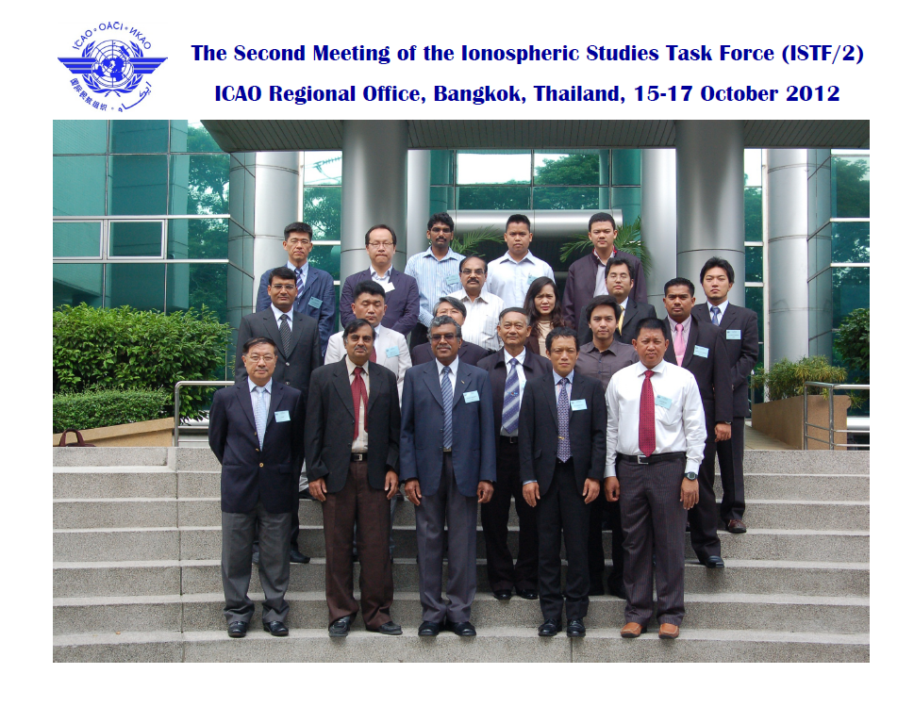
ICAO Asia and Pacific
Ionospheric studies task force (ISTF)
ICAO plans to use aviation navigations based on GNSS, such as GBAS and SBAS. ICAO recognizes a necessity to evaluate the ionospheric effects on such navigations.
ICAO Asia and Pacific have discussed about the effect of low-latitude ionospheric disturbances such as plasma bubble since 2009 and established the ionospheric studies task force (ISTF) in July 2011.
In the 2nd meeting of ISTF held at Bangkok in Oct. 2012, the ionospheric data format for data sharing among countries were discussed.
The GTEX format proposed by Japan (ENRI, NICT) were adopted as the sharing format in ISTF.

Slide 15
International Telecommunication Union Radiocommunication Sector (ITU-R)
NICT, as a delegate of Japan, proposed “GTEX” as a format to promote international exchange and sharing of GNSS-TEC data in an input document to a meeting of Working Party 3L (ionospheric propagation and radio noise), Study Group 3 (radiowave propagation) of International Telecommunication Union Radiocommunication Sector (ITU-R) in June 2013 at Geneva, Switzerland.
The document was discussed in the larger context of the need to incorporate new digital products and SG3DB tables (Study Group 3 databanks of radiowave propagation measurement data) .
The definition and explanation of GTEX format was included in a Chairman’s report towards the definition of new digital products for transionospheric propagation. The Chairman’s report also included “IONEX” and “SCINTEX” format. The definition of digital products was added to the list of future work programme in Working Party 3L.

Slide 16
Summary
High-resolution TEC observations using dense GNSS receiver networks can be a powerful tool to monitor and research medium-scale (~100-1,000 km) ionospheric disturbances such as plasma bubble.
We propose a data format, GTEX, to promote international exchange and sharing GNSS-TEC data to expand observation area of high-resolution TEC maps.
We have discussed about GTEX data sharing at AOSWA and started data sharing among some countries.
The GTEX has been adopted as the basis of ionospheric data sharing by ICAO/ISTF and included in a Chairman’s report of ITU-R WP3L.

