Slide 1
ISES Director’s Report
Terry Onsager, April 9, 2015
• Accomplishments
• Actions from 2014 Annual Meeting
• Complementary Activities
• Challenges

Slide 2
Accomplishments
• WMO Information System Pilot Project – Flare forecast metadata defined and registered in WIS. RWC Australia forecasts available
• ISES Centers have indicated numerous new data, products, and services being offered – summarized in ISES/ICSU Biennial Report
• ISES-WMO Exchange-of-Letters text finalized – Awaiting letter from WMO
• ISES members contributed substantially to the WMO four-year plan and to the COSPAR space weather roadmap
• Others?

Slide 3
Actions from 2014 Annual Meeting (1 of 2)
Action 1: Post all of the relevant documents on the ISES webpage for easy access. (Completed)
Action 2: ISES members are encouraged to stay informed of the actions that will be decided by ICAO and to participate through the appropriate organizations as needed. (Ongoing)
Action 3: Investigate XML/GML as a format for space weather products in WIS and recommend if this format should be used in the WIS pilot project. (Completed – XML Metadata created)
Action 4: Define the metadata format, register the test products in WIS through DCPCs, and test the use of WIS to submit and to retrieve space weather products. (Ongoing)

Slide 4
Actions from 2013 Annual Meeting (2 of 2)
Action 5: Compile and distribute a document that indicates all text changes between the original and the current ISES Constitution and supporting documents for review and discussion by all Members, with final text to be ratified by vote at the 2015 ISES Annual Meeting. (To be discussed at this meeting)
Action 6: Draft and recommend an approach for describing a set of products and their regions of applicability for inclusion on the ISES web site. (To be discussed at this meeting)
Action 7: Recommend a set of common products and information that should be exchanged in machine-readable format, and recommend a format for exchange (e.g., current ISES codes or WIS Pilot Project format) and a format for display on the ISES web page. (To be discussed at this meeting)
Action 8: Organize a forecast verification workshop to be held in conjunction with the U.S. Space Weather Workshop to explore forecast verification techniques and metrics that could be applied in a consistent manner among RWCs. (Completed)

Slide 5
Complementary Activities
• World Meteorological Organization
– Strong overlap and synergy with ISES
• International Civil Aviation Organization
– Opportunity and challenge to establish coordinated global and regional capability
• Coordination Group for Meteorological Satellites (CGMS)
- Increasing emphasis on space weather
• UN Committee on the Peaceful Uses of Outer Space (UNCOPUOS)
- Draft guidelines being adopted for space weather
- Space Weather Expert Group formed

Slide 6
UNCOPUOS Space Weather Expert Group
• Mandate:
– To promote awareness, provide guidance, and enable communication and cooperation in space weather related activities among Member States and related national and international organizations.
• Work Plan (abbreviated):
– Promote the implementation of guidelines and recommendations
– Inventory relevant organizations and promote coordination
– Promote involvement in space weather services
– Report annually on progress

Slide 7
Challenges
From November, 2011 – ISES Director Candidacy Compliance Submission
(Note: My four-year term as ISES Director will end at the 2016 meeting.)
Three major challenges face ISES:
1. Utilizing our network of Regional Warning Centers to enhance our global and regional capabilities;
2. Coordinating with the other international organizations that are becoming engaged in space weather services, such as the WMO;
3. Solidifying our institutional affiliation within the World Data System or other appropriate organization.
What should our priorities be to improve our products and services through cooperative ISES activities?

Slide 8
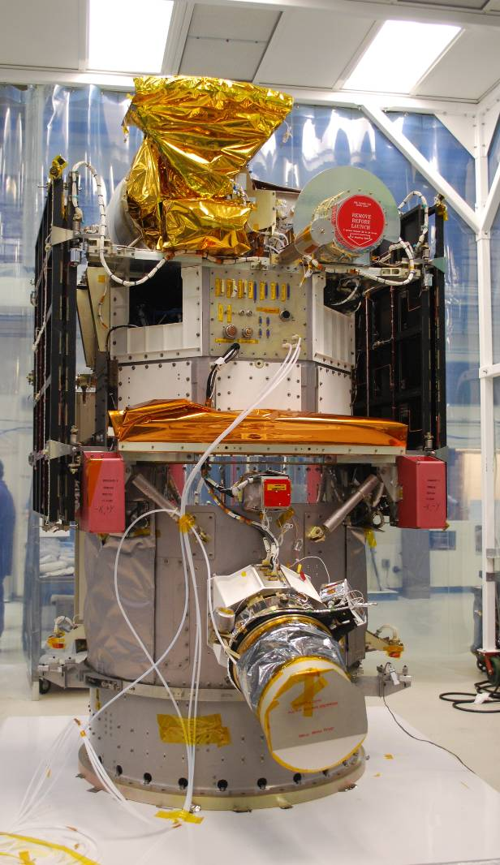
Deep Space Climate Observatory (DSCOVR) Solar Wind Mission
Launched February, 2015
  Space weather is the primary mission; climate is secondary
  Faraday cup: solar wind density, speed, temperature
  Electron electrostatic analyzer
  Magnetometer
  International network of real-time receiving antennas: Germany, Japan, South Korea, U.S.
  Real-time data processed and provided by NOAA

Slide 9
Research and Modeling Priorities
• Improved accuracy of 1-4 day forecasts of geomagnetic storms
• Localized specifications and forecasts of the impacts of geomagnetic storms at ground level
• Forecasts of ionospheric conditions relevant to GNSS users
• Specifications and forecasts of the radiation environment for satellites and commercial aircraft
• Improved probability of solar active-region eruption, including flare x-rays and energetic particles

Slide 10
High-Priority Needs for Real-Time Data
In Approximate Priority Order
• Back-up of space-based solar and solar wind measurements
- Receiving antennas for real-time data (e.g., DSCOVR, STEREO, etc.)
- Coronagraph, solar E/M emissions, solar wind plasma and mag field
• Off Sun-Earth-line coronagraph (e.g., L5)
• Ionospheric measurements (ground-based and space-based)
- Global TEC, scintillation, FUV images, electron density profile
• Magnetospheric in-situ measurements
- Energetic electrons and protons, low energetic electrons, mag field
• Earth-surface magnetic field
- Global ground magnetometer data

