Slide 1

State-of-the-art in (terrestrial) weather forecast verification and tools and resources
Barbara Brown (bgb@ucar.edu) and
Tara Jensen (jensen@ucar.edu)
Research Applications Laboratory
National Center for Atmospheric Research
Boulder CO USA
ISES Forecast Verification Workshop
Boulder, Colorado
11 April 2015

Slide 2

What’s new?
“Organized” community
  Verification as a research topic
User-focused verification
New methods
  Ensembles
  Extremes
  Measuring uncertainty
  Spatial approaches
  New graphics for traditional methods
Tools!
  Model Evaluation Tools (MET)
  R verification library
Resources
  Books
  Web pages
  Workshops
  Tutorials/training

Slide 3
User-focused forecast evaluation approaches
Basic level
  Ask what are the questions of interest (not just the variables to be verified)
  Identify a suite of methods/metrics to answer the questions of interest
Moderate level
  Apply diagnostic approaches that use “event-based” approaches (spatial and temporal events)
Highest level
  Evaluate usefulness or value

Slide 4
Good forecast or bad forecast?
F
O
Many verification approaches would say that this forecast has NO skill and is very inaccurate.

Slide 5
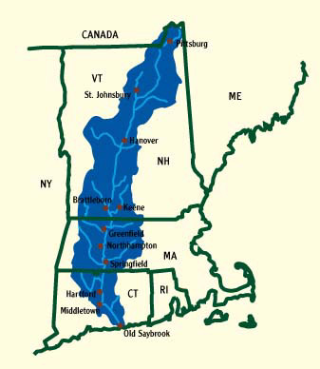
Good forecast or Bad forecast?
If I’m a water manager for this watershed, it’s a pretty bad forecast…
F
O

Slide 6
Good forecast or Bad forecast?
F
O
A
Flight Route
B
O
If I’m an aviation traffic strategic planner…
Different users have different ideas about what makes a forecast good
It might be a pretty good forecast
Different verification approaches can measure different types of “goodness”

Slide 7
Ensemble forecast methods

Slide 8
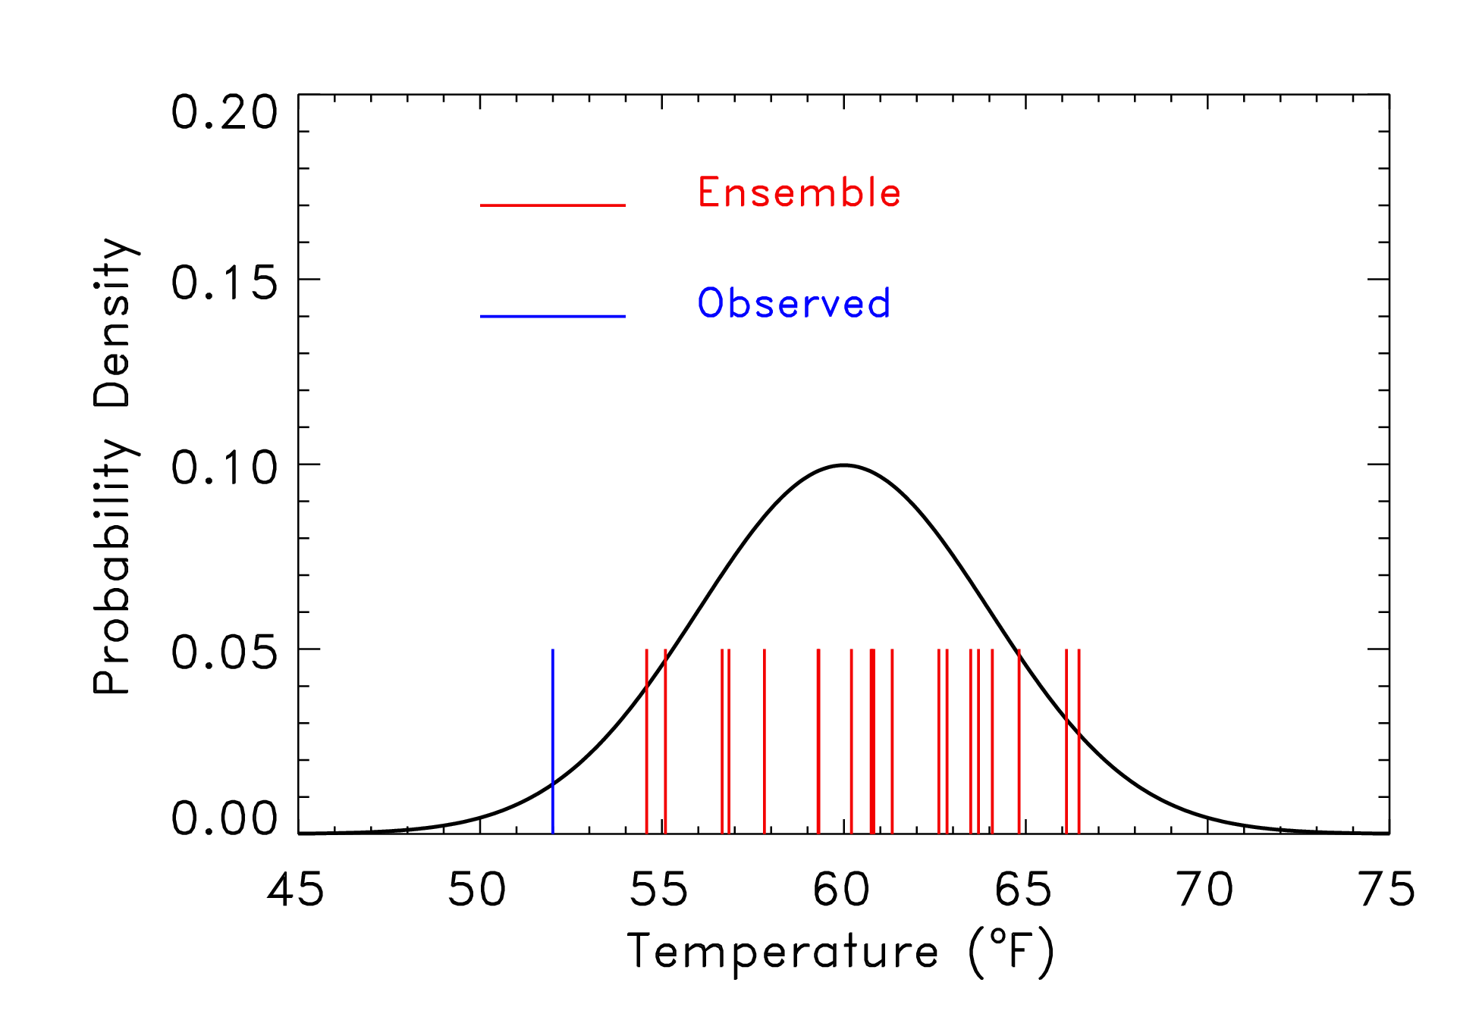
How good is this ensemble forecast?

Slide 9
Approaches for ensemble evaluation
Treat ensemble as deterministic forecast (individual members, mean forecast etc.)
  Use “traditional” approaches for evaluation of deterministic forecasts (contingency table, scores for continuous forecasts)
  Can learn about differences among members (e.g., if members are defined uniquely)
Create probability forecasts
  Post-process ensemble to obtain probabilities
  Evaluation considers both the ensemble and the post-processing
Whole distribution
  Allows direct evaluation of the ensemble generation process

Slide 10
Measure | Attribute evaluated | Comments
Probability forecasts
Brier score | Accuracy | Based on squared error
Resolution | Resolution (resolving different categories) | Compares forecast category climatologies to overall climatology
Reliability | Calibration
Skill score | Skill | Skill involves comparison of forecasts
Sharpness measure | Sharpness | Only considers distribution of forecasts
ROC | Discrimination | Ignores calibration
C/L Value | Value | Ignores calibration
Ensemble distribution
Rank histogram | Calibration | Can be misleading
Spread-skill | Calibration | Difficult to achieve
CRPS | Accuracy | Squared difference between forecast and observed distributions Analogous to MAE in limit
log p score | Accuracy | Local score, rewards for correct category; infinite if observed category has 0 density

Slide 11
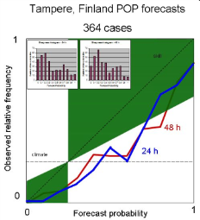
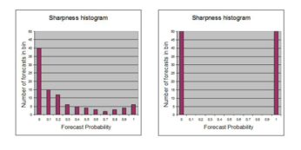
Diagrams for evaluating probability and ensemble forecasts
Probability forecasts
Reliability (or attributes) diagram
Sharpness
Discrimination
ROC
Ensemble forecasts
Rank histogram
(Spread-skill)
observed
non-events
observed
events
frequency
forecast

Slide 12
Measuring uncertainty in verification metrics

Slide 13
Accounting for Uncertainty
Observational
Model
  Model parameters
  Physics
  Etc…
Sampling
  Verification statistic is a realization of a random process.
  What if the experiment were re-run under identical conditions?
  Impact of small sample sizes
Accounting for these other areas of uncertainty is a major research need

Slide 14
Hypothesis Testing and Confidence Intervals
Example: The difference in bias between two models is 0.01.
Hypothesis test:
Is this different from zero?
Confidence interval:
Does zero fall within the interval?
Does 0.5 fall within the interval?
How wide is the interval?

Slide 15
Confidence Intervals (CI’s)
Parametric
  Example: Normal approximation
  Quick and easy.
Nonparametric
  Assume observed sample is representative of the population distribution.
  Bootstrap CI’s
  Take advantage of computer power…
Need to account for non-independence of data

Slide 16
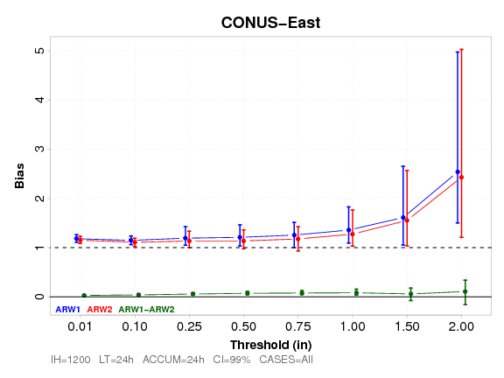
Confidence interval example (bootstrapped)
Significant differences may show up in differences but not when looking at overlap in confidence intervals
Sometimes significant differences are too small to be practical – need to consider practical significance

Slide 17
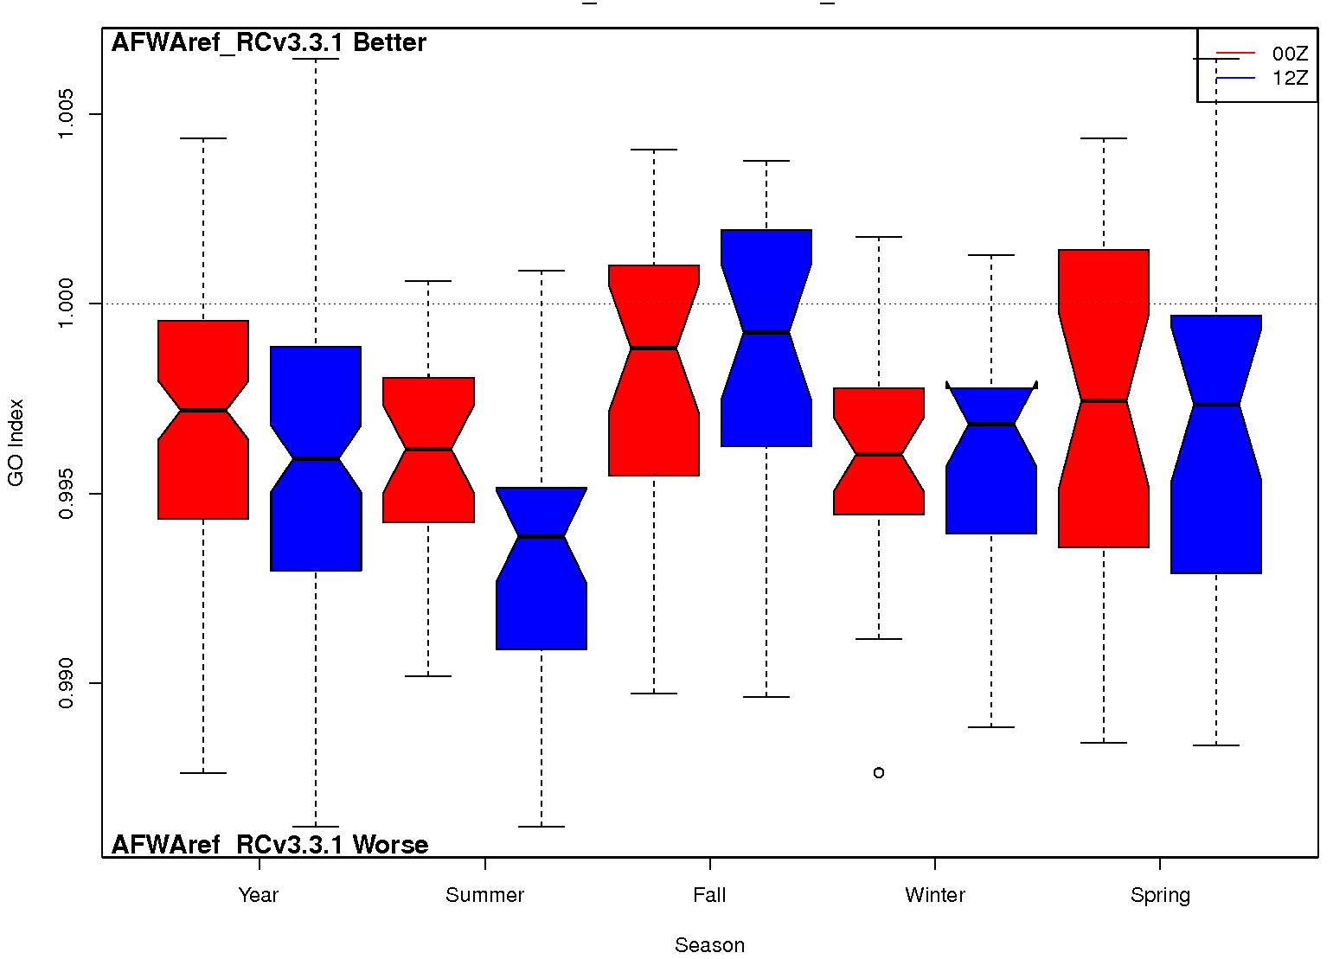
Alternative approach: Look at distributions
Example: GO Index (summary index)
Line at 1 discriminates between one model performing better than the other
Model 1 better
Model 2 better

Slide 18
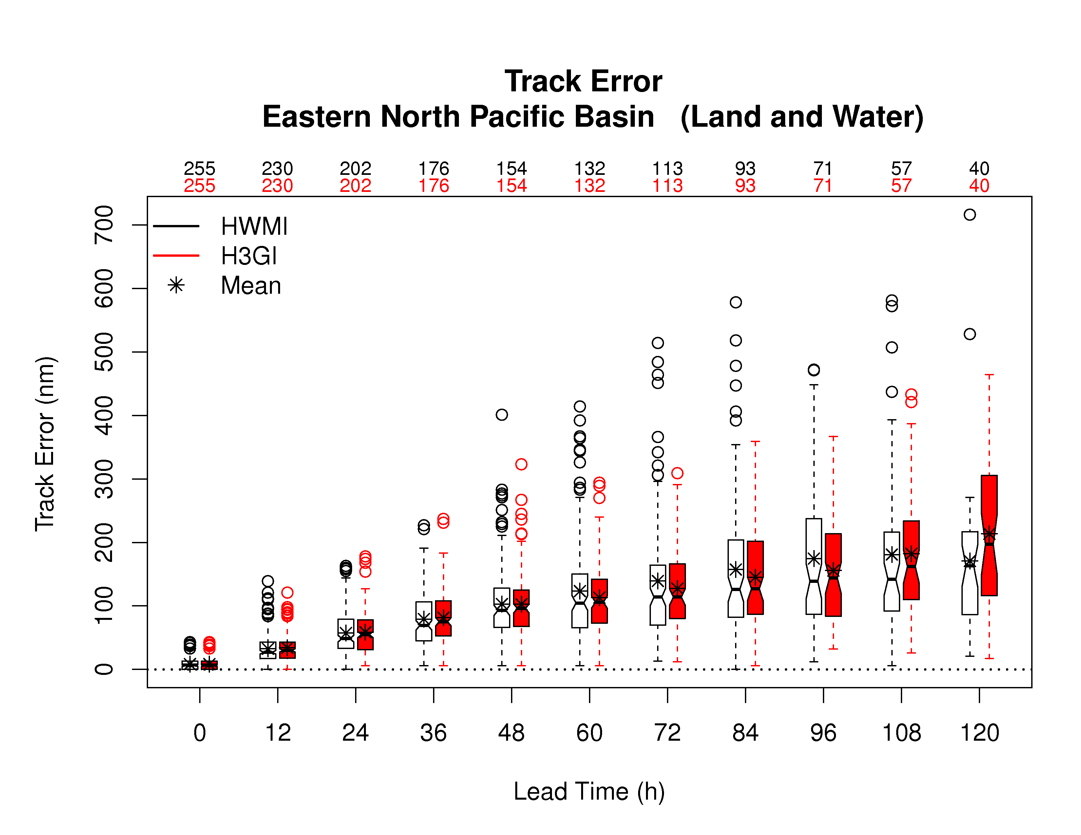
Error Distributions: Box Plots
HWRF
Example

Slide 19
Spatial methods

Slide 20
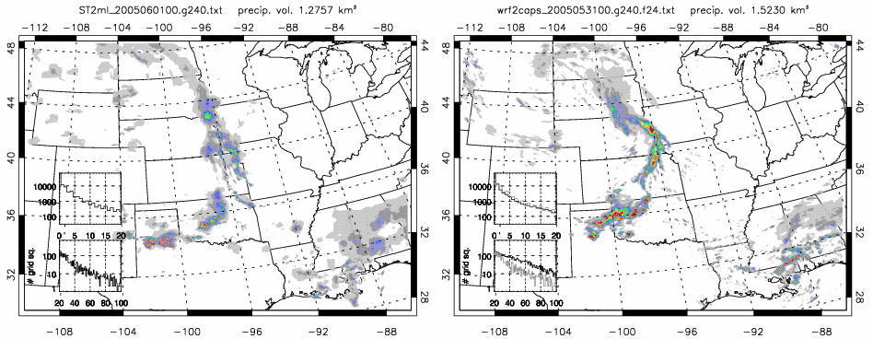
Spatial fields
Many weather variables defined over spatial domains have coherent spatial structure and features
Traditional verification approaches ignore this structure
WRF
model
Stage II
radar

Slide 21
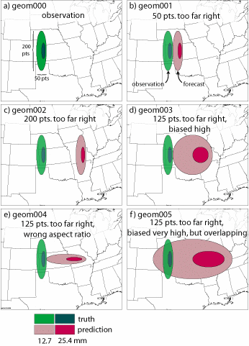
Traditional approach
Consider gridded forecasts and observations of precipitation
OBS
1
Which is better?
2
3
4
5
Notes:
These are the geometric cases from the ICP – but you don’t need to mention that here.
Just say that these are artificial precipitation forecasts and observations. The graphs are pretty self-explanatory.
The upper left is the observed field, the others show various forecasts to be compared to the obs.

Slide 22
Traditional approach
Scores for Examples 1-4:
Correlation Coefficient = -0.02
Probability of Detection = 0.00
False Alarm Ratio = 1.00
Hanssen-Kuipers = -0.03
Gilbert Skill Score (ETS) = -0.01
OBS
1
Scores for Example 5:
Correlation Coefficient = 0.2
Probability of Detection = 0.88
False Alarm Ratio = 0.89
Hanssen-Kuipers = 0.69
Gilbert Skill Score (ETS) = 0.08
2
3
4
5
Forecast 5 is “Best”
Notes:
This is a summary of the “traditional” results for the artificial cases. Basically all results point to Forecast 5 being the best.
Whether Forecast 5 actually IS the best, of course, depends on the user. But many users (I believe) would NOT prefer this forecast over Forecast 1 (i.e., part b in the graph)

Slide 23
What are the issues with the traditional approaches?
“Double penalty” problem
Scores may be insensitive to the size of the errors or the kind of errors
Small errors can lead to very poor scores
Forecasts are generally rewarded for being smooth
Verification measures don’t provide
  Information about kinds of errors (Placement? Intensity? Pattern?)
  Diagnostic information

Slide 24
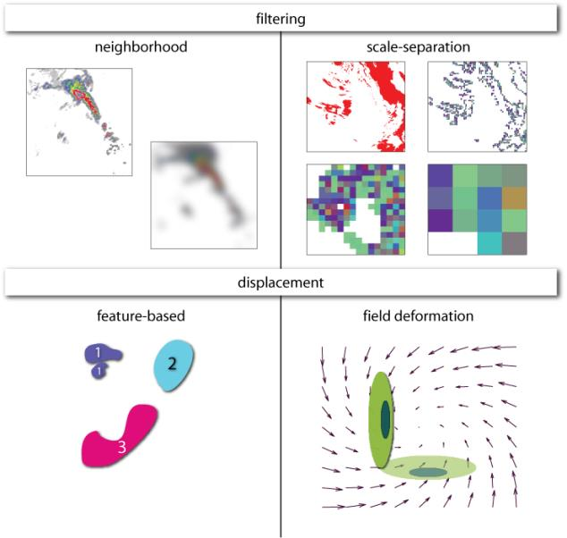
Spatial Method Categories
Notes:
This is a summary of the types of spatial methods that are available.
The 2 main categories are “filtering” and “displacement” methods
Each of these can be further sub-divided into 2 categories, as shown above.
More details on these categories are presented in the next slide, so you can go through this slide pretty quickly.

Slide 25

New spatial verification approaches
Neighborhood
Successive smoothing of forecasts/obs
Gives credit to "close" forecasts
Scale separation
Measure scale-dependent error
Field deformation
Measure distortion and
displacement (phase error) for
whole field
  How should the forecast be
  adjusted to make the best match
  with the observed field?
Object- and feature-based
Evaluate attributes of
identifiable features

Slide 26
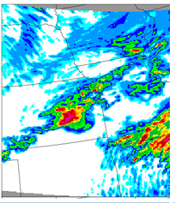
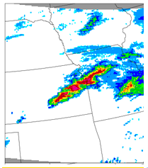
Typical situation
6hr accumulated precip
Forecast
Observation
Object verification mimics what human brain does.
It recognizes the spatial relationship between points.

Slide 27
Comparing objects can tell you things about your forecast like . . .
This: | Instead of this:
30% Too Big (area ratio=1.3) | POD = 0.35
Shifted west 1 km (centroid distance = 1km) | FAR = 0.7235
Rotated 15° (angle diff = 15%) | CSI = 0.1587
Peak Rain 1/2” too much (diff in 90th percentile of intensities = 0.5)

Slide 28
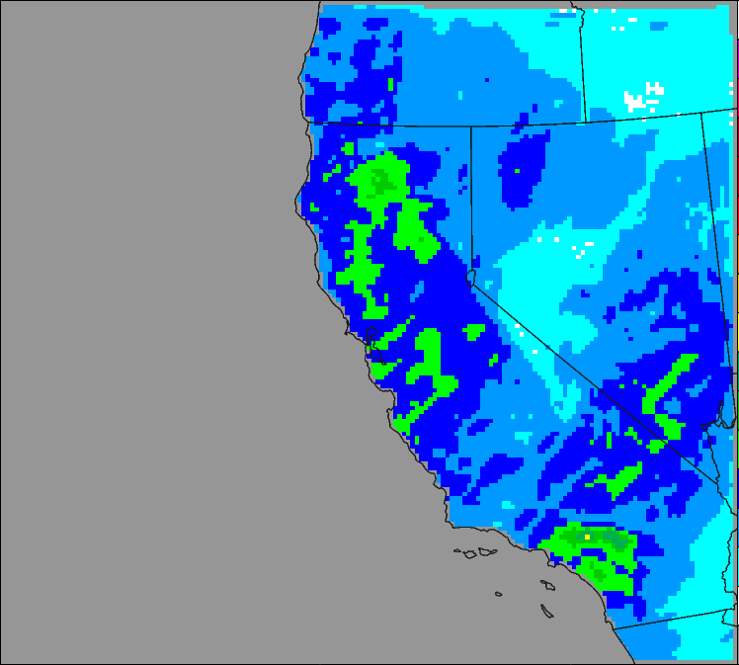
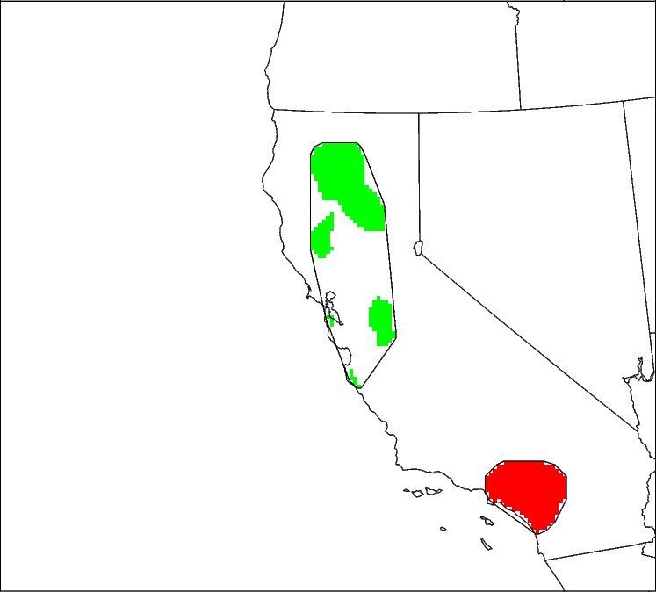
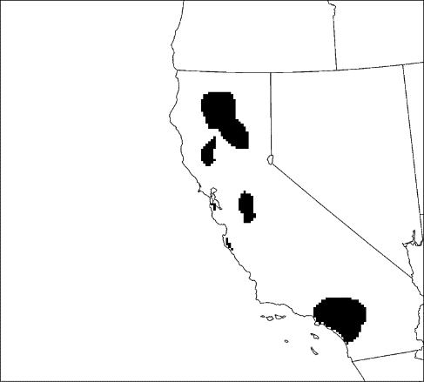
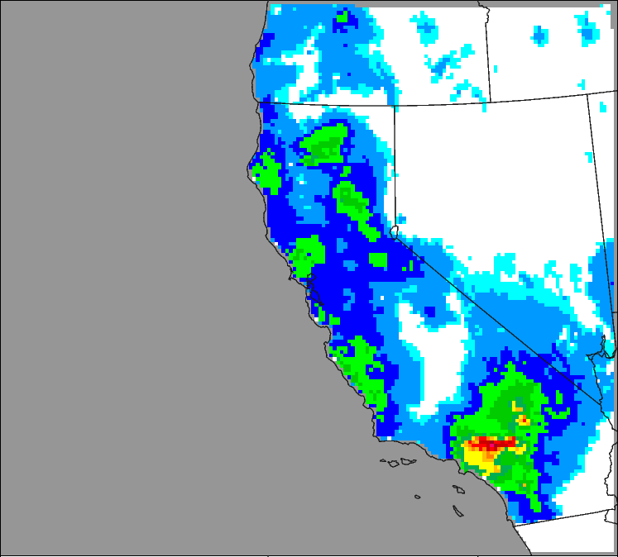
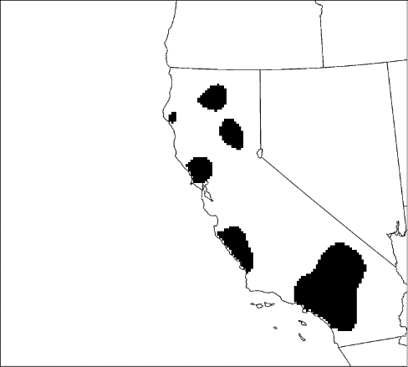
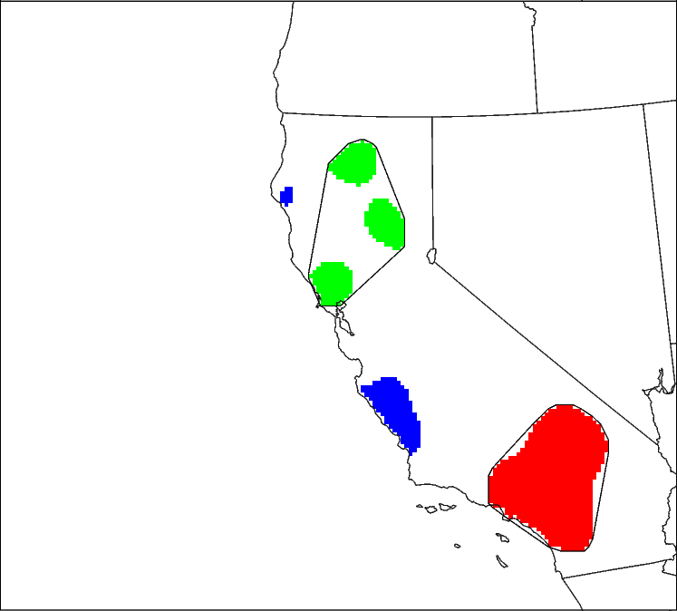
Method for Object-based Diagnostic Evaluation (MODE)
How it works
  Matched Object 1
  Matched Object 2
  Unmatched Object
ENS FCST
OBS
Radius=5
ObjectThresh
>6.35 mm
MergingThresh
>5.7 mm
Radius=5
ObjectThresh
>6.35 mm
MergingThresh
> 5.7 mm
Merging
Merging
No false alarms
Misses
Matching
Notes:
Precipitation fields are smoothed using a user specified radius.
The smoothed fields are then thresh-holded to form objects.
MODE then acts on the individual fields to merge objects into clusters, which in this case is done by using a second lower threshold – the rubber band and coloring indicate the merged clusters.
MODE then compares the objects and clusters between fields and calculates an interest value and matches based on these.
MODE compares gridded model data to gridded observations and can be used as a basis for development of diagnostic verification metrics that can provide quantitative measures of uncertainty.

Slide 29
Use of Attributes of Objects defined by MODE
Forecast
Field
Observed
Field
Centroid Distance: Provides
a quantitative sense of spatial
Displacement.
Small is good
Axis Angle: Provides an objective measure of how well the objects are aligned. Small is good
Obs
Area
Area Ratio: Provides an
objective measure of whether
there is an over- or under-
prediction of areal extent.
Close to 1 is good
Area Ratio =
Fcst Area
Obs Area
Fcst
Area

Slide 30
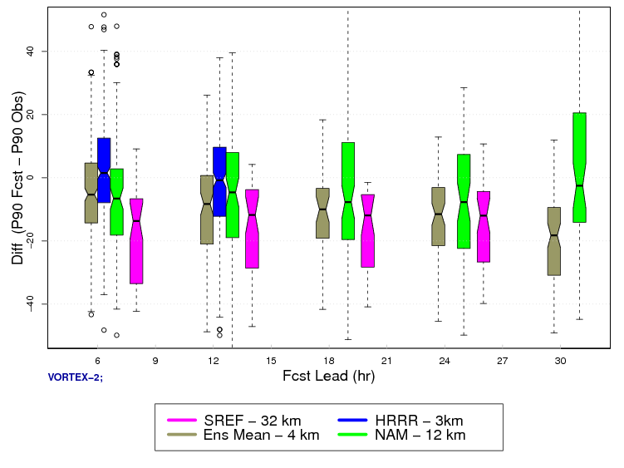
6hr Accumulated Precipitation Near Peak (90th%)
Intensity Difference (Fcst – Obs)
Overforecast
High Resolution
Deterministic
Does Fairly Well
Difference(P90 Fcst – P90 Obs)
High Resolution
Ensemble Mean
Underpredicts
Mesoscale
Deterministic
Underpredicts
Mesoscale
Ensemble
Underpredicts
the most
Underforecast

Slide 31
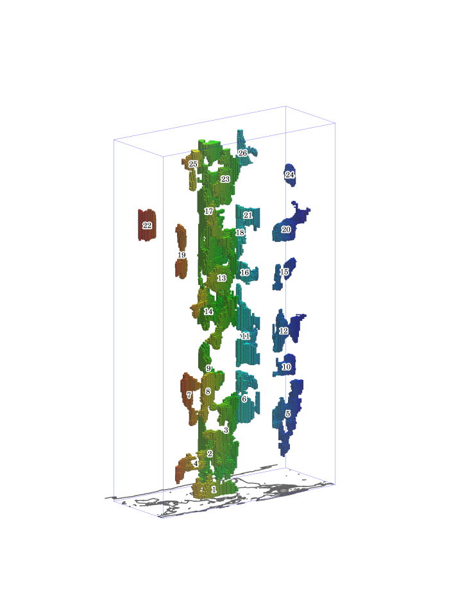
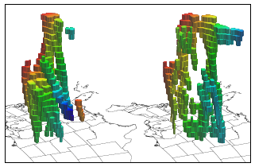
MODE Time DOMAIN
X, Y, Time
Great tool for high temporal resolution to look at forecast consistency and evolution

Slide 32
tools

Slide 33
Method availability
R verification libraries
  Traditional and spatial
  Freely available statistic package
Model Evaluation Tools (MET)
  Available at http://www.dtcenter.org/met/users/
  Implemented and supported by the Developmental Testbed Center and staff at the Joint Numerical Testbed Program at NCAR/RAL

Slide 34
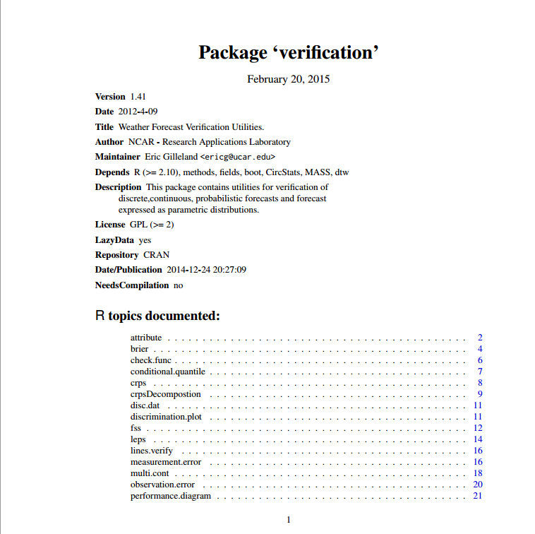
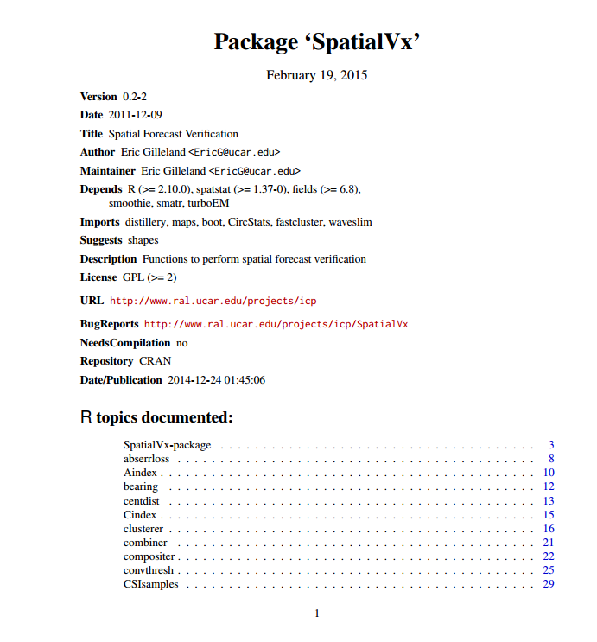
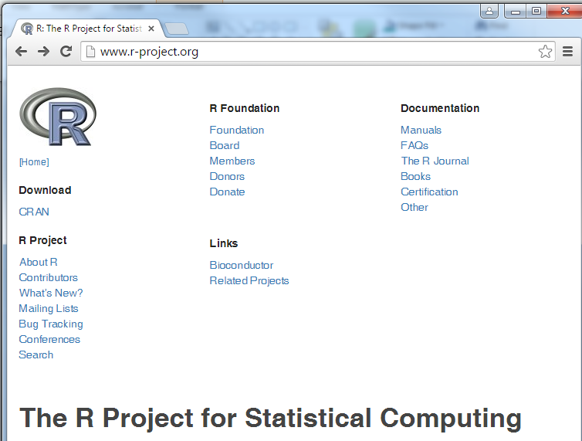
R verification libraries
R is available at http://www.r-project.org/
Maintained and supported by Eric Gilleland (NCAR)

Slide 35
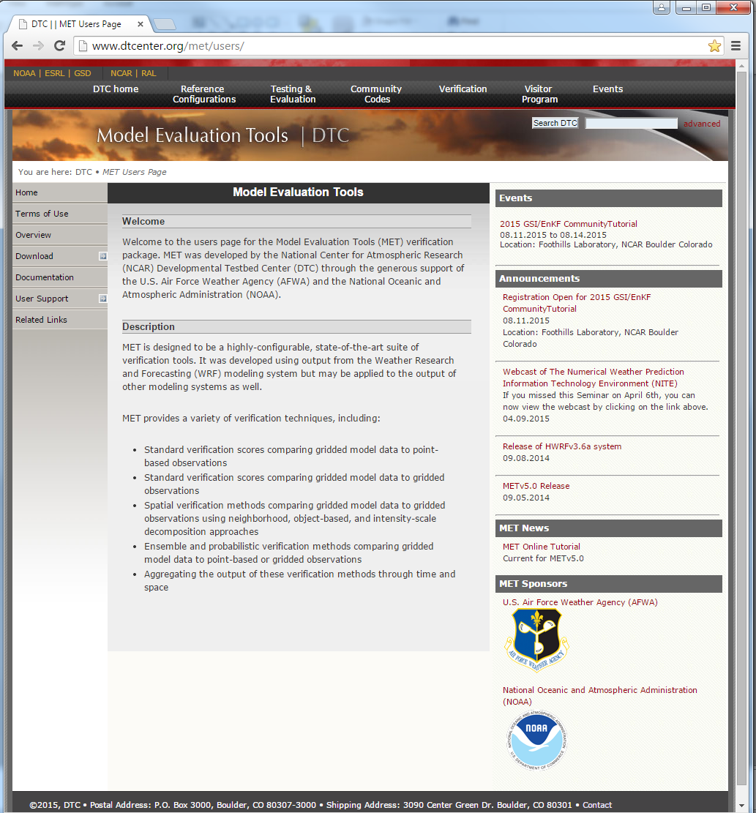

Model Evaluation Tools
Modular forecast evaluation tools
Traditional and advanced methods
Gridded obs and point obs
Freely available
Highly configurable
Fully documented
Supported via the web, met_help@ucar.edu, and on-line and “live” user tutorials
Supported by the Developmental Testbed Center (DTC)
http://www.dtcenter.org/met/users/

Slide 36
MET…
Is a state-of-the-art forecast evaluation system
Includes
  a full Suite of Standard Statistics
  a variety of non-Traditional Statistics (e.g., spatial methods)
  diagnostic capabilities
Is designed to undertake systematic evaluations
Is used internationally
Has a database and display system for aggregating and plotting data (currently limited release)
Provides a standardized evaluation platform for
cross-institution comparisons

Slide 37
MET v5.0 Overview
New Tool
New Output
Input
Reformat
Plot
Statistics
Analysis
MET-TC
Gridded
Model
Forecasts
and
Observation
Analyses
Gen
Masks
NetCDF
Mask
File
Plot
MODE
Field
PNG
MODE
ASCII
NetCDF
PS
Land
Data
File
PCP
Combine
MODE
Analysis
Plot
Data
Plane
Wavelet
Stat
STAT
ASCII
NetCDF
PS
NetCDF
DLand
TC
DLAND
MODIS
Data
MODIS
Regrid
Gridded
NetCDF
Grid
Stat
STAT
ASCII
NetCDF
ASCII
TC
PAIRS
ATCF
Track
Data
TRMM
Point Obs
TRMM
2NC
WWMCA
Plot
Series
Analysis
NetCDF
Stat
Analysis
TCST
Pairs
WWMCA
Data
WWMCA
Regrid
Plot
Point
Obs
Ensemble
Stat
STAT
ASCII
NetCDF
TC
STAT
ASCII
Point Obs
ASCII
2NC
NetCDF
Point
Obs
Point
Stat
STAT
ASCII
ASCII
PrepBufr
Point Obs
PB2NC
PS
MADIS
Point Obs
MADIS
2NC
Notes:
37

Slide 38
Data | MET Tool
Gridded Forecasts Gridded Observations | Grid Stat (traditional or neighborhood) Ensemble Stat Wavelet Stat MODE Series Analysis Stat Analysis
Gridded Forecasts Point Observations | Point Stat Ensemble Stat Stat Analysis
Point Forecasts Point Observations | TC Pairs TC Stat

Slide 39
MET Categorical and Continuous Statistics
Continuous | Categorical / Multi-Categorical
Forecast Mean Forecast Standard Deviation Observation Mean Observation Standard Deviation Pearson Correlation Coefficient (aka Correlation) Spearman’s Rank Correlation Kendall’s Tau statistic Number of ranks used in Kendall’s tau Number of tied forecasts in Kendall’s tau Number of tied observations in Kendall’s tau Mean error Standard Deviation of error 10th, 25th, 50th, 75th, 90th Percentile of Error Interquartile Range Multiplicative Bias (aka Bias) Mean Absolute Error Mean Square Error Bias-corrected Mean Square Error Root Mean Square Error Mean Absolute Deviation | Total number of matched pairs Contingency Table Counts Forecast rate Hit rate Observation rate Base rate Forecast mean Accuracy Frequency Bias Probability of Detection – Yes Probability of Detection – No Probability of False Detection (aka False Alarm Rate) False Alarm Ratio Critical Success Score (aka Threat Score) Gilbert Skill Score (aka Equitable Threat Score) Bias-Adjusted Gilbert Skill Score Odds Ratio Log-Odds Ratio Odds-Ratio Skill Score Hanssen-Kuipers Discriminant Heidke Skill Score Extreme Dependency Score Symmetric Extreme Dependency Score Extreme Dependency Index Symmetric Extreme Dependency Index
25 Statistics
24 Statistics

Slide 40
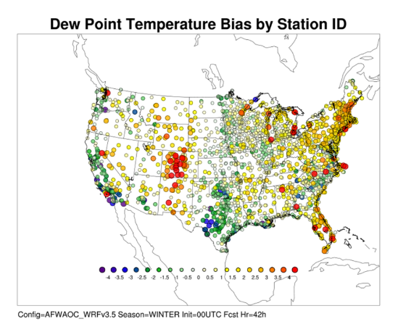
Geographic Representation of Scores (Stat-Analysis “by-case” option)
Accumulates statistics separately for each grid location over a series
  Time
  Height
  Other series
Accumulate over
  Stations
  Grids

Slide 41

Upper Air SS/PS (AFWA - RRTMG)
SS (light shading) and PS (dark shading) differences for the annual aggregation of upper air temperature and dew point temperature BCRMSE and bias
Statistical Significance (light shading)
Differences pass the test
Practical Significance (dark shading)
Which SS differences are greater than the observation uncertainty
Mesoscale
Modeling Task

Slide 42
resources

Slide 43


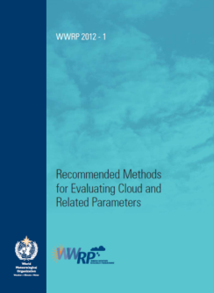
WMO Working Group on Forecast Verification Research
Working Group under the World Weather Research Program (WWRP) and Working Group on Numerical Experimentation (WGNE)
International representation
Activities:
  Verification research
  Training
  Workshops
  Publications on “best practices”: Precipitation, Clouds, Tropical Cyclones
http://www.wmo.int/pages/prog/arep/wwrp/new/Forecast_Verification.html

Slide 44
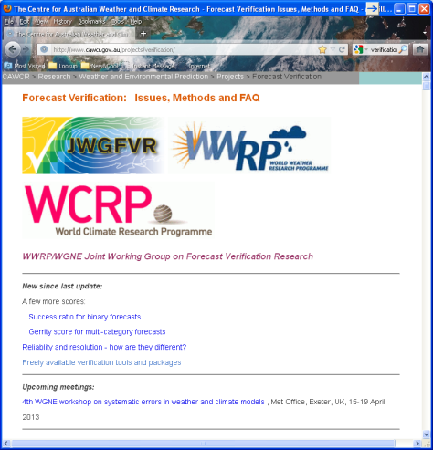
Resources: Verification methods and FAQ
Website maintained by WMO verification working group (JWGFVR)
Includes
  Issues
  Methods (brief definitions)
  FAQs
  Links and references
Verification discussion group:
http://mail.rap.ucar.edu/mailman/listinfo/vx-discuss
Or email vx-discuss@mail.rap.ucar.edu
http://www.cawcr.gov.au/projects/verification/

Slide 45
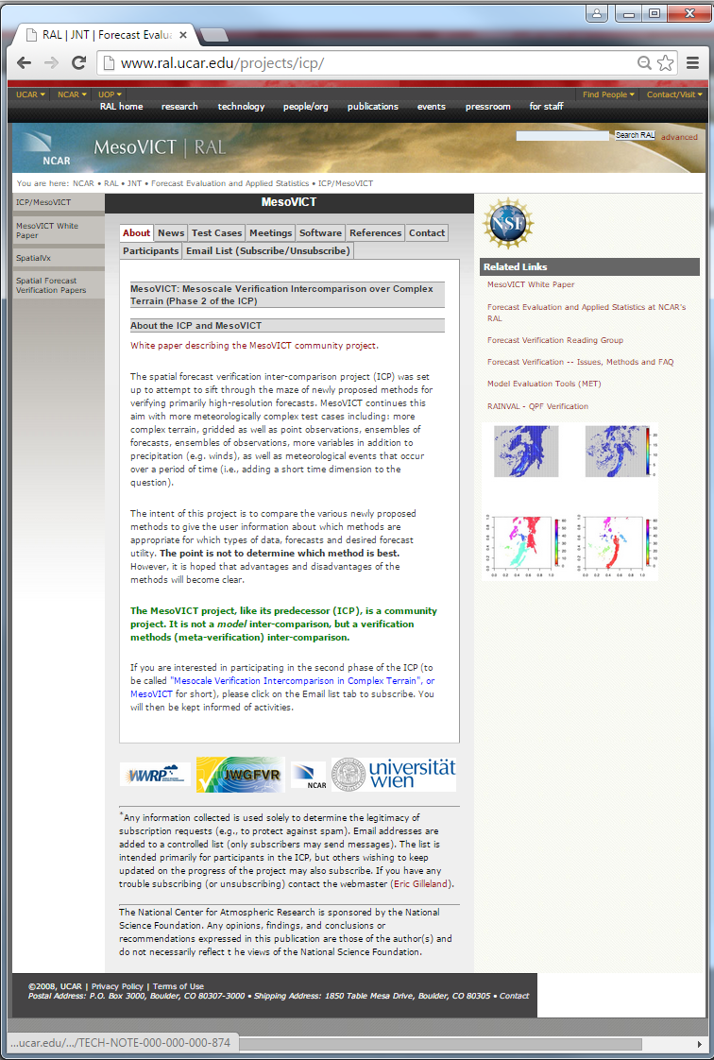
Spatial Method Intercomparison Project
International effort to evaluate and compare new verification methods
Second intercomparison in progress
  Focus on complex terrain, ensembles, precipitation and wind
Many references on spatial methods
http://www.ral.ucar.edu/projects/icp/

Slide 46


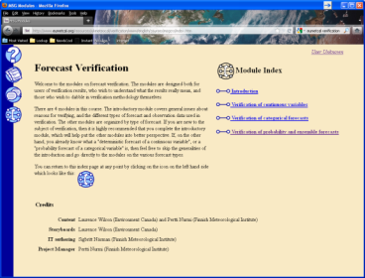

Workshops and tutorials
WMO Tutorials (3rd, 4th, 5th, 6th workshops)
  Presentations available
EUMETCAL tutorial
  Hands-on tutorial
http://www.space.fmi.fi/Verification2009/
http://cawcr.gov.au/events/verif2011/
http://www.ncmrwf.gov.in/verif2014/Tutorial-Program.php
http://www.eumetcal.org/-Eumetcal-modules-

Slide 47
Resources: Overview papers
Casati et al. 2008: Forecast verification: current status and future directions.
  Meteorological Applications, 15, 3-18.
Ebert et al. 2013: Progress and challenges in forecast verification
  Meteorological Applications, 20, 130-139.
Papers summarizing outcomes and discussions from 3rd and 5th International Workshop on Verification Methods

Slide 48
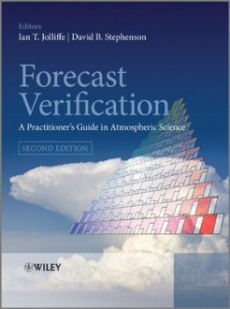

Resources - Books
Jolliffe and Stephenson (2012): Forecast Verification: a practitioner’s guide, Wiley & Sons, 240 pp.
Stanski, Burrows, Wilson (1989) Survey of Common Verification Methods in Meteorology (available at http://www.cawcr.gov.au/projects/verification/)
Wilks (2011): Statistical Methods in Atmospheric Science, Academic press. (Updated chapter on Forecast Verification)

Slide 49
Revisiting the idea of “user” relevance…
A challenge in the verification world is meeting the needs associated with different kinds of forecasts (and users)…
  In the weather world, for example:
    Climate predictions
    Seamless predictions
    Hydrologic predictions
    Air quality
    …
A challenge: Adapting terrestrial weather tools to meet the needs for space weather forecast evaluation
  And/or developing new tools
  What tools are relevant “as is”?
  What new tools/methods are needed to meet the additional needs posed by space weather forecasts?

