Slide 1
Introduction to NICT’s evaluation of the space weather forecasts provided by Japan, US, Belgium, Australia and China.
Mamoru Ishii, Shin’ichi Watari and Tsutomu Nagatsuma
National Institute of Information and Communications Technology, Japan
Notes:
Good morning ladies and gentleman. I am Mamoru Ishii from NICT. I will present our recent activities of WDC-Ionosphere and Space Weather

Slide 2
UGEOA code
Legend ISES/regional warning center has been using URSIgram Codes which were originally developed to facilitate the rapid exchange of information by telex.
UGEOA code is one of URSIgram codes and means GEOALERT.
NICT provide the hit rate of SW-forecast using UGEOA code from each RWC.
Site name and DOY
Station indicator
Key code
GEOALERT TOK059
UGEOA IIIII YMMDD HHmm GSMII
1FIID 2FIID 3FIID
99999
PLAIN BT
Year, Month and Day
UGEOA
Groundbased solar data
used for forecast
Flare forecast
Last data line
Universal Time
Text line
Break of text
Magnetic forecast
Proton forecast

Slide 3
Level of flare and gemagnetic forecast on the UGEOA code
Flare forecast
  0 = Quiet (<50% probability of C-class flares)
  1 = Eruptive (C-class flares expected, probability >=50%)
  2 = Active (M-class flares expected, probability >=50%)
  3 = Major flares expected (X-class flares expected, probability >=50%)
  4 = Proton flares expected (proton flares expected, probability >=50%)
  8 = Warning condition (activity levels expected to increase, but no numeric forecast given)
  / = No forecast
Geomagnetic forecast
  0 = Quiet
  1 = Active conditions expected (A>=20 or K=4)
  2 = Minor storm expected (A>=30 or K=5)
  3 = Major magstorm expected (A>=50 or K>=6)
  4 = Severe magstorm expected (A>=100 or K>=7)
  8 = Warning condition (activity levels expected to increase, but no numeric forecast given)
  / = No forecast

Slide 4
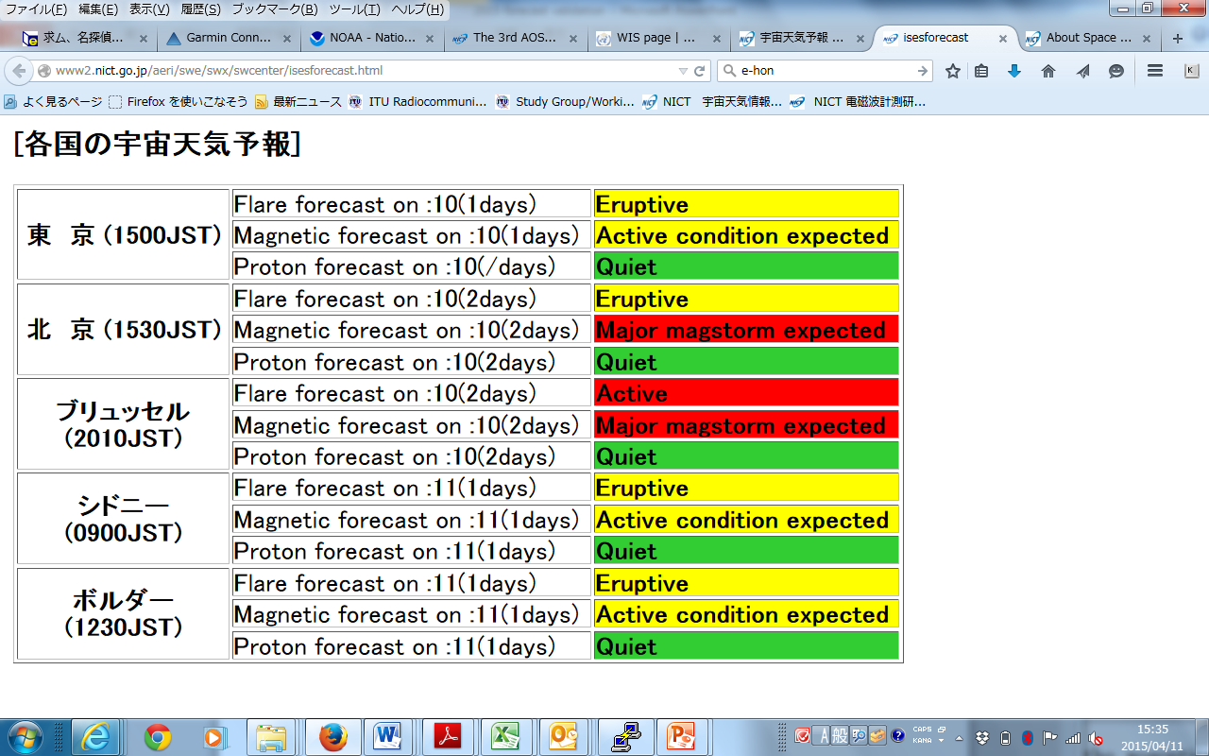
Space weather forecast by five RWC
Tokyo
Beijing
Brussels
Sydney
Boulder

Slide 5
Results of evaluation in Solar flare forecast on March, 2015
Overestimate
Hit rate
Underestimate
Threat
Score

Slide 6
Hit Rate and Threat Score
Underestimate
 |  | Forecast
 |  | Major Flares | Active | Eruptive | Quiet
observed | Major Flares | A | B | C | D
 | Active | E | F | G | H
 | Eruptive | I | J | K | L
 | Quiet | M | N | O | P
T (Total) = A + B + … + P
Overestimate
Hit
Hit rate = (A+F+K+P)/T
Threat Score = (A+F+K+P)/(T-P)
Quiet condition is dominant especially in solar quiet period. In the case the subset of “P” tend to be large and the value of hit rate does not representative the actual meaning.

Slide 7
Result of evaluation in the geomagnetic disturbance on March 2015
Overestimate
Underestimate

Slide 8
Comments on NICT forecasts in November, 2014
We check why our forecast failed every month.
…When Active Region 2205 was located on the east limb of the solar disk (November 2nd to 3rd)
The solar activity was mostly moderate when Active Region 2205 was located on the far side of the solar disk; however, a C9.4 flare occurred on the 2nd (UT) when the region was located on the east limb of the solar disk. (The magnetic field structure was unclear because the region was located on the east limb of the solar disk.)
On the 3rd, a slightly high level of solar activity was forecast because further occurrence of C-class flares was expected on the basis of past records. However, M2.2 and M6.5 flares occurred in this region. Solar activity was not accurately forecast.

Slide 9
Hit rate of Flare forecast

Slide 10
Threat score of Flare forecast

Slide 11
Hit rate of Magnetic activities

Slide 12
Threat score of magnetic activities

Slide 13
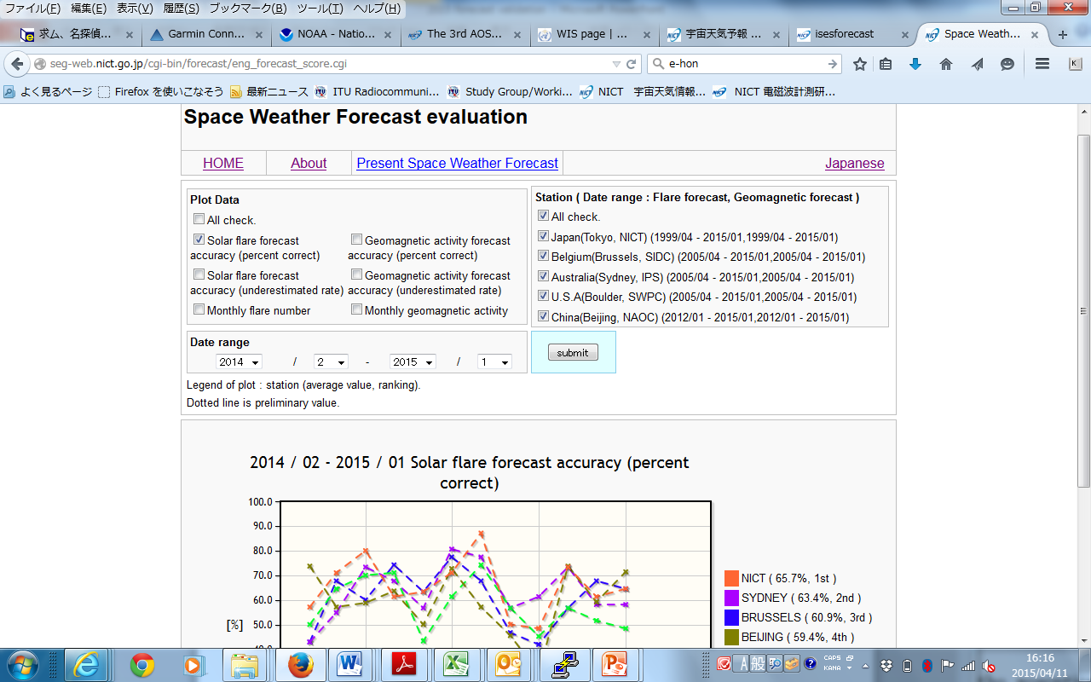
Forecast evaluation on Web site

