Slide 1

Summary of the workshop
Mamoru Ishii

Slide 2



National Institute of Information and Communications Technology
ISES: International Space Environment Service
(16 countries and ESA as a Collaborative Expert Center)
Operational Space Weather Forecast
Ground-based observations
Developing original space weather forecasting code
Warsaw, Poland
Lund , Sweden
Exeter, UK
?
?
Moscow, Russia
Brussels, Belgium
Beijing, China
Ottawa, Canada
Kanzelhöhe, Austria
NICT, Tokyo, Japan
Prague, Czech
Jeju, Korea
NOAA as the headquarter of ISES, Boulder, USA
New Delhi, India
European Space Weather Week
Sao Jose dos Campos, Brazil
Hermanus, South Africa
Sidney, Australia
Space Weather Workshop
Space weather forecast with international cooperation

Slide 3

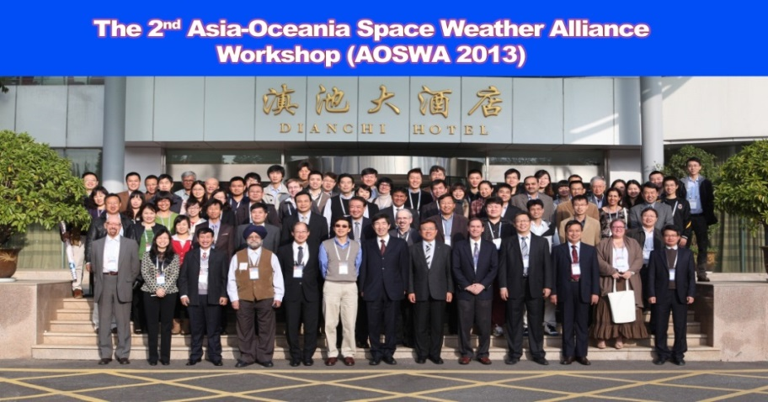
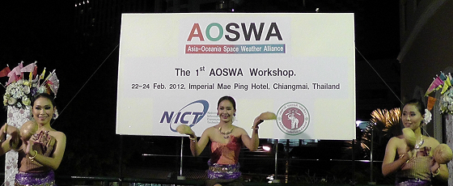
The former AOSWA workshops
National Institute of Information and Communications Technology
The main theme of special session: Present Status and Future Plan of Operation, Services, and Modeling of Space Weather
76 people from 30 organizations of 10 counties participated in the workshop.
2nd meeting: Nov 4-7, 2013, Kunming , China
100 people from 14 countries attended the meeting
The main theme of the special session: “R2O” Research to Operation of space weather forecast

Slide 4
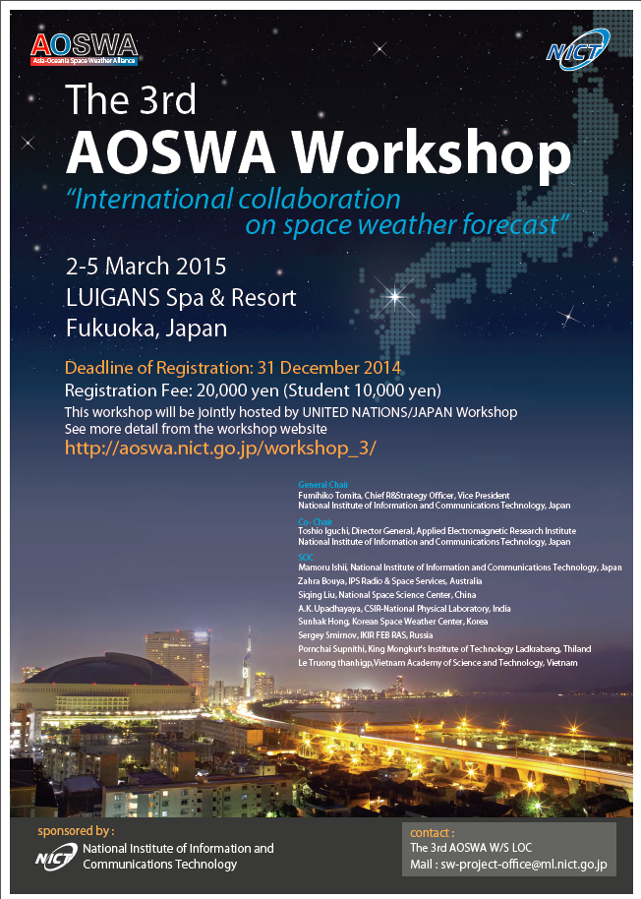
The 3rd AOSWA Workshop
National Institute of Information and Communications Technology
The 3rd Asia-Oceania Space Weather Alliance (AOSWA) Workshop will be organized by NICT at Fukuoka, JAPAN during March 2-5, 2015.
A theme of this workshop is “International collaboration on space weather forecast”

Slide 5
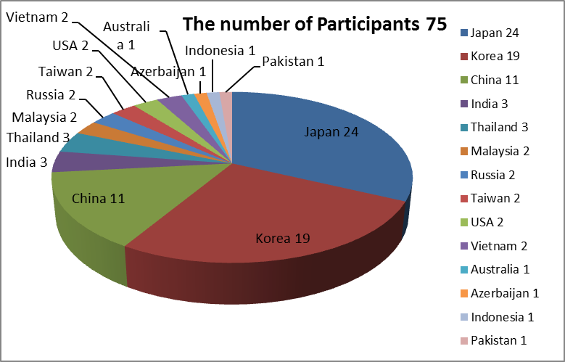
Participants
Country: 14 Japan, Korea, China, India, Thailand, Malaysia, Russia, Taiwan, USA, Vietnam
Australia, Azerbaijan, Indonesia, Pakistan
Institute:37 NICT, Kyoto Univ., Nagoya Univ., Kyushu Univ., NSSC, NAOC, IGGCAS, USTC, ENRI, SWPC, KASI, ETRI, Kyung Hee Univ. SELab, IKIR,ANGKASA, UKM, KMITL Chiang Mai Univ., NOAA, SRI International IPS, NPL, NCRA, LAPAN, VAST, NSC_TW CWB_TW, SUPARCO etc.

Slide 6

Wants, Seeds and Needs
What is aimed at?
What is the
strength/resource?
What is needed?

Slide 7
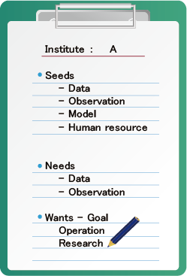
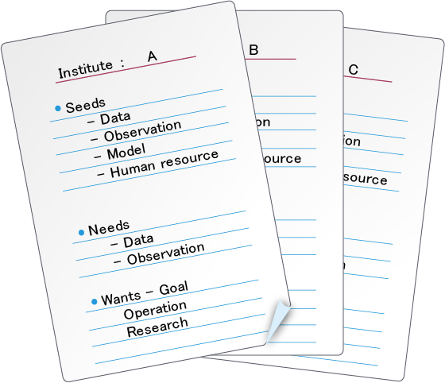
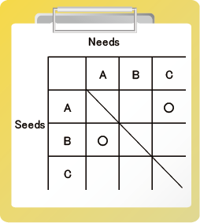

Questionnaire submitted in advance
On the base of this questionnaire, SOC will prepare the matrix of needs/seeds
We SOC will send a questioner to invited speakers in which we ask their needs, seeds and wants.
We should prepare some options in each item for answering easily.
Matrix of needs/seeds

Slide 8

Discussion based on the table for “Omiai”
Discussion
Using this table, each institute has a small meeting with the potentially matching partners.
the meeting time should be limited (15-20 min) SOC keeps the time. Each institute will have three potential partner institutes. In addition they can choose another one which they like.
After the meeting we have plenary meeting for discussing the results.

Slide 9
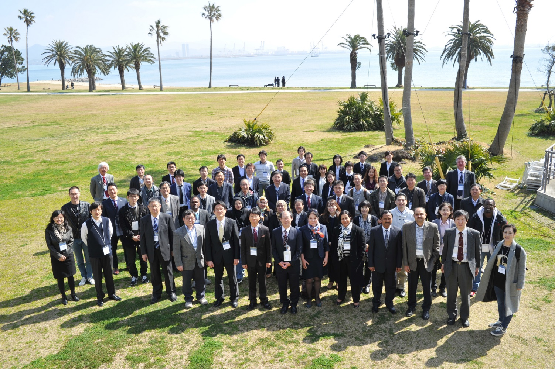

Slide 10
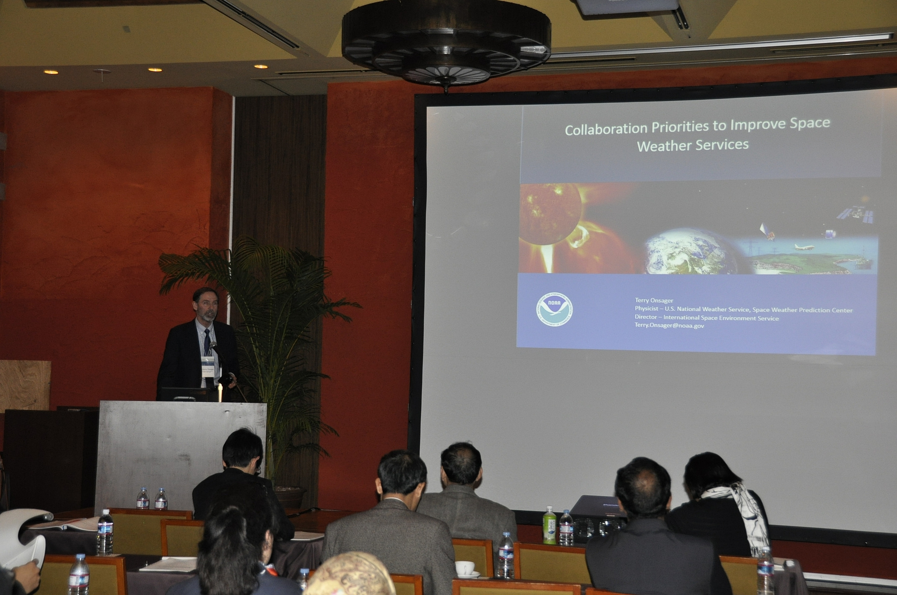

Slide 11
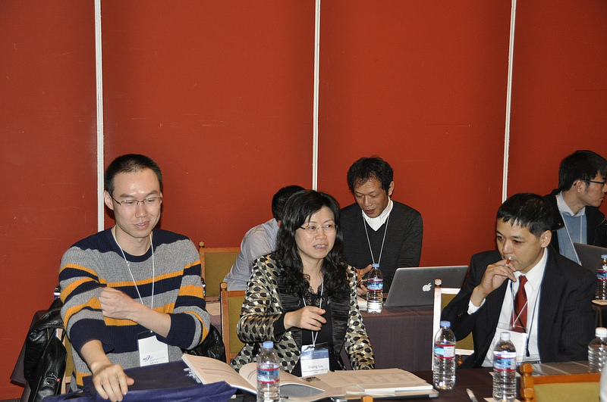

Slide 12
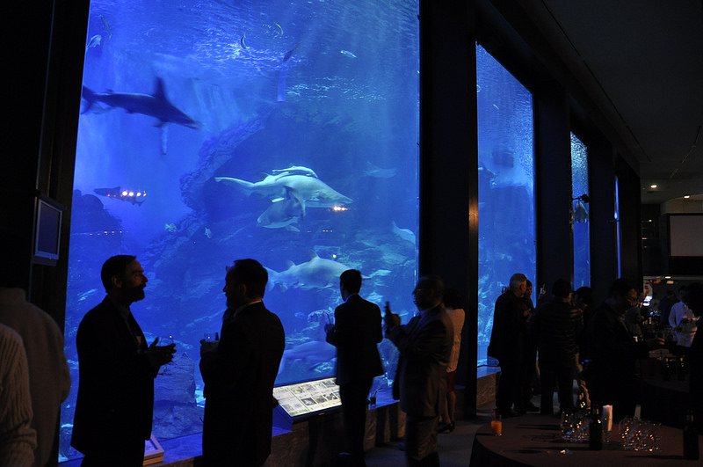

Slide 13
Lap-up of the special session
“Omiai” meeting is a new style to create a new collaboration.
Although there are several issue to be improved, (I believe) many people enjoy the meeting.
Comments
  Discussion time is too short
  We need some additional slot which we discuss with preferable institutes.
  It is very heavy to make combinations in advance. In addition, several institutes disappear and the counterparts lost their partners.
  The expected merit of “Omiai” is to create a new collaboration with needs-seeds matching, but in addition that, it is another merit to meet institutes who does not talk each other in ordinal situation.

Slide 14
Treatment of metadata
With preparing the “Omiai” session, we could get together the metadata of observation in each institute. They are precious information and (I believe that) they should be shared in appropriate meta database.
On the assumption of agreement for open policy of these metadata from each institute, we would like to have discussion how we treat them. For example,
  Build our own meta-database
  Put them in some meta-database in present

Slide 15

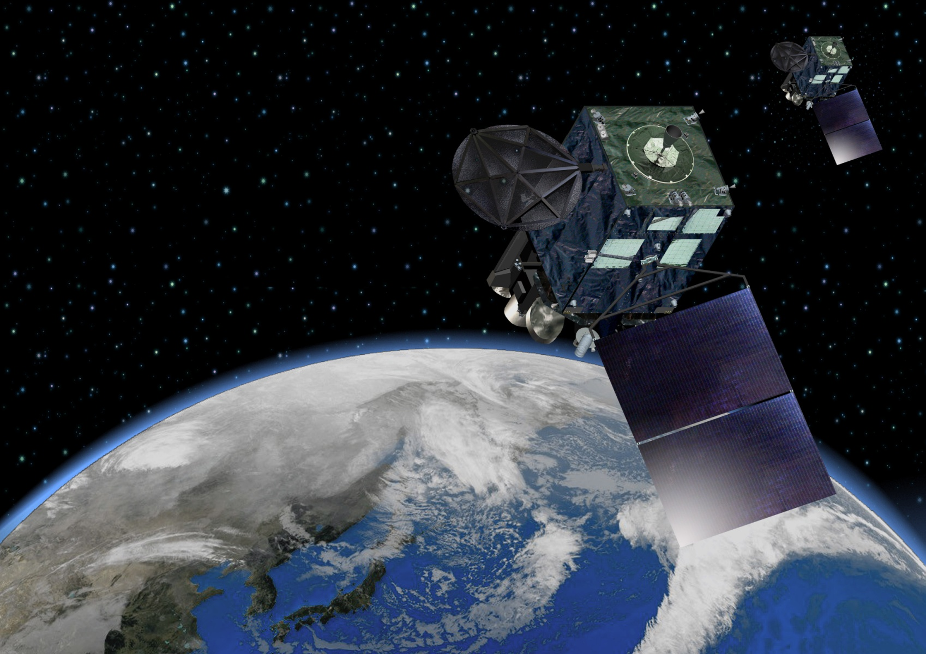
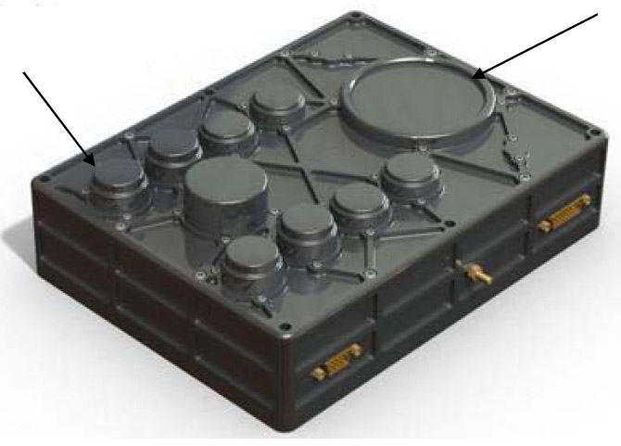
Space Environment Data Acquisition Monitor (SEDA) onboard Himawari-8,9
National Institute of Information and Communications Technology
Items | Description
Number of Channels | Protons : 8 (individual 8 sensor elements) Electrons : 8 (8 stacked plates in one elements)
Energy Range | Protons : 20 MeV – 100 MeV Electrons : 0.2 MeV – 5 MeV
Time Resolution | 10 sec.
Field of View | Protons : ± 39.35 deg. Electrons : ± 78.3 deg.
Electron Sensor
Proton Sensor
(8 Units)
- High-energy particle environment over Japanese sector will be monitored by SEDA.
- Near-real time SEDA data is provided from JMA to NICT. We will provide SEDA data as part of space weather information.
Longitude: ~140 deg.
Himawari-8 Launch: 2014/10/07
Himawari-9 Launch; 2016
SEDA observation is started at Nov. 03, 2014.

Slide 16
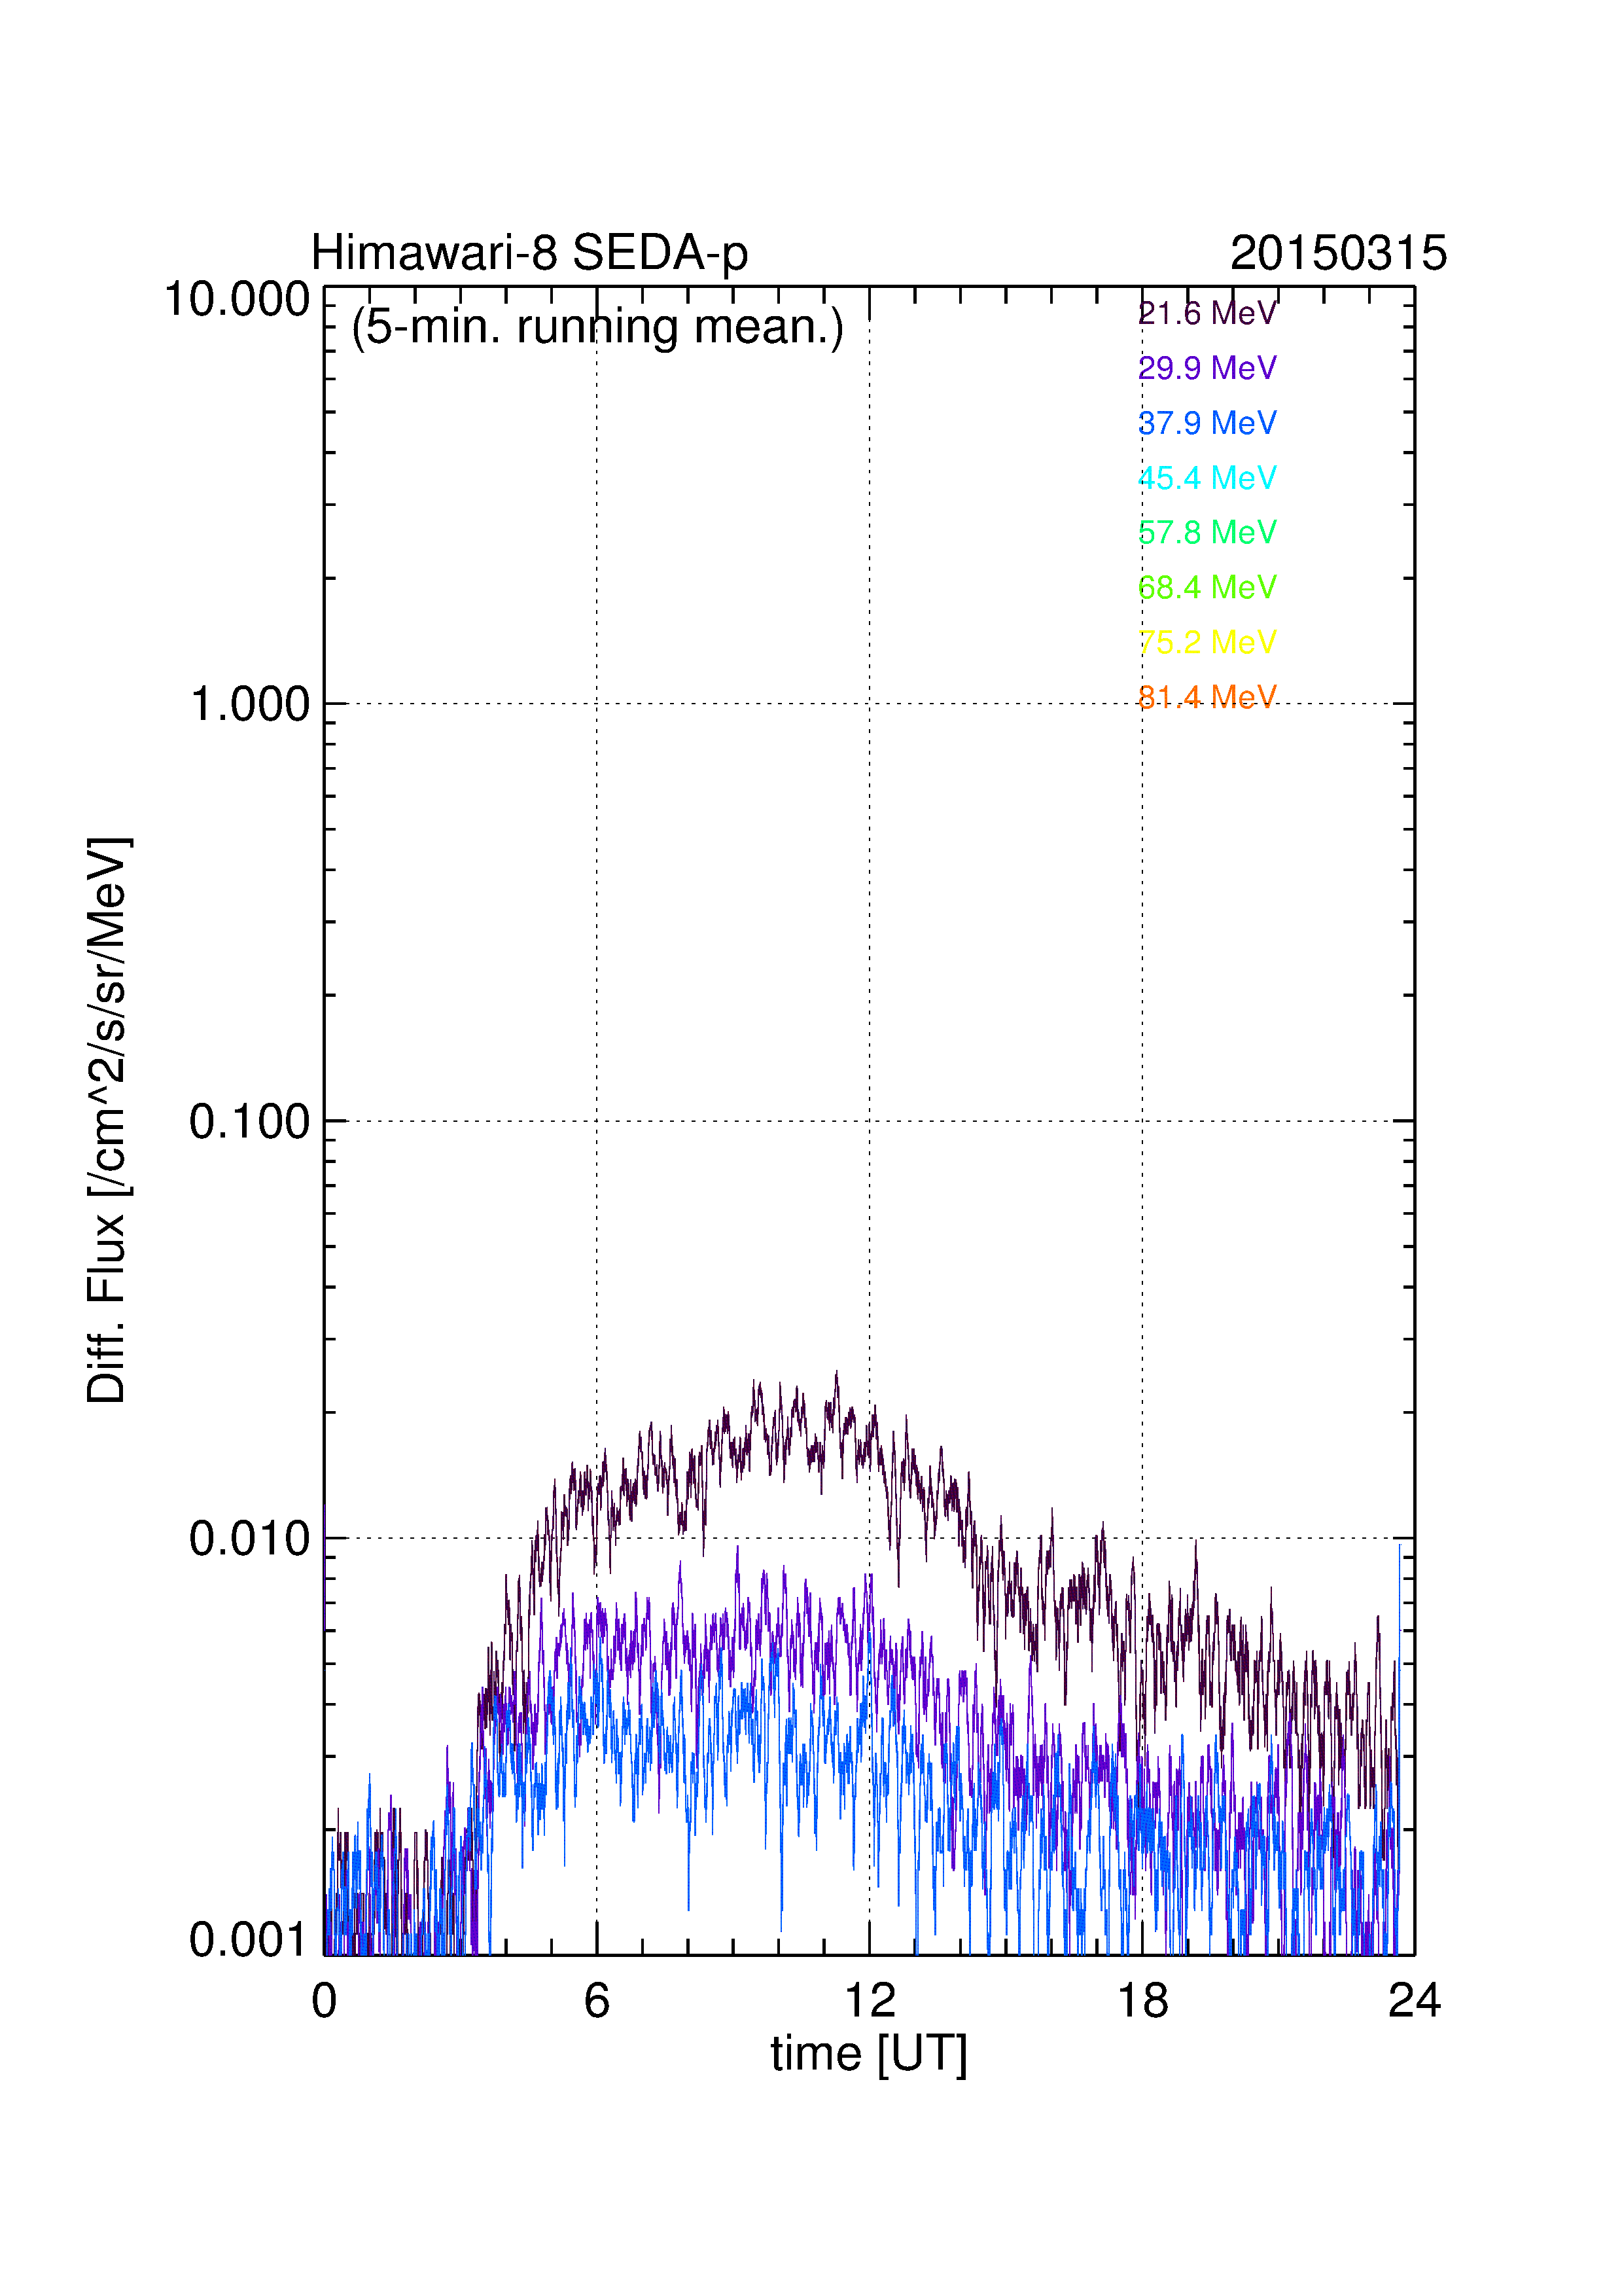
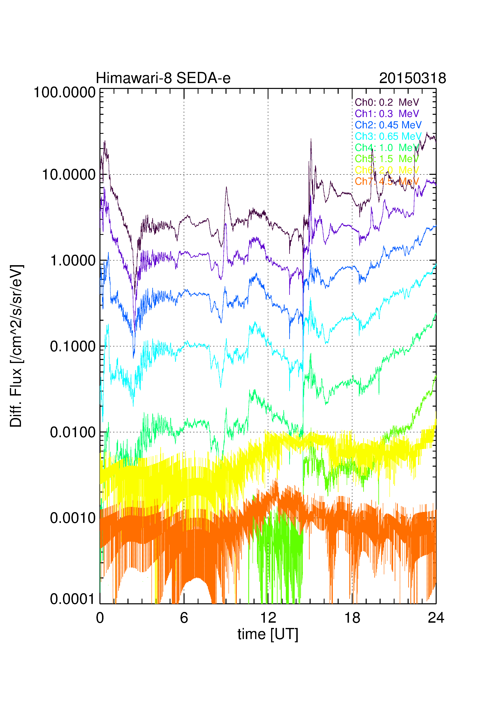
Example

Slide 17
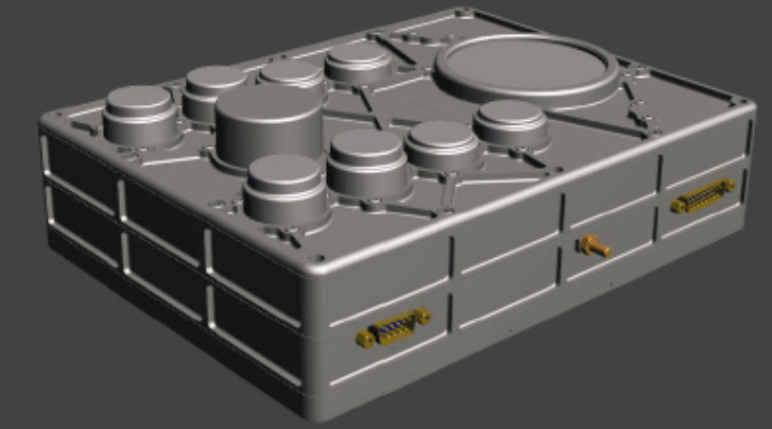
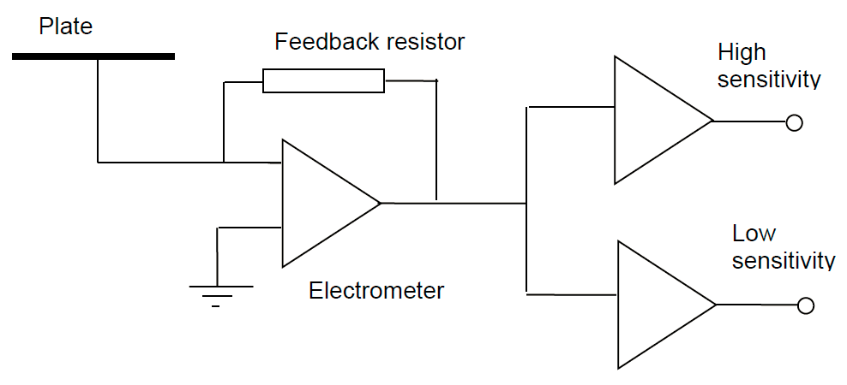
National Institute of Information and Communications Technology
SEDA-e
Ch0: 0.2 MeV
Ch1: 0.3 MeV
Ch2: 0.45 MeV
Ch3: 0.65 MeV
Ch4: 1.0 MeV
Ch5: 1.5 MeV
Ch6: 2.0 MeV
Ch7: 4.5 MeV
SEDA-e measures internal charging currents produced from high energy electrons (0.1 – 4.5 MeV) collected by 8 plates arranged in a stack. Electron fluxes are estimated from the charging currents.

Slide 18
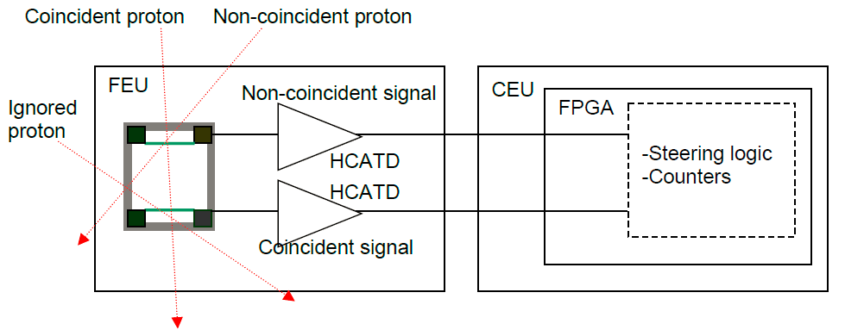
National Institute of Information and Communications Technology
SEDA-p
Ch0: 21.6 MeV
Ch1: 29.9 MeV
Ch2: 37.9 MeV
Ch3: 45.4 MeV
Ch4: 57.8 MeV
Ch5: 68.4 MeV
Ch6: 75.2 MeV
Ch7: 81.4 MeV
SEDA-p measures proton flux in 8 energy channels from 15 to 100 MeV. Each energy range of each channel is optimized based on each shielding.

